Slide 1

Albert Widjaja - 18512001
Gavin Gillian - 18383715
Dwiki Lingga Ananda Putra - 18374065
Kim Minseo - 18608159

Slide 2
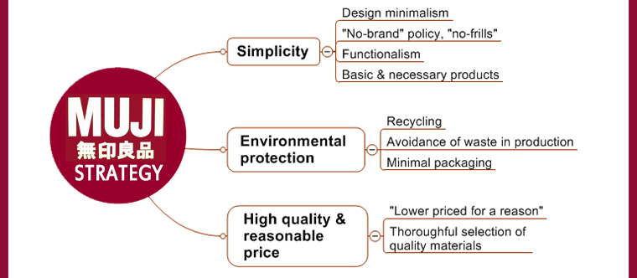
What is MUJI
Also known as Mujirushi Ryohin and was founded in Japan in 1980.
Mujirushi Ryohin translates as “no-brand quality goods”.
MUJI offers wide variety of goods such as; household products, apparel and food.
MUJI have more than 700 stores around the world with more than 7,000 products in range.

Slide 3
Market Analysis
Domestic : Muji using Cost Leadership
Overseas : Muji Using Differentiation Strategy
Target Market
Consumers in 20’s and 30’s
Young people, pursuing minimalism, environmentalism, and simplicity
Consumers who are thrifty, practical and looking for frill-less products

Slide 4
Campaign objectives and ad groups
AdWords campaign
To get the control over exactly where and how our ads show using language and location targeting functionality
To reach the specifically the audiences who are looking for MUJI products
To greatly expand marketing presence to customers and increase business’s appeal to a variety of audiences
To obtain the maximum return on advertising investment
To ensure MUJI’s success and satisfaction

Slide 5
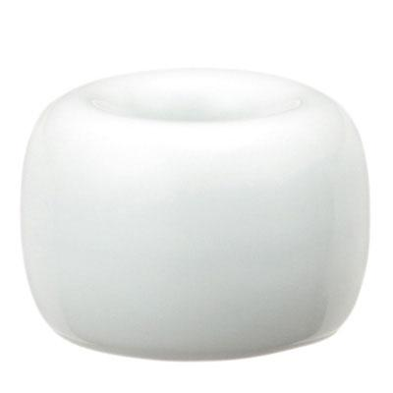
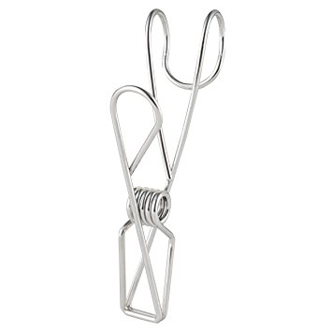
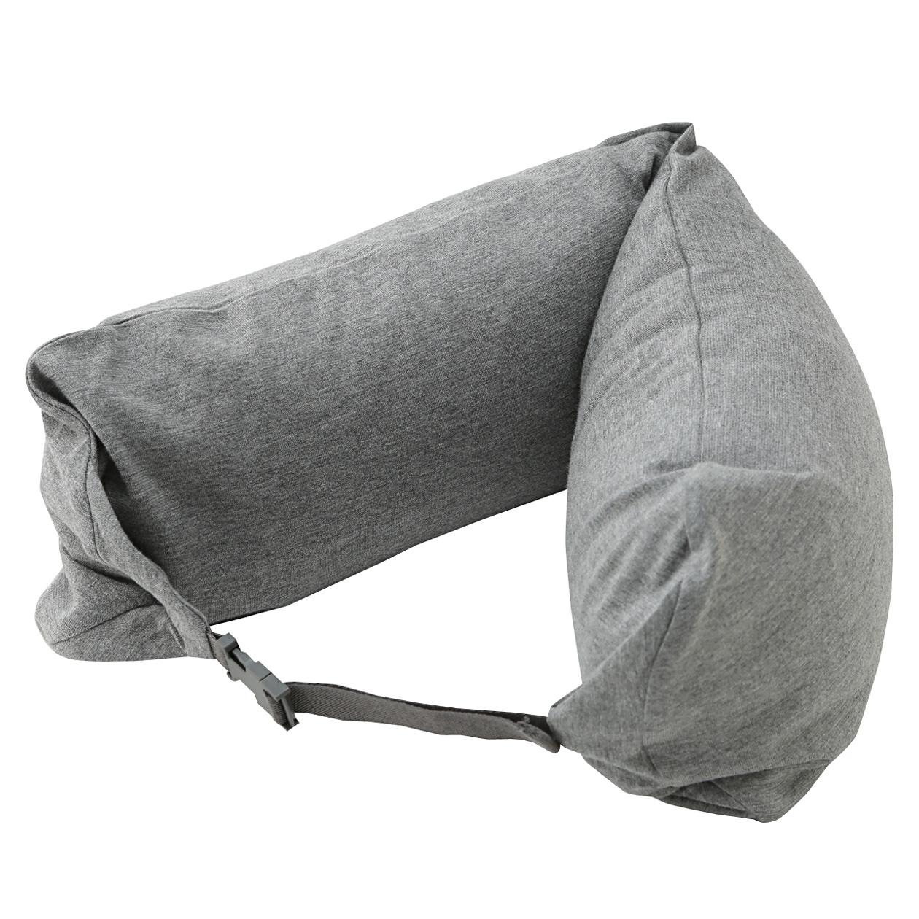
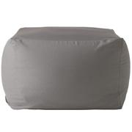
Ad Groups
Ad Group 1: White Porcelain Toothbrush Stand
Ad Group 2: Stainless Hook Wireclip
Ad Group 3: Neck Cushion
Ad Group 4: Beads Sofa

Slide 6
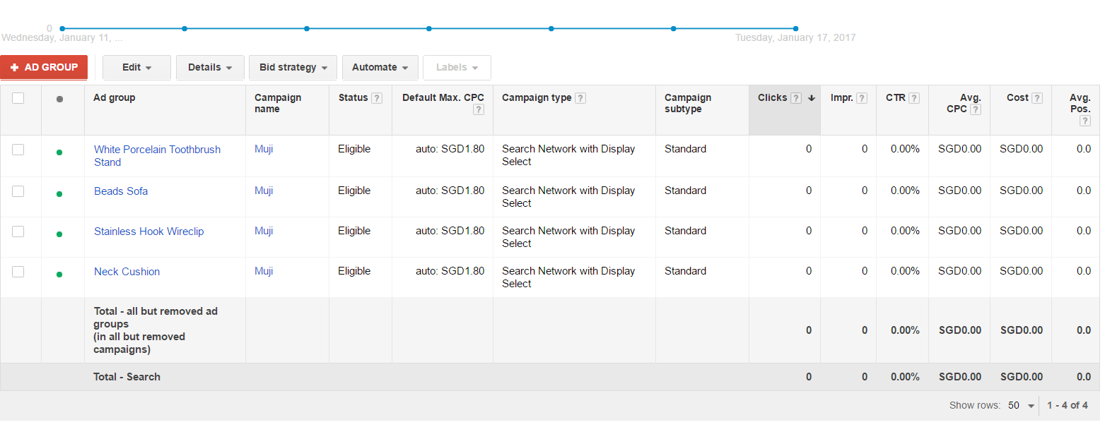
Four Ad Group

Slide 7
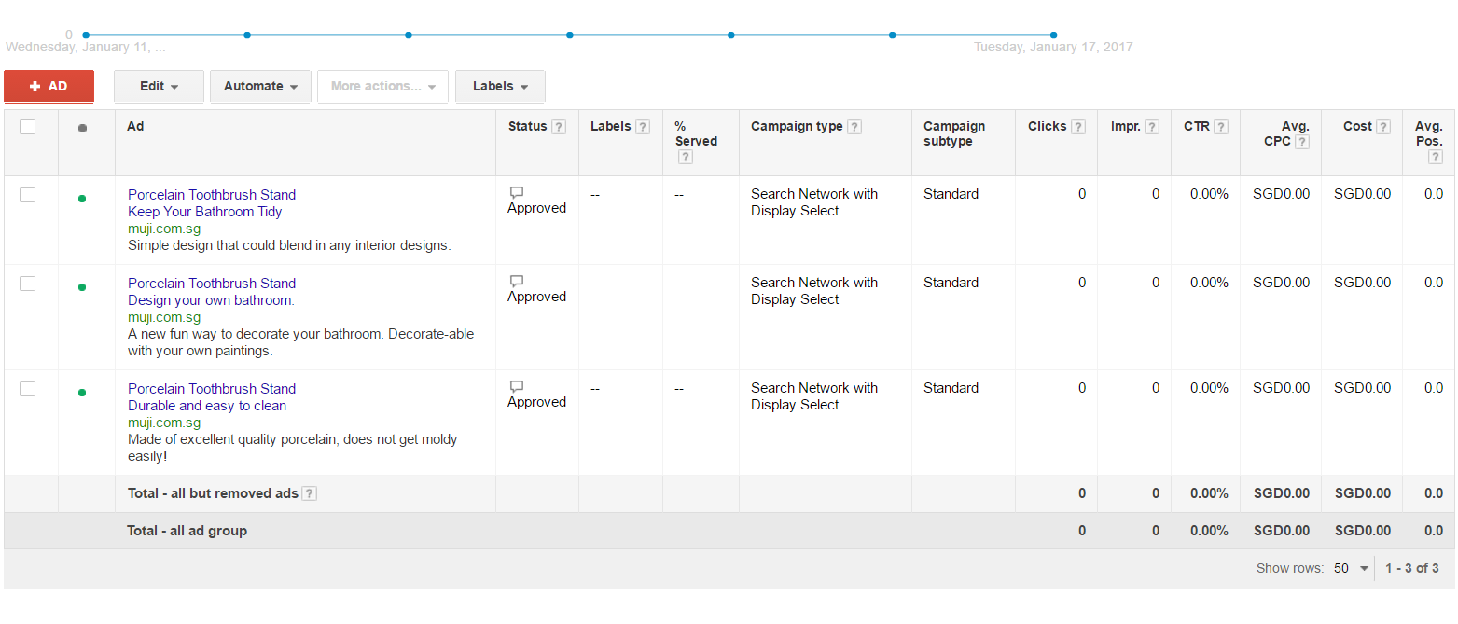
Porcelain Toothbrush Stand Ads

Slide 8
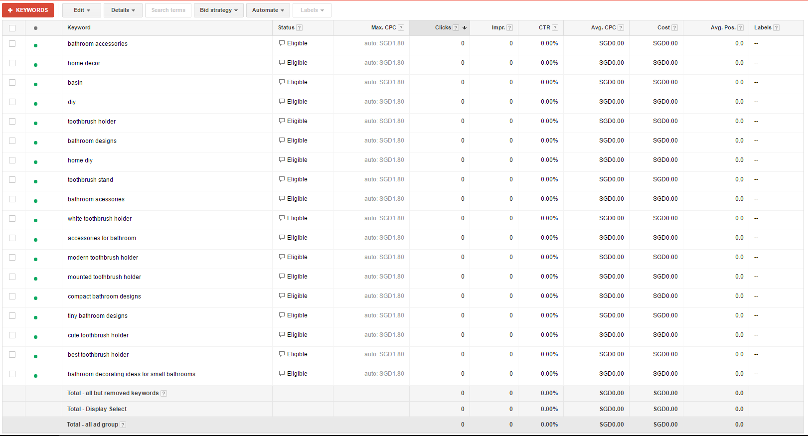
Porcelain Toothbrush Stand Keywords

Slide 9
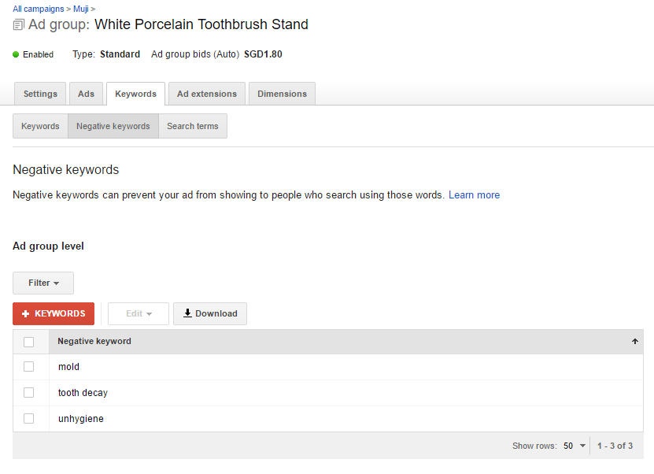
Porcelain Toothbrush Stand Negative Keywords

Slide 10
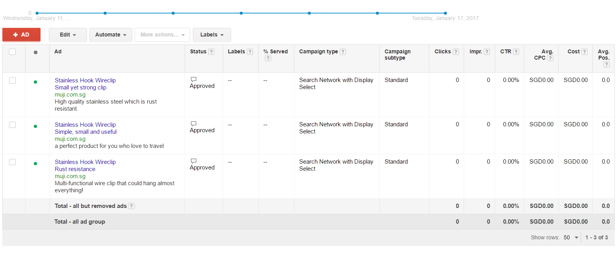
Stainless Hook Wireclip Ads

Slide 11
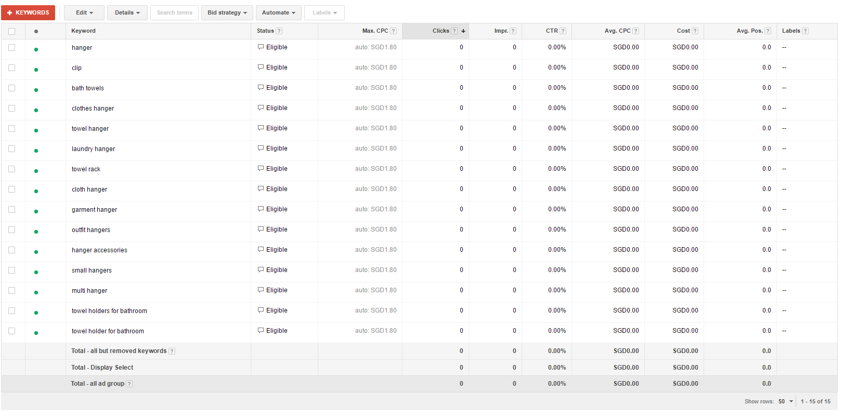
Stainless Hook Wireclip Keywords

Slide 12
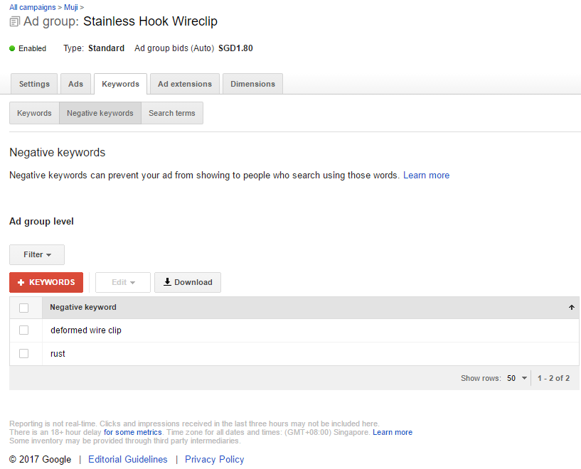
Stainless Steel Hook Wireclip Negative Keywords

Slide 13
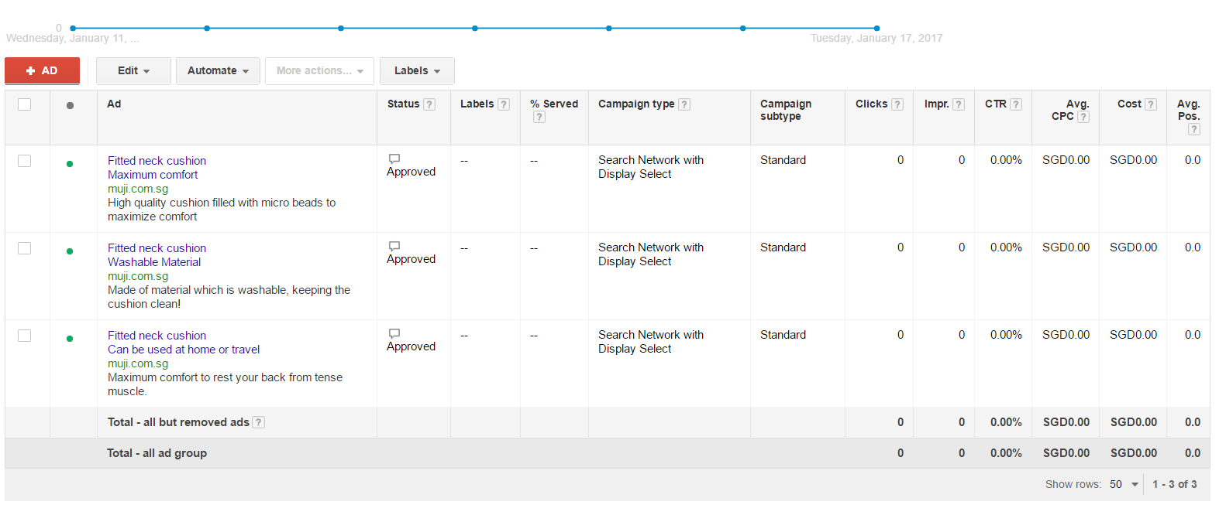
Neck Cushion Ads

Slide 14
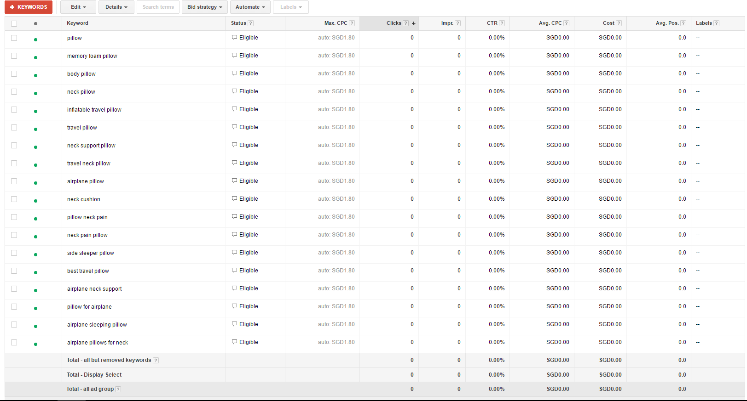
Neck Cushion Keywords

Slide 15
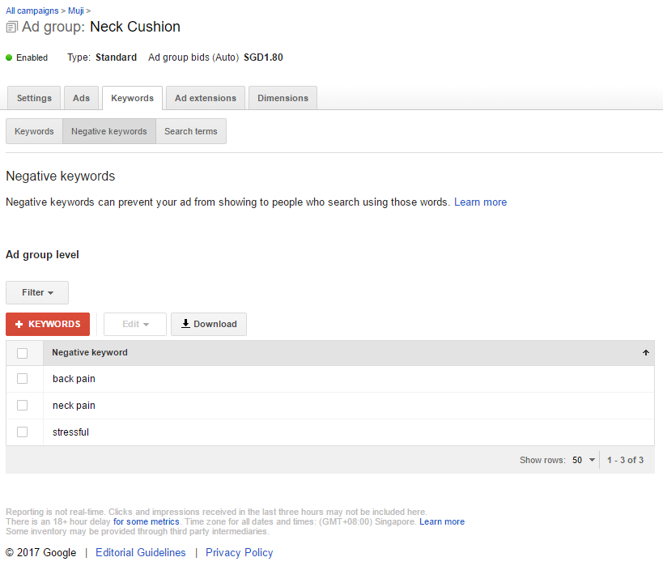
Neck Cushion Negative Keywords

Slide 16
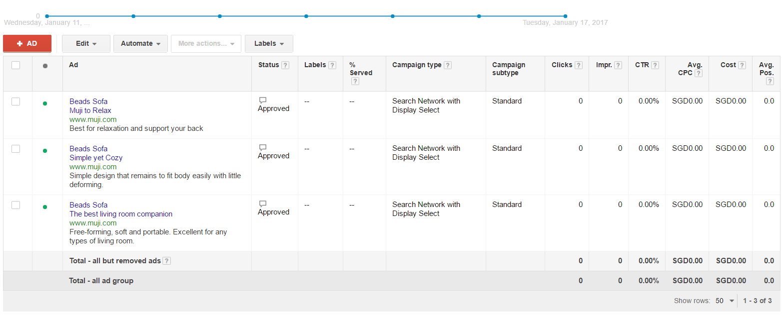
Beads Sofa Ads

Slide 17
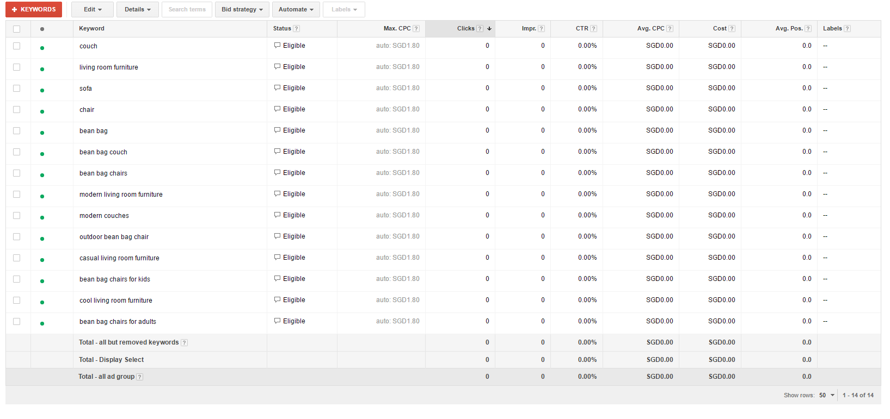
Beads Sofa Keywords

Slide 18
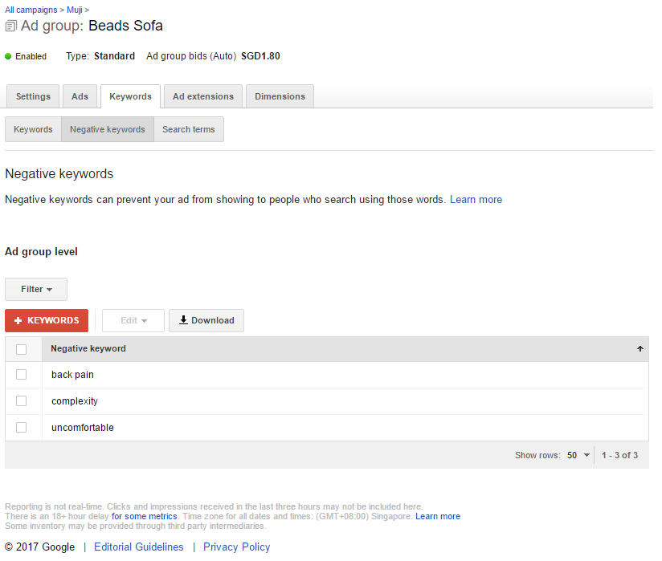
Beads Sofa Negative Keywords

Slide 19

Estimated Click
Ad Group 1
Estimated Click per Week :100 clicks
Ad Group 2
Estimated Click per Week : 80 clicks
Ad Group 3
Estimated Click per Week : 80 clicks
Ad Group 4
Estimated Click per Week : 120 clicks

Slide 20
Singapore Dollar ($) | Ad Group 1 (White Porcelain Toothpick Stand) | Ad Group 2 (Stainless Steel Hook Wire Clip) | Ad Group 3 (Neck Cushion) | Ad Group 4 (Beads Sofa)
Daily | $26 | $21 | $21 | $31
Total | $99
Weekly | Total x 7 Days
 | 99 x 7 Days
Total | $693
Monthly | Total x 4 Weeks
 | 693 x 4 Weeks
Total | $2772
dwiki homo

Slide 21
Any Questions?

