Slide 1
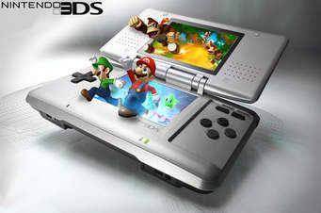
The history of Nintendo and their range of products
E

Slide 2
Introduction
The Nintendo company was established in 1889 in Japan.
Its founder; Fusajiro Yamauchi started manufacturing Japanese playing cards.
The company has seen immense advancement and innovation which have made it establish subsidiaries in The United States and Europe.
It has also emerged as one of the eminent producers of interactive entertainment systems(As stated in Nintendo.co.uk)

Slide 3
Inventions And Advancements
1902- the company started manufacturing western style playing cards which became popular all over the world
1933 established as unlimited partnership; Yamauchi Nintendo & Co
Changed name to Nintendo Playing Card Co. Ltd.
In 1953 started mass production of playing cards in Japan
In 1963 changed name to Nintendo Co., Ltd
Notes:
By 1963 the company had started producing cards printed with Walt Disney characters. It was also the first company in Japan to succeed in mass production of plastic playing card. After changing its name in 1963, it also started manufacturing games. Besides, it established a game production plant in UJI city. Also, the gun beam series was the first to employ electronic technology in the toy industry in Japan.

Slide 4
Continuation
1970- began the beam gun series
1973- 1974 developed laser clay shooting system, image projection systems, videogame system
1975-1978 introduced microprocessor in the video game system, developed home-use videogames and arcade cocktail table game (As noted in Nintendo.co.uk)
Notes:
The image projection system utilized the 16mm film projector and it was used in amusement arcades. Conversely, the videogame and home use systems were developed in collaboration with the Mitsubishi Electric

Slide 5
Subsidiaries
1980-American subsidiary in new York; Nintendo of America Inc.
1990- European subsidiary in Germany
Notes:
After launching the American and European subsidiaries, the company embarked on producing more developed entertainment systems. This was further facilitated by the wave of technological advancement in the early 21st century.

Slide 6
Products
The company produces a wide range of interactive entertainment systems such as;
Game boy series
Animal crossing series, Touch! series, The Legend of Zelda, among others
Nintendo 3D series including Monster Hunter, Captain Toad, Mario Golf, Mario & Luigi e.t.c (Nintendo.co.uk)
Notes:
Notably, the products named above are just but a few. Accordingly, Nintendo company has witnessed many innovations and advancement in the gaming industry to emerge among the best gaming companies around the globe.

Slide 7
References
Nintendo History. Nintendo. Retrieved On 19 June 2017, from https://www.nintendo.co.uk/Corporate/Nintendo-History/Nintendo-History- 625945.html.

