Slide 1
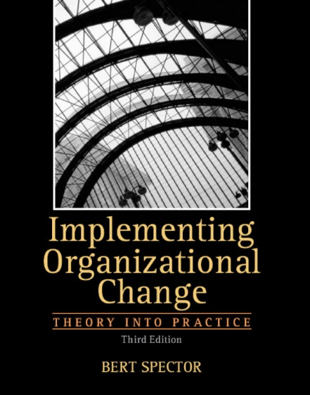
Implementing Organizational Change: Theory into Practice Bert Spector
Chapter 6
Reinforcing New
Behaviors
Copyright © 2013 Pearson Education, Inc. publishing as Prentice Hall

Slide 2
Learning Objectives
Identify the major structural choices faced by organizational leaders and the behavioral implications of those choices.
Consider the requirement of aligning financial measures with the strategic goals of the firm.
Analyze the role of information technology in impacting employee behaviors.
Copyright © 2013 Pearson Education, Inc. publishing as Prentice Hall

Slide 3
Organizational Focus
In all organizations, the activities of employees need to be focused on two separate issues:
The functional or technical activities required to achieve the desired outcomes of the organization.
2. Responsiveness to the external marketplace
(customers, suppliers, competitors, regulators, etc.)
Organization structure is a mechanism for helping to
achieve the desired focus.
Copyright © 2013 Pearson Education, Inc. publishing as Prentice Hall

Slide 4
Building a Vocabulary
Organizational structure: the manner in which employees are subdivided into units and divisions as a way of focusing effort on the required tasks of the company
“Organization structure is more than just boxes and lines; it is a way to focus the activities of employees.”
“As organizations move beyond the small, start-up stage, they are likely to adopt a simple functional structure: people with similar skills performing related activities are placed in functional departments.”
Copyright © 2013 Pearson Education, Inc. publishing as Prentice Hall

Slide 5
Functional Organizational Structure
CEO/
President
CFO
Business
Development
Sales
Engineering
Surfing
Production
Brand
Marketing
“Use functional structures to shape the development of technical skills and expert knowledge on the part of employees.”
But:
“Organizations seeking to create seamless coordination across functions may find that the silos erected through functional structures get in the way.”
Copyright © 2013 Pearson Education, Inc. publishing as Prentice Hall

Slide 6
Divisional Organizational Structure
Divisional structure: an organizational design choice that groups people together in units based on common products, services, or customer
CEO/
President
CFO
Enterprise
Products
Commerce
Products
Publishing
Financial
Services
Retail
“Divisional structures enhance coordinated focus on the marketplace but make integration across highly autonomous divisional units difficult to achieve.”
Copyright © 2013 Pearson Education, Inc. publishing as Prentice Hall

Slide 7
Matrix Organizational Structure
CEO
Matrix structure:
an organizational design choice that groups people by both function and product or product and geographical region
Product
Line A
Product
Line B
Product
Line C
Marketing
R & D
Production
Procurement
Finance
“Organizations move to a matrix structure help support dual focus—on technical expertise and marketplace responsiveness”
Copyright © 2013 Pearson Education, Inc. publishing as Prentice Hall

Slide 8
Horizontally Linked Structure
CEO
Warehousing
Designing
Cutting
& Sewing
Packaging
Horizontally linked structure:
an organizational design choice that groups people along the value chain activities and processes that produce, market, deliver, and service the firm’s offerings
Value-Chain Teams
“Organizations can use cross-functional teams to achieve linkages across the various and interdependent activities of their value chain.”
Copyright © 2013 Pearson Education, Inc. publishing as Prentice Hall

Slide 9
The Role of Structural Intervention in Implementing Change
“Think of structural change in terms of Lewin’s refreezing, not in terms of unfreezing.”
Compensation is one of the strongest, perhaps most immediate tools that impact patterns of employee behavior.
“When structural change occurs early in a change process, employees can be confused by its purpose, unsure of what new
competencies are being required, and unwilling—or unable—to make appropriate alterations in behavioral patterns.”
Copyright © 2013 Pearson Education, Inc. publishing as Prentice Hall

Slide 10
Building a Vocabulary
Pay for performance: pay that is tied to the performance in the form of either a merit raise to base pay or an incentive bonus that does not increase base pay
“Individual incentives will be most effective in shaping behavior when the individual controls the outcomes being measured and rewarded, when the outcomes are tied to improved performance, when the evaluation of an employee’s contribution are perceived as being valid, and when the difference between rewards for high and low performance is significant.”
Copyright © 2013 Pearson Education, Inc. publishing as Prentice Hall

Slide 11
Pay-for-Performance Plans
Plan | How It Works
Piece rate | Employee earns all or part of a wage based on number of units produced.
Commission | Sales person earns all or part of a wage based on number of units sold.
Merit pay | Employee earns raise to base wage based on performance evaluation.
Bonus | Employee earns extra payment based on performance evaluation.
Copyright © 2013 Pearson Education, Inc. publishing as Prentice Hall

Slide 12
Factors That May Undermine Pay-for-Performance Plans
Performance appraisals are subjective.
Individual rather than group goals are emphasized.
Encourage short-term orientation at the expense of long-term goals.
Merit pay raises become an expected annuity.
Lengthy time lag between performance and reward.
Many jobs cannot be isolated and precisely measured.
Pay differentials among performance levels are small.
Payout factors determined by organizational performance not by individual performance.
Copyright © 2013 Pearson Education, Inc. publishing as Prentice Hall

Slide 13
Team-Based Bonus Plans
Team-based bonuses:
Enhances team performance
Hurts collaboration among and between teams
“Organizations call upon team-based performance bonuses
to enhance the effectiveness of teams, but the bonus may undermine collaboration between teams.”
“Bonuses based on the overall performance of the organization make a symbolic statement recognizing the shared purpose and responsibility of all employees and organizational units.”
“Bonuses based on the overall performance of the organization make a symbolic statement recognizing the shared purpose and responsibility of all employees and organizational units.”
Copyright © 2013 Pearson Education, Inc. publishing as Prentice Hall

Slide 14
Building a Vocabulary
Extrinsic rewards: rewards (pay, promotion, praise, and so forth) provided by the organization to employees
Intrinsic rewards: (feelings of pride, satisfaction, and self-esteem) that accrue to the individual based on the performance of a task
Pay equity: a perception by employees that their pay is fair and equitable in relationship to others: peers inside the organization and out as well as subordinates and superiors in the hierarchy
“By relying heavily on extrinsic rewards to shape employee behavior, organizations risk driving out the intrinsic rewards that might be associated with the work; as a result curiosity, creativity, and problem‐solving behaviors may be lessened.”
“
“Introducing new incentives early in a change implementation process risks negative consequences.”
“Organizations will not be able to call on intrinsic motivation unless employees feel that they are being paid equitably.”
Copyright © 2013 Pearson Education, Inc. publishing as Prentice Hall

Slide 15
Building a Vocabulary
Technology: the processes, mechanics, and interactions of human behavior required to convert raw material into finished offerings
“When introducing new technology, organizational leaders face a choice: to use that technology to automate existing processes or to use new technology to support transformed behaviors.”
“New technologies can be introduced as a way to support desired behavioral changes.”
Copyright © 2013 Pearson Education, Inc. publishing as Prentice Hall

Slide 16
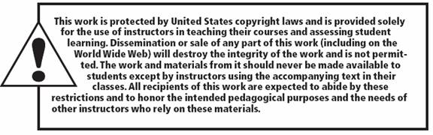
All rights reserved. No part of this publication may be reproduced, stored in a retrieval system, or transmitted, in any form or by any means, electronic, mechanical, photocopying, recording, or otherwise, without the prior written permission of the publisher. Printed in the United States of America.
6-16

