Slide 1
Whirlpool Corporation
Competitive Advantage

Slide 2
The Objectives of the Presentation
To determine the sources of Whirlpool’s competitive advantage
How and why Whirlpool became a global leader in the industry
Notes:
By the end of the presentation, the audience will understand the critical sources of Whirlpool Corporation competitive advantage and the link to the firm’s resources to the strategies

Slide 3
Whirlpool Corporation Background
The business was incorporated in the year 1950. Previously, the company was referred to as Upton Machine Company that operated between the year 1911 and 1929. Later the firm was referred to as The Nineteen Hundred between the year 1929 to the year 1950.
The firm operates in home appliance industry
The company had both positive and negative performances attributable to manufacturing inefficiencies and start-up cost of new fridges in the US, partly due to restructuring difficulties in Europe, as well as raw materials cost increases combined with minimal growth or even declining demand in North America and Europe.
By 1995, the major players in the appliance market were Whirpool 35%, GE 29 3%, Maytag 14 4%, Electrolux 13 5%, and Raythron 6 2%
Notes:
Whirlpool is among the top five firms in the home appliances industry. The company is headquartered in Michigan.

Slide 4
Definition of Competitive Advantage
A firm is said to have a competitive advantage when it is implementing a value creating strategy not simultaneously being implemented by any current or potential competitors (Porter, 2008).
Competitive advantage grows fundamentally out of the value a firm can create for its buyers. It may take the form of prices lower than competitors’ for equivalent benefits or the provision of unique benefits that more than offset a premium price.
The only way to gain lasting competitive advantage is to leverage your capabilities around the world so that the company as a whole is greater than the sum of its parts. Being an international company-selling globally, having global brands, or operations in different countries – isn’t enough (Chor, 2010).
Notes:
The definitions cut across the importance of firm in developing unique strategies in the industry it operates to earn a competitive advantage over the competitors (Porter, 2008).

Slide 5
Sources of Competitive Advantage of Whirlpool Corporation
The firm’s competitive advantages are within its internal processes
Product innovation and differentiation
Foreign direct investment
Efficient supply chain system
Notes:
Whirlpool competitive advantages are derived from product differentiation, international market expansion, and an efficient supply chain system.

Slide 6
Product Innovation and Differentiation
How does product innovation enhance the firm’s competitive advantage?
Washer that used fuzzy logic that controlled the consumption of water automatically
Development of self-cleaning ovens
Self-defrosting refrigerators
Automatic ice cube markers
SERP program offered the firm an award for a refrigerator prototype that was free from chlorofluorocarbons which was a major innovation for the company
Notes:
Innovation plays an essential role in the household appliances industry. A firm becomes successful in the industry by coping with the development of technology and developing products with a variety of features relative to the competitors’ products.

Slide 7
Foreign Direct Investment
How does foreign direct investment enhance the firm’s competitive advantage?
Mergers and acquisitions – the firm has made several alliances with other companies with the objective of attaining synergy
Transnational strategy - offers the centralization benefits provided by a global plan, along with the responsiveness and characteristics of domestic strategies.
Notes:
Foreign direct investment is an expansion strategy into international markets. Whirlpool has benefited a lot by diversifying investment to diverse geographical locations in the world. Further, the firm has gained a competitive advantage in the international market by implementing prompt responses on domestic strategies (Porter, 2008). Therefore, the firm develops products according to specific market segment and customers’ expectations.

Slide 8
Porter’s 5 Forces Industry Analysis
What are the factors that impact profitability in the industry?
Competitive rivalry
Threats of new entrants
Bargaining power of suppliers
Bargaining power of buyers
Threats of substitutes

Slide 9
Competitive Rivalry (High)
Does competition deprives Whirlpool the capability of generating more profit from the market?
There is high number of participants in the household appliances industry. Thus, there exists stiff competition in the industry
GE was the closest competitor from the case study. However, the current close competitors are LG and Electrolux.
The competitiveness of a firm in this industry is enhanced by the capacity of the firm to lead in innovativeness and bringing superior technology to the market.
Price competition is also of significant concern to the company in this industry as firms set prices with an objective of attracting customers to their products
Notes:
This is a considerable force to Whirlpool Corporation, and the business copes with the force by developing products with superior qualities and unique features to remain competitive in the market.

Slide 10
Threats of New Entrants (Medium)
Are there threats that Whirlpool Corporation faces in the household appliance industry?
The household appliances industry is characterized by rapid technological development and thus preventing new entrants in the market
Establishing a business I the household appliance industry involves a massive capital investment and thus, reduces the chances of new entrants in the market
However, some companies become successful in entering the household appliances industry and capture some small market share hence the threat of new entrants is medium.
Notes:
This force is not significant to the firm’s performance as the chances of new entrants into the market is minimal

Slide 11
Bargaining Power of Suppliers (Low)
Does the bargaining power of suppliers affect the profitability of the firm?
The firm has developed a sustainable relationship with its suppliers through ownership of shares
Whirlpool suppliers provide equipment parts to the firm
The healthy connection established by the company to the suppliers ensures a continuous supply of quality inputs and at relatively lower prices. Consequently, the suppliers influence the firm's supply chain management positively (Asad, 2012).
The supplier switching cost is not high, and therefore, the bargaining power for the suppliers in the house appliances industry is low
Notes:
This force is not significant to the performance of the firm. The firm implemented strategies aimed at making suppliers own the firm. The suppliers contribute to efficient supply chain system.

Slide 12
Bargaining Power of Buyers (High)
Does the buyers’ bargaining power influence the performance of Whirlpool Corporation?
The high number of competitors in the competitors increases the chances of development of exact products that Whirlpool Corporation develops.
Customers have a variety of household appliances to choose what best suit them
There is less or no switching cost to buyers
Firms in the household appliances compete on innovative features on the products, and this increases the buyer bargaining power
There is some degree of brand loyalty in this industry
The bargaining power of the buyers against Whirlpool is high
Notes:
This force is very significant to the firm. The high number of participants in the industry gives customers a broad range to choose their products from a variety of products (Fung, 2014). The firm responds to this force by developing unique features on the products as well as attractive packaging. Further, the company produces environment-friendly products as a corporate social responsibility practice.

Slide 13
Threats of Substitutes (Low)
How quickly do customers find close substitutes for Whirlpool products?
Some of the firm’s products such as television were easily substituted by computer with internet access
However, a significant component of the firm’s products such as air conditioners, washing machines among others has no close substitutes and is a necessity to consumers with no alternative in the markets.
Therefore, the threat of substitutes for Whirlpool Corporation is low.
Notes:
The threat of substitute is not significant to the performance of the firm. There are fewer substitutes in the market, and the consumers are left with no choice but to purchase what is provided in the market.

Slide 14
Porter’s Generic Strategies for Competitive Advantage
A significant concern among businesses is achieving a sustainable competitive advantage over the competitor’s products in a market.
Porter’s Generic Strategies
Cost leadership
Cost focus
Differentiation leadership
Differentiation focus
Notes:
The cost and differentiation leadership strategies seek competitive advantage in a broad range of market or industry segment. These are strategies adopted by Whirlpool Corporation to maintain the firm’s competitive advantage (Fung, 2014). On the other hand, the cost focus and differentiation focus strategies are adopted in a narrow market or industry

Slide 15
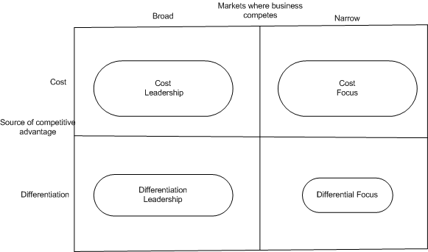
Porter’s Generic Strategies for Competitive Advantage

Slide 16
The Link
The link between competitive advantage, strategies, and resources and capabilities of Whirlpool Corporation
The firm utilizes the available resources (tangible, intangible and human) in identifying and understanding the firm’s capabilities; and developing strategies that keep the firm at a competitive advantage over the competitors (Fung, 2014).

Slide 17
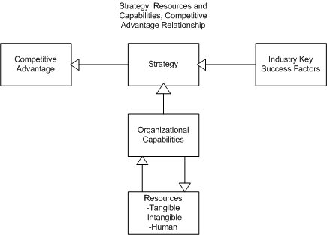
The Link

Slide 18
References
Asad, M. (2012). Porter Five Forces vs Resource Based View – A Comparison. SSRN Electronic Journal. http://dx.doi.org/10.2139/ssrn.1986725
Chor, D. (2010). Unpacking sources of comparative advantage: A quantitative approach. Journal Of International Economics, 82(2), 152-167. http://dx.doi.org/10.1016/j.jinteco.2010.07.004
Fung, H. (2014). The Relationships Among Porter Five Forces, Generic Strategies, Ansoff Growth Strategies & Strategy Methods in an IT Industry A Conceptual Paper. SSRN Electronic Journal. http://dx.doi.org/10.2139/ssrn.2540078
Porter, M. (2008). Competitive advantage. New York: Free Press.

