Slide 1
Child Support Program
Student’s Name
Institutional Affiliation

Slide 2
Child Support Payments
Child Support Enforcement Program.
Department of Health and Human Services.
Children aged between 7 and 18 years old.
School-age children and teenagers.
Michigan.
Notes:
The proposed program is the Child Support Enforcement program, sponsored by the Michigan Department of Health and Human Services. Its main target population are poor families with children aged between 7 and 18 years including teenagers and school-age children.

Slide 3
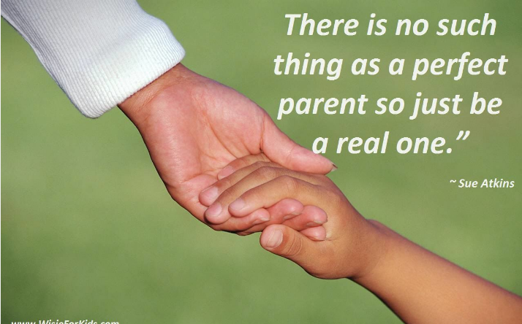
Program purpose
Formal and informal payment of child support.
Customer-oriented.
Easier planning and resolutions.
Notes:
The main purpose of the program is empowering both poor and those paying for child support effective services that enable easier and effective resolutions to conflicts. By adopting a customer-oriented approach, the program will help parents arrange for both formal and informal child support services. This means that parents will be able to informally support their children based on the numerous benefits it offers in their development.

Slide 4

Why it’s necessary and appropriate
Increase stability.
Enhance development.
Reduce stress.
Notes:
This program in terms of both offering formal and informal ways for parents to pay or receive child support services helps with enhancing stability within a family. Most families in the U.S that receive child support often live in poverty especially for single parents. However, with monthly payments of about 200 to 400 USD, these families can become stable and uplifted from poverty (California Child Support, 2016). The program also helps in enhancing development. Children grow through different stages questioning their own purpose as well as that of others. Parents can peacefully agree outside of court to support their child willingly enabling more time with both parents and a sense of accountability that boosts the child development poverty (California Child Support, 2016). Lastly, both parents and children have reduced stress as they can depend on child support rather than struggling each month to foot the bills.

Slide 5

Expected Outcomes
Full-payment of child support.
Easier and effective resolution.
Increased contact between children and parents.
Notes:
The main outcomes expected being with on-time and full-payment of child support. Most parents that receive child support lack the proper means to meet their financial needs. Enabling them access this support offers a better chance or opportunity for the children to develop poverty (California Child Support, 2016). The program also aims at easier and effective conflict resolution between parents. This can be achieved by enabling informal child support services as well as a customer-oriented approach to child support services. This will likely increase the need for both parents to be in contact with their children. The main variables or measures include the amount paid in child support, number of custodial parents, development of children, and number of times separated parents come in contact with their children.

Slide 6
Developmental Theory
Psychosocial development.
Industry vs. inferiority.
Intimacy vs. isolation.
Teenagers
Notes:
The child support program aligns to the theory of psychosocial development or how children develop with the social setting or interactions in their lives. School age children under go increased development in fitting in among their peers. This is where they seek the support of the parents to achieve certain accomplishments that they deem are necessary to fit into society. Moreover, as they grow up they tend to confide in people they are intimate with, which can lead to isolation. This program offers the option of informal child support that has been associated with increased behavioral development rather than formal child support. Overall, teenagers face increased challenges in getting to know who they are and the reasons for their challenges (National Conference of State Legislatures, 2012).

Slide 7
Research
Reduction in poverty.
Increased visitation.
Fairness a key concern.
Growth in non-traditional families
Notes:
Research has illustrated that child support has reduced poverty among women and children in the U.S In 2010, about 4 million parents paid an estimated 24 billion in child support for children aged 21 years and below (Moses, 2013). This reduced the poverty of most families. Additionally, the high number of father paying around $400 per month in child support are more likely to see their child once in a while to support their development (Moses, 2013). Most men also face increased punishment for being too poor to afford child support or make the payments, the new program has the ability to set up informal child support agreements to support fairness. The country is also witnessing a growth in non-traditional families calling for new innovative ways.

Slide 8
Program Modifiation
Introduce informal child support.
Consider fairness.
Visitation assistance,.
Universal mediation.
Notes:
The first modification is introducing informal child support where parents with disputes do not have to go to court to support their child. They can make out-of court arrangements that are informal, but helpful at the end of the day (Moses, 2013).. It is also key to consider fairness in terms of ensuring that those who pay child support are treated fairly and not being punished for not having any money. Parents can also get visitation assistance and universal mediation.

Slide 9
Modifications
Better alternatives.
Equity and justice.
Developmental assistance.
Notes:
Allowing parents to choose between formal and informal settlements on child support matters offers alternatives that could make it easier for families. Moreover, fairness and justice can only be served if such modifications are included. Visitation assistance can easily help a child to psychologically and socially develop since they can see both their parents more often.

Slide 10
references
California Child Support, (2016). The Secondary Benefits of Paying Child Support. Retrieved from https://www.co.sutter.ca.us/contents/pdf/css/Secondary_Benefits.pdf
National Conference of State Legislatures, (2012). The basics of Child support. Retrieved from http://www.ncsl.org/research/human-services/child-support-basics.aspx
Moses, J., (2013). A Customer-Oriented Approach to Meeting Child Support Enforcement Goal. Retrieved from https://cdn.americanprogress.org/wp-content/uploads/2013/11/ChildSupport.pdf

