Slide 1
CULTURAL TRANSFORMATION OF THE SIXTIES
Student’s Name:
Professors Name:
Course:
Date:

Slide 2
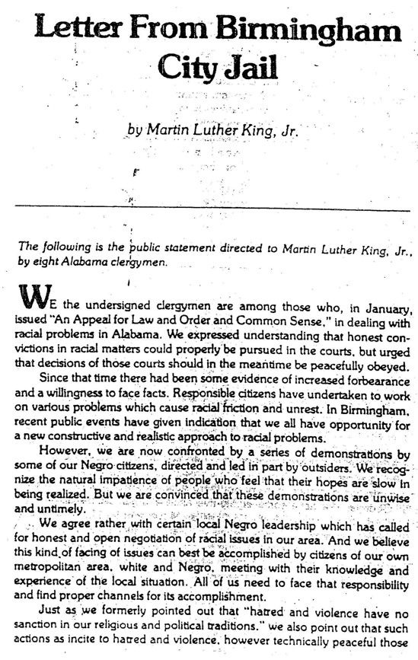
Letter from Birmingham Jail
This was an open letter by Martin Luther King Junior written in April 1963(Upchurch,2008).
The letter suggests that people have the moral responsibility to take direct action and break unjust laws.
Defends non-violent resistance to racism(Upchurch,2008).
Notes:
The letter from Birmingham was an open letter written by Martin Luther King Junior in April 1963.Even though the letter was written in newspaper margins,it played a significant role in defending the non-violent resistance to racism by suggesting that people had the moral responsibility to take direct action and break unjust laws. The Birmingham letter was a response for the statement made by eight clergy men in Alabama against Martin Luther King and his methods.In his response,he addressed various criticisms made by the “Call of Unity “ clergy men. One of the things that Martin Luther king addressed included the clergymen’s arguments that social injustices should be fought in the streets and not in the courts. Martin Luther King responded by speaking about the black oppression that existed in America. He also responded to the Clergy men’s criticisms on some of the public actions that he used. Martin Luther addressed this in the letter by indicating that he was using non-violent demonstrations to get negotiations with the white structure for true civil rights for African-Americans to be achieved. Towards the end of the letter,Martin Luther King also criticizes the praise given to the Birmingham police for maintaining non-violently to others but violently to the black people.

Slide 3
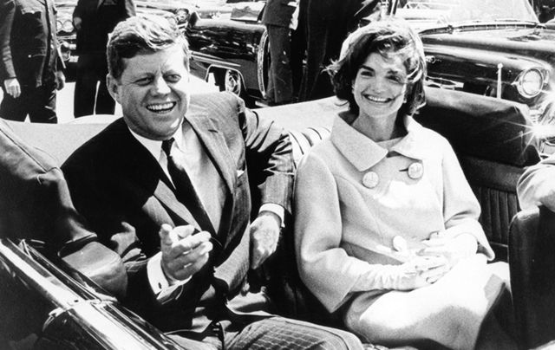
John. F. Kennedy Assassination
President John. F. Kennedy was assassinated by Lee Harvey Oswald in November 1963.
The assassination took place as his motorcade drove through Dealey Plaza in Texas.
Notes:
The assassination of President John. F. Kennedy took place in 1963 as he drove through Dallas ,Texas when gunfire reverberated in the Dealey Plaza. The bullets struck in John Kennedy’s head and neck. The governor who was also at the scene was shot in the chest. In an attempt to save the president, the car sped off to Parkland Memorial Hospital which was just a few minutes away from the scene. However,nothing could be done for the president and at 1:00 pm,he was pronounced dead.The police arrested Lee Harvey Oswald as he was identified to be the president’s assassin. The next morning, Oswald was scheduled to be transferred to a county Jail. During his transfer, he was assassinated by a night club owner known as Jack Ruby.The assassination of John.F.Kennedy raised a lot of controversy as most believed that it was a conspiracy in the CIA who wanted to punish the president as a result of a failed invasion.After the assassination,Lyndon.B.Johnson took the oath of office. On Monday 23,November, John Kennedy was laid to rest in Arlington National Cemetery. Head of states and representatives in more than 100 countries attended the funeral.

Slide 4
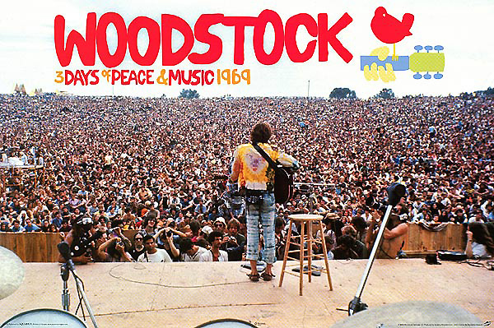
Woodstock Festival
It was an outdoor three day concert held from August 15- August 17 1969 in New York.
About half a million people attended the festival.
The aim of the festival was to promote peace and music.
Notes:
The Woodstock festival that took place for three days in 1969 aimed to promote peace and music. The promoters of the festival were four young men who included Joel Rosemann, John Roberts, Mike Lang and Artie Kornfeld. The original idea involved building a retreat and a recording studio for rock musicians in Woodstock.However,the idea then changed to creating a two day concert that would raise enough money to build the recording studio. Consequently, they began arranging for a large music festival and they found the perfect location which was an industrial park in Wallkill. However,their plans in regards to the location did not go as expected as the citizens of Wallkill did not want the festival to be held in their town. In July 2nd,1969 they even went ahead and passed a law that banned the concert from their vicinity.This brought about panic and doubts as to whether or not the festival was going to take place.The negotiations with the musicians to perform at the festival proved to be difficult and the stores refused to sell the tickets. However, the promoters managed to get a dairy farm in Bethel as their new location where about 500,000 people attended the festival.Some of the musicians that performed during the festival include Richie Havens, Joan Baez, Janis Joplin and Santana.

Slide 5
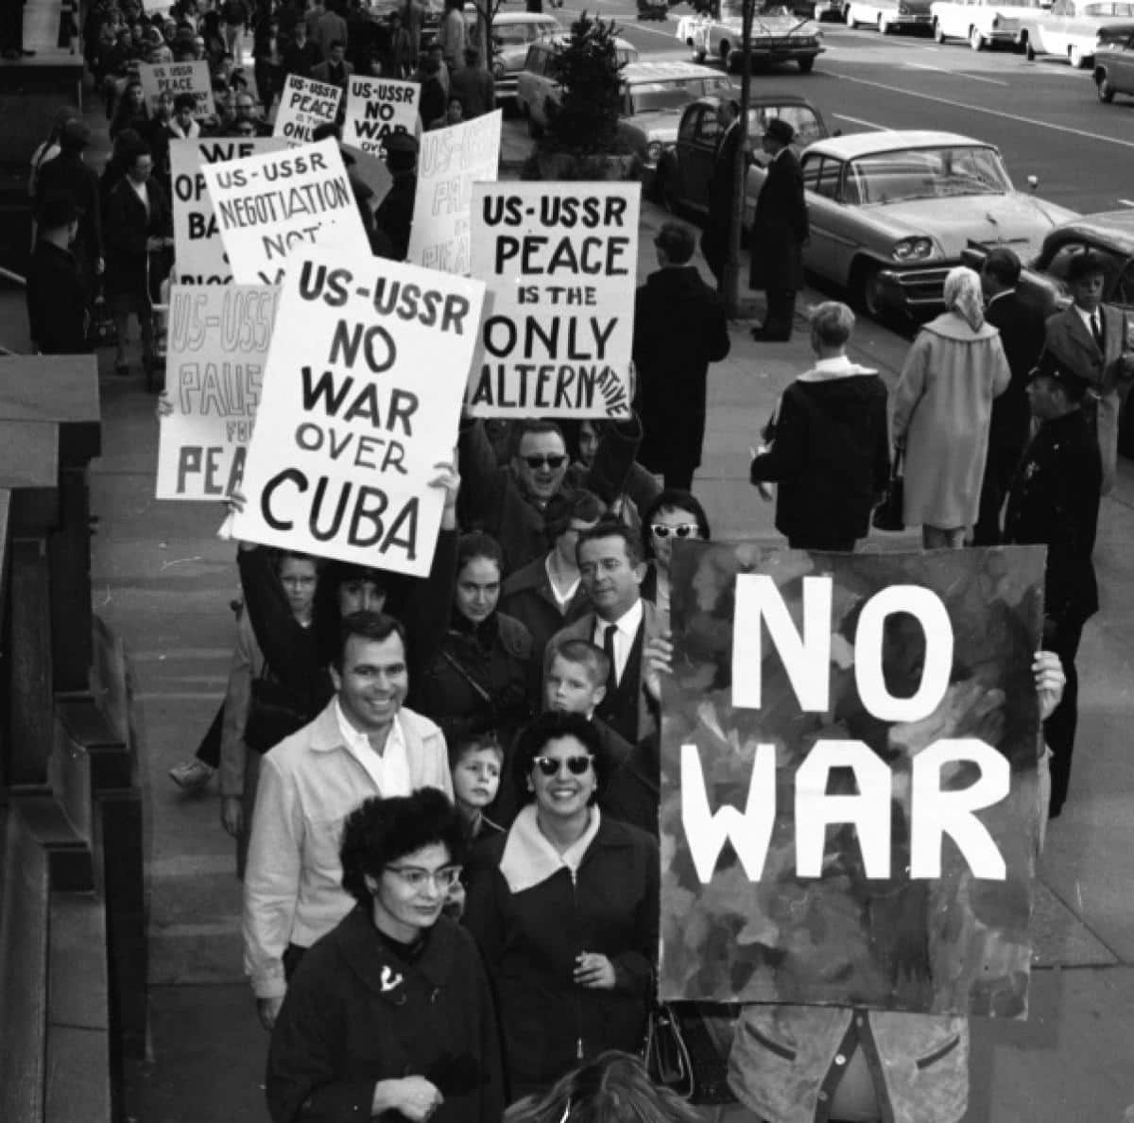
Cuban Missile Crisis
The crisis involved conflict between the United States and the Soviet Union over the Soviet nuclear missiles built in Cuba.
The 1962 crisis nearly led to a nuclear war between the United States and Soviet Union.
Notes:
The Cuban Missile crisis was a conflict between the Soviet Union and United States in October 1962 over the Soviet Union missiles deployed in Cuba.This crisis nearly led to a nuclear conflict between the United States and the Soviet Union. The crisis made history because of numerous reasons such as the calculations and miscalculations as well as the secret and direct communications on both sides. The nuclear missiles in Cuba were first discovered by an American plane which secretly photographed the Soviet Union building the missiles in Cuba. At first, John Kennedy who was the president of the United States at the time did not want Cuba and Russia to know that he had discovered the missiles. Instead, he heled meetings to discuss the problem and he finally decided that he would place a naval blockade in Cuba to prevent the Soviet Union from bringing more military supplies and ordered for the destruction of the Soviet sites. There was tension on how the Soviet president would react to President Kennedy’s actions. Luckily,the leaders from both countries realized that there would be a possibility of a nuclear war hence the Soviet Union agreed to dismantle the nuclear war while the United States agreed not to invade Cuba.

Slide 6
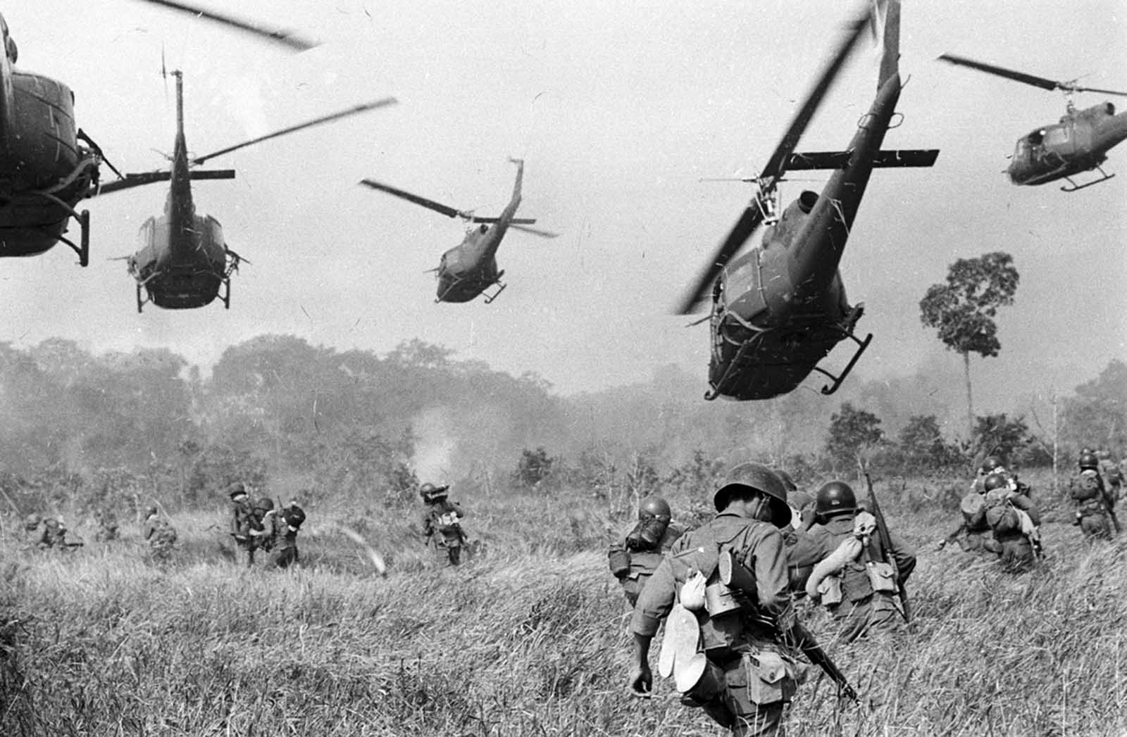
Vietnam War
The Vietnam war is regarded to be the aftermath of the Second World War.
In 1965,the United States officially adopted a war policy in Vietnam
Notes:
The interest of the United States in Vietnam can be traced back to 1965 after the Second World War. In the same year, the United States is believed to have deployed over 3,500 troops in South Vietnam. Therefore, the United States used military force to obtain national political objectives in Vietnam. North Vietnam reacted to US infiltration in South Vietnam by deploying more men and supplies in South Vietnam to combat the US. However, it is worth noting that the US involvement in South Vietnam was to prevent the communists from taking over. In March, the United states began its attack on North Vietnam to defeat the communist forces under the command of William Westmoreland. His strategy during the war involved mobility, technology, attrition and using US superiority of fire power to his advantage. In November, the same year, the armies met head on for the first time and they both claimed victory. Both armies received military aid from different countries .The United States received aid from Australia and New Zealand while North Vietnam was assisted by China and the Soviet Union. However, at the end of the Year, the President Johnson Lyndon declared a temporary halt to the war to conduct negotiations.

Slide 7
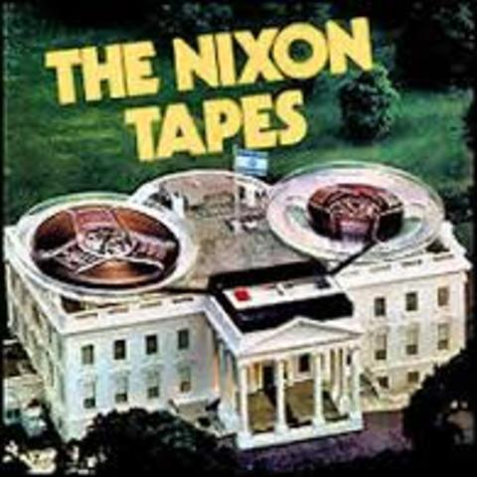
The Watergate Scandal
The tapes revealed the political scandals during President Richard Nixon administration(Genovese,1999).
The Scandal led to President Nixon resignation from office.
Notes:
The scandal entails a series of political events from the 1960’s such as the Vietnam war as well as the pentagon papers publications. The scandals during President Nixon’s administration were revealed after there was an arrest of five burglars in the Democratic National Committee. Four of the burglars were CIA activists against Fidel Catro in Cuba. The fifth burglar was the security Chief of the Committee involved in President Nixon’s re-election(Genovese,1999). The burglars were found with a series of items. At first, the White House distant itself from the scandal but later on after president Nixon’s inauguration, investigations found out that the White House was involved in the scandal.

Slide 8
References
Genovese.M. (1999). Watergate Crisis. Westport, Conn. [u.a.] : Greenwood Press
Upchurch. T.(2008) Race Relations in the United States, 1960-1980. Westport, Conn. : Greenwood Press

