Slide 1
Parent Literacy Presentation
Name
Institution

Slide 2
Importance of Reading to Young Children
Reading to young children enhances their social, intellectual and emotional development
It also augments their literary skills and language acquisition
Reading develops a young child’s imagination and creativity
Reading to young children improves their concentration
Notes:
When reading to children, they encounter a wide range of vocabularies from numerous topics. This enhances their literary and language acquisition skills that would otherwise not be obtained in the regular talking. Also, as young children listen to stories, they are able to concentrate and sit for longer spans of time. They also make imaginations based on the readings.

Slide 3
Continuation
Reading to young children prepares them for the future learning
Reading also develops a thirst for knowledge
Reading books aids children in developing empathy
Books are also a kind of entertainment
Reading to young children helps to build a bond between the parent and the child
Notes:
Reading to young children helps to instill in them a reading culture which continues when they go to school and when they start reading for themselves. Furthermore, reading to them creates anticipation which makes them want to learn more. Also, when parents spend time reading and talking to their children they can relax together and enjoy each other’s company in the process, thus creating a bond between them.

Slide 4
continuation
Reading to young children prepares them for academic success.
Also, reading to young children helps to cultivate a lifelong love for reading.
Parents can instill important values and virtues by reading to their children.
Notes:
When reading to children, they develop vital skills including phonemic awareness, phonics, reading comprehension and fluency. These skills are vital in aiding the children jumpstart their academic success. When children enjoy reading at a young age, there is a high probability that they would sustain the reading culture throughout their lives. Quality readings have lessons which teach the children about the world around them and vital values and virtues that they are supposed to emulate. A great example is the importance of reading in building own and foreign cultural awareness in children.

Slide 5
Resources for stories and music time
Resources for stories can be obtained from various sources including
Local libraries
Classroom teachers
Book stores
National education association
Authentic websites that offer quality children's literature.
Notes:
Parents can borrow storybooks from the child’s teacher. They can also access children literature from the local library. Furthermore, in this internet era, parents can access a wide range of reading materials from the internet.

Slide 6
Resources for music time
Self composition
Introducing the young children to a wide range of musical instruments
Common nursery rhymes
Buy compact discs with children songs
Encourage the children to participate in musical festivals and concerts
Notes:
Parents can compose silly songs and sing them with, and to their children. They can also expose their children to musical instruments including the guitar, the xylophone, among others.

Slide 7
How to decide what type of books are appropriate for young learners
One of the important factor to consider when choosing books for the young ones is the age of the child and the developmental stage they are in.
Select a variety of books
Books with brightly colored pictures appeal to young children
Involve the children in selecting the books
Choose books that imitate various scenarios in the child’s life.
Notes:
toddlers would enjoy books that have rhyme and repetition.
Preschoolers would enjoy books that depict objects and experiences that are familiar to them.
The early scholars of between the age of 5-8 enjoy books that portray a strong story line and character development also while children may want to read a single book over and over again, it is important to expose theme to books with a variety of themes (Koralek, 2001).

Slide 8
continuation
Activity books appeal more to children because they are demonstrative
Children also enjoy poetry books because they are rhythmic
choose books that have topics that interest the child
Provide the child with a wide range of books with different types of literacy including audio, visual, tactile; among others (Koralek, 2001).

Slide 9
Gestural Literacy Books
The Pout-pout Fish by Deborah Diesen
Olivia by Ian Falconer
Both books are appropriate because they offer the children a chance explore various gesture, and discuss their applicability in the appropriate settings.

Slide 10
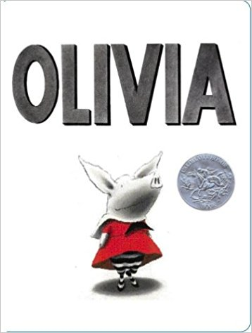
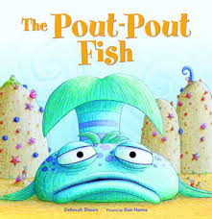
Gestural Literacy Books
The Pout-pout Fish by Deborah Diesen
Olivia by Ian Falconer
Both books are appropriate because they offer the children a chance explore various gesture, and discuss their applicability.

Slide 11
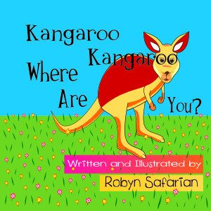
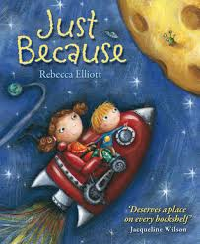
Spatial literacy books
Barnyard Dance by Sandra Boynton
Kangaroo, Kangaroo, Where Are You by Robyn Safarian
Both books will benefit the spatial literacy of the child because they offer a setting whereby the student can imagine and appreciate the events which the characters are experiencing

Slide 12
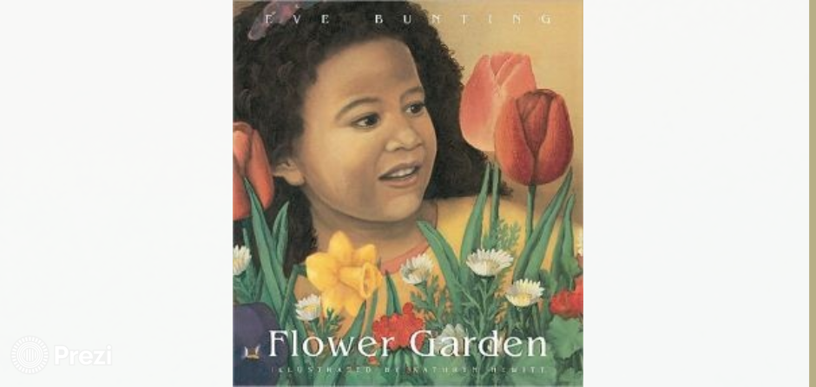
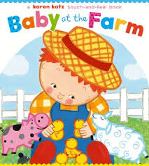
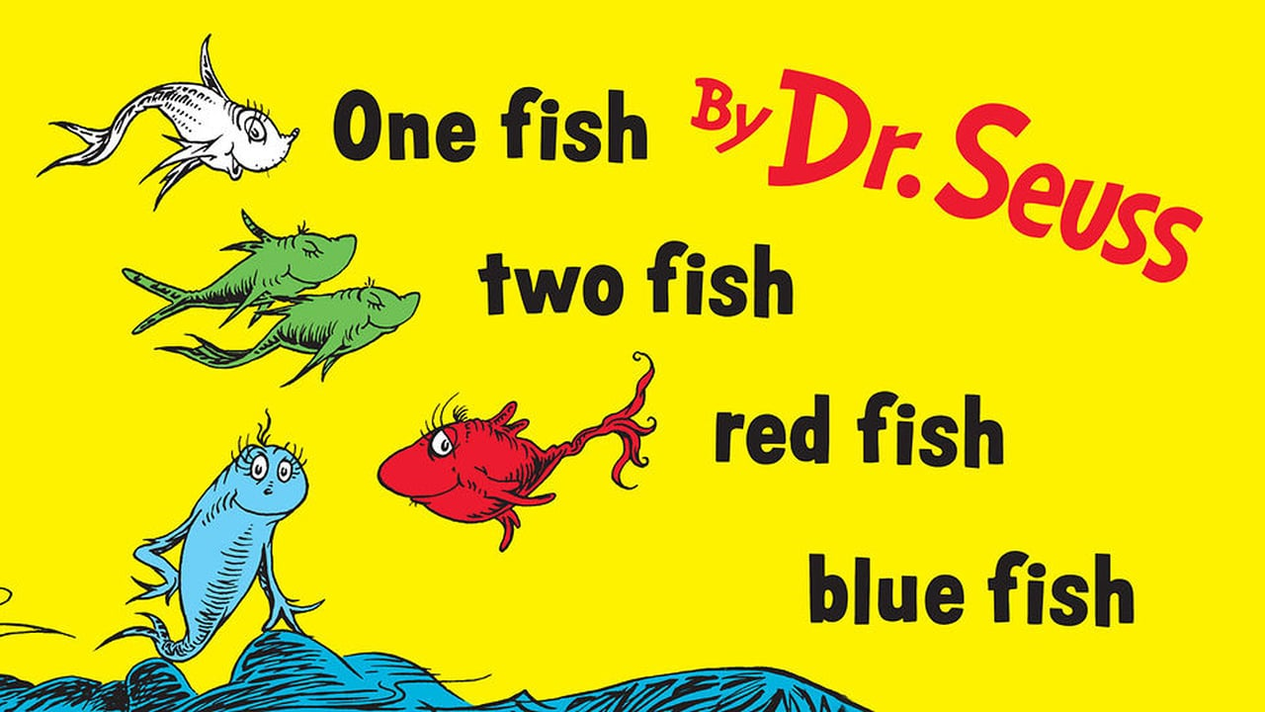
Linguistic Literacy: Flower Garden by Eve Bunting supports linguistic literacy due to the rhyming words and phrases
Audio literacy: One Fish, Two Fish, Red Fish, Blue Fish by Dr. Seuss. The book can be read rhythmically and help attract the attention of the children and keep them engaged
Tactile Literacy: children can learn as they move around and develop their sensory experiences

Slide 13
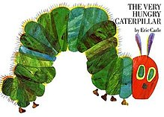
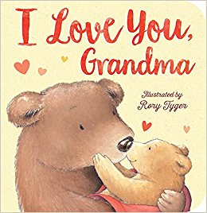
Visual Literacy
The Very Hungry Caterpillar by Eric Carle
I Love You Grandma by Roly Tyger
Both books meet the visual literary requirements because; they have used elements such as color, art, and character to appeal to a young reader.
The detailed pictures makes it easier to express the message that the author wishes to convey.

Slide 14
Visual literacy
The Very Hungry Caterpillar by Eric Carle
My Mom Loves Me by Marianne Richmond
Both books meet the visual literary requirements because; they have used elements such as color, art, and character to appeal to a young reader.
The detailed pictures makes it easier to express the message that the author wishes to convey.

Slide 15
References
Coats, K. (2013). Children’s Literature & The Developing Reader. San Diego, Ca: Bridgepoint Education, Inc.
Koralek D. (2001) Reading aloud with children of all ages. Retrieved from https://www.naeyc.org/files/yc/file/200303/ReadingAloud.pdf

