Slide 1
Communication In Health Education/Nursing Theory using
Care, Cure, Core Nursing Theory
By Tinuolu Shokunbi

Slide 2
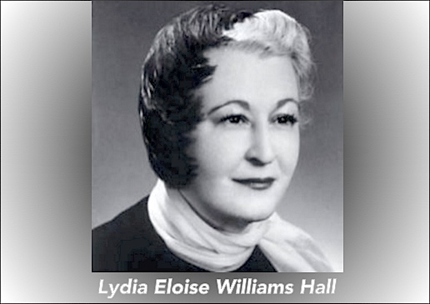
Objectives
Introduction
  Care, Core, Cure theory
  Application in the clinical scholarly project
  Alignment to healthy people 2020
Overview
  Central philosophy
  Concepts
Application in primary care
  Enhancing physical activity among patients with hypertension
  Patient Education
Education handout

Slide 3
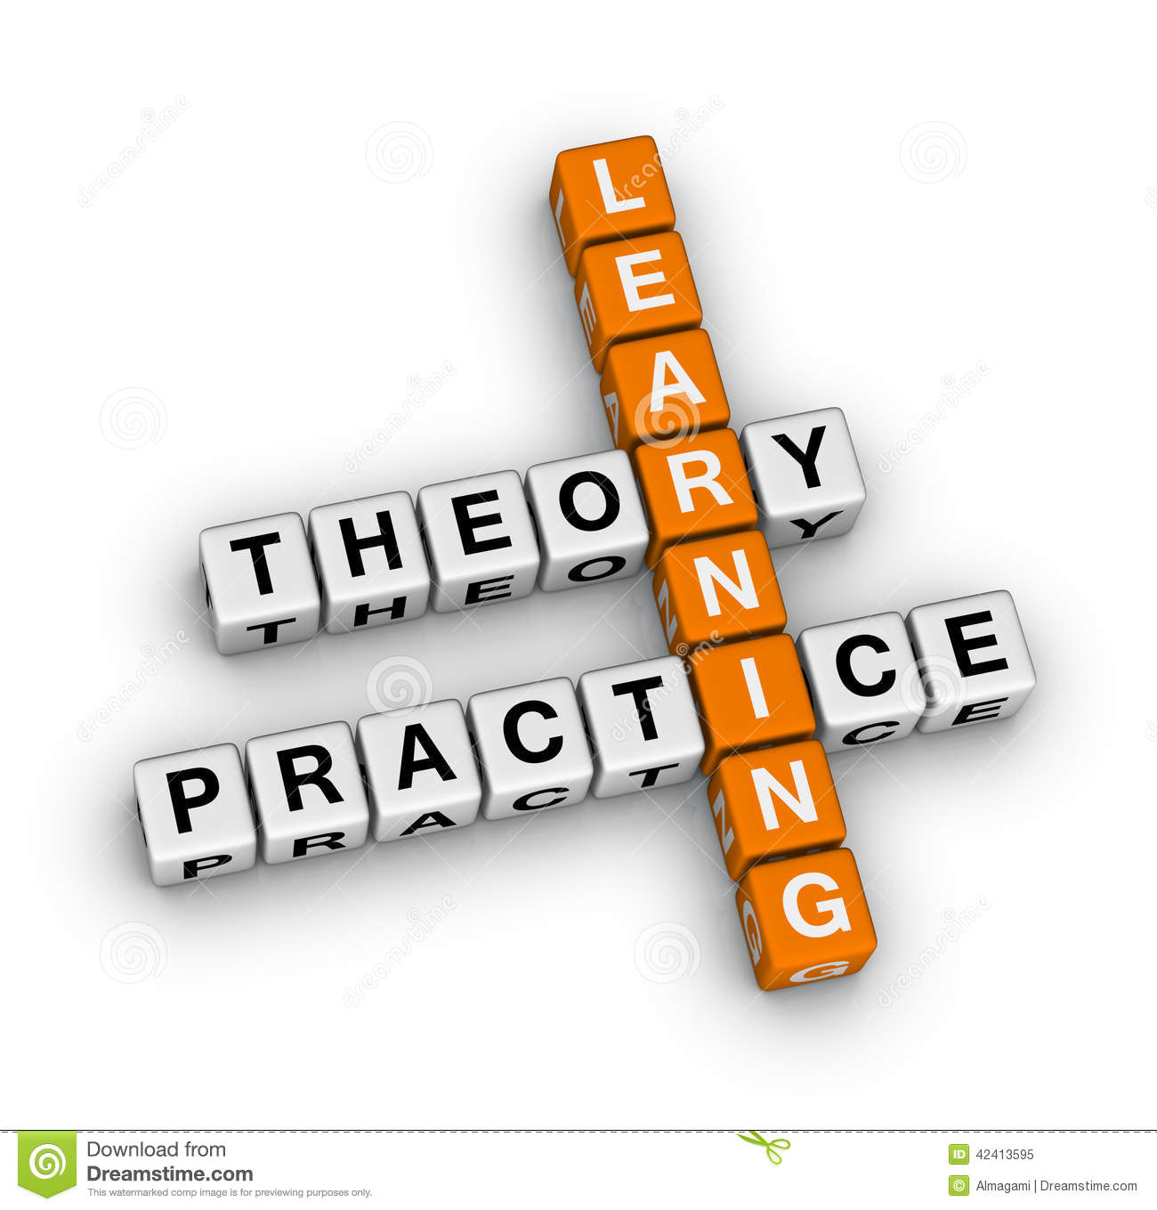
Care, cure, core nursing theory
The Care, Cure, Core Nursing Theory, also referred to as “Three Cs of Lydia Hall.”
Developed by Lydia Hall in the year 1966
Application
Clinical Scholarly Project:
  Effectiveness of Pedometer in enhancing physical activity among African Americans adults with hypertension
Healthy people 2020 Alignment:
  Topic: Heart disease and stroke
  Objective:HDS-10.4: Increase the proportion of adults with hypertension who meet the recommended guidelines for physical activity

Slide 4
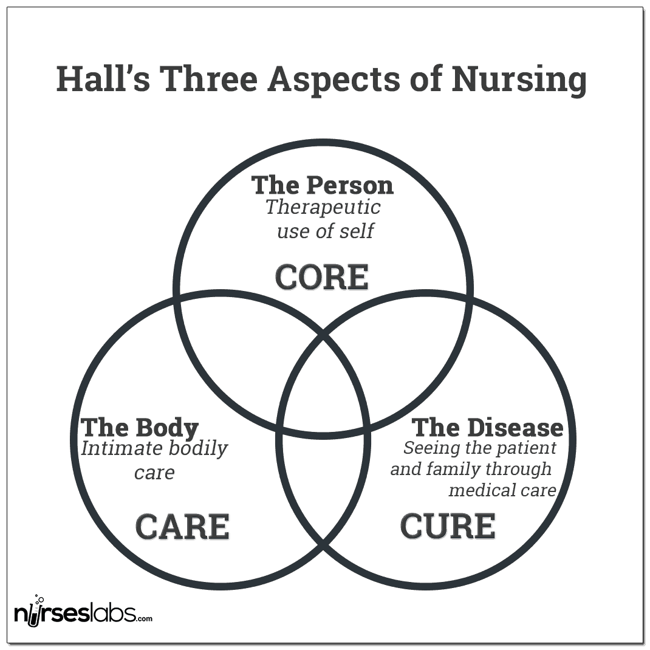
Overview
Central philosophy: holistic care through patient nurturing based the patients expectations and needs.
Application: Post acute care and for patient aged above 16 years
CSP Application: Primary Care
Concepts:
  Care
    Primary nursing role
    Care and comfort
    Patient education
  Core
    Patient needs and expectations
    Health status
  cure
    Shared with other health care provides
    Treatment- medication, therapies
    Advocating for better care

Slide 5
Use In Clinical Settings
Core, care, and cure theory | Application in enhancing physical activities
Motivation and energy necessary for healing is bestowed to the patient as opposed to the healthcare team. | The first goal in achieving recommended physical activity for patient with hypertension is thus helping the clients understand the need for optimal blood pressure.
Core, care and cure concept should be viewed as interrelated | This allows the nurse to consider other aspects and other health provider involved in the management of the clients blood pressure, thus fostering holistic management.
The nurse has a role in all the concepts which are presented as three interlocked circles. | Under care- nurse educate the patient need for physical activity and introduce interventions such as pedometer to foster participation Under core- nurse use reflective practice to foster awareness and motivate the patient Under cure- nurse monitor patient BP, treatment regimen and link patient to other healthcare providers.
The care, cure and core circles interlock and overlap and changes in size as the patient phase in disease process change. | As the patient understand the concept of physical activity and monitoring their progress, the need for nursing intervention reduce and their blood pressure improve and stabilize.

Slide 7
References
Nursing Theory (n.d). Lydia Hall Theory. https://nursing-theory.org/theories-and-models/hall-care-cure-core-theory-of-nursing.php
Gonzalo, A. (2021) Lydia Hall: Care, Cure, Core Nursing Theory. Nurseslabs.com. https://nurseslabs.com/lydia-e-halls-care-cure-core-theory/
HealthyPeople.gov (n.d). Heart Disease and Stroke. https://www.healthypeople.gov/2020/topics-objectives/topic/heart-disease-and-stroke/objectives

