Slide 1
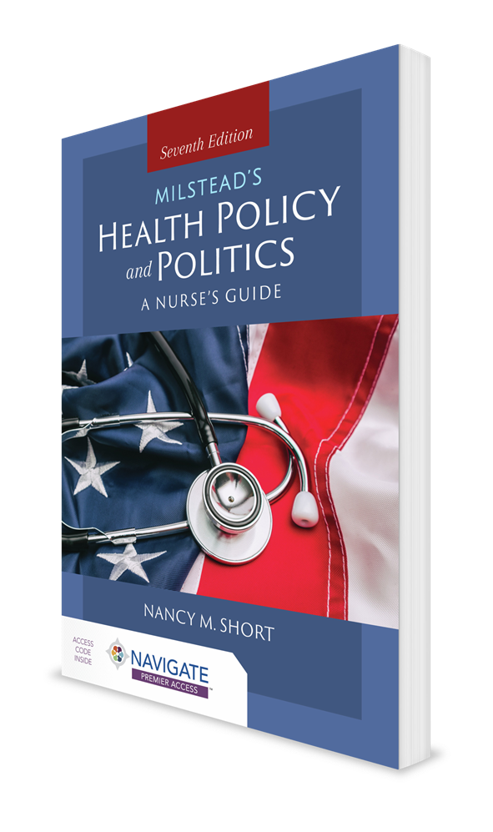
Problem Identification and Agenda Setting: What Rises to a Policymaker’s Attention?
CHAPTER 3

Slide 2
Introduction
Getting policymakers’ attention
Engaging in agenda setting
Process of moving a problem to the government’s attention so that different solutions can be considered by policymakers
Focus of healthcare-related politics
Finding solutions to problems
Barriers to change
Bounded rationality
Satisficing
Incremental nature of change

Slide 3
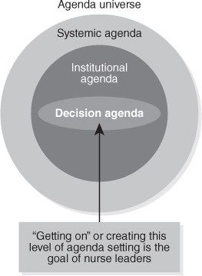
Levels of the Political Agenda
Agenda universe—all possible ideas
Systemic agenda—all issues commonly perceived as meriting public attention
Institutional agenda—items that have risen to the attention of a governing body
Decision agenda—items about to be acted on by a governing body

Slide 4
Case Study 1: A Local-to-National Example
The Community Aging in Place—Advancing Better Living for Elders (CAPABLE) model
Nurse-led initiative
Aim is to address many senior citizens’ inability to take care of their basic needs and prevent admission to a long-term facility

Slide 5
Case Study 2: Local-to-Regional-to-State Example
Incremental journey to full practice authority for Virginia nurse practitioners
Incremental changes since 1975, including:
Required certification for licensing
Gradual expansion of prescriptive authority
Updated supervisory language and collaborative practice agreements
Passage of House Bill 793
Further reduced barriers to full practice authority
Requires NPs to have 5 years of full-time practice (or 5,000 hours) before applying for an autonomous license

Slide 6
Overview of Models and Dimensions
Actors—motivated policy entrepreneurs, activists, and other representatives of professional groups and organizations
Ideas—power of shared norms and values in getting an issue on the policymakers’ agenda
Interests—for example, reelection (political self-preservation), economic benefit, national security, professional advancement, and more; shape the behavior of policymakers and those who work to influence them
Institutions—organizational structures, rules, and procedures that are entrenched and shape actors’ expectations, preferences, and behaviors

Slide 7
Kingdon Model
How issues get on the political agenda and how alternative solutions are devised
Three streams
Policy
Problem
Political
Window of opportunity

Slide 8
Importance of Contextual Dimensions
Political context
Fragmentation of power
Economic context
Scarcity
Social and cultural values
Administrative context
Who will implement a policy
How a policy will be implemented

Slide 9
Target Populations and Issue Characteristics
Value of knowing how elected officials perceive different target populations
Population categories
Advantaged
Contenders
Dependents
Deviants

Slide 10
Advocacy Coalition Framework
Predicated on the idea that interest groups organize in policy communities around a particular policy domain
Presumes that most policymaking is complex
See policy participants as relatively stable
Iron triangle
Academics, researchers, and journalists who specialize in policy
Characterizes policymaking as a gradual process

Slide 11
Path Dependency
Sees agenda setting and policy creation as occurring in a context that is significantly shaped by existing policies
Emphasizes benefit of studying the feedback patterns between economic and political events and policy responses that unfold over longer periods of time

Slide 12
Punctuated Equilibrium
Focuses on political processes that produce radical change
Posits that the following can lead to rapid change:
Massive shifts in public understanding of problems
Major crises
Dramatic election outcomes

Slide 13
Case Study 3: The Patient Protection and Affordable Care Act (ACA)
Passage of the ACA in March 2010 was a remarkable policy breakthrough
Its roots lie in the failed efforts of Democrats’ and President Clinton’s efforts at comprehensive healthcare reform in 1993–1994
Path dependency limits

Slide 14
Litigation
Filing lawsuits to effect change
Whistleblowing
Public reporting of wrongdoing or misconduct that leads to corrective action

Slide 15
Conclusion
Nurses and IPHCWs bring a unique and trusted perspective to policy deliberation and development because of their training, values, ethics, and experiences.
Nurses can use their numbers (size) to their advantage.
Nurses require a basic understanding of:
What gets on policy agendas in health systems
Legislative settings
How to get policymakers to pay attention

