Slide 1
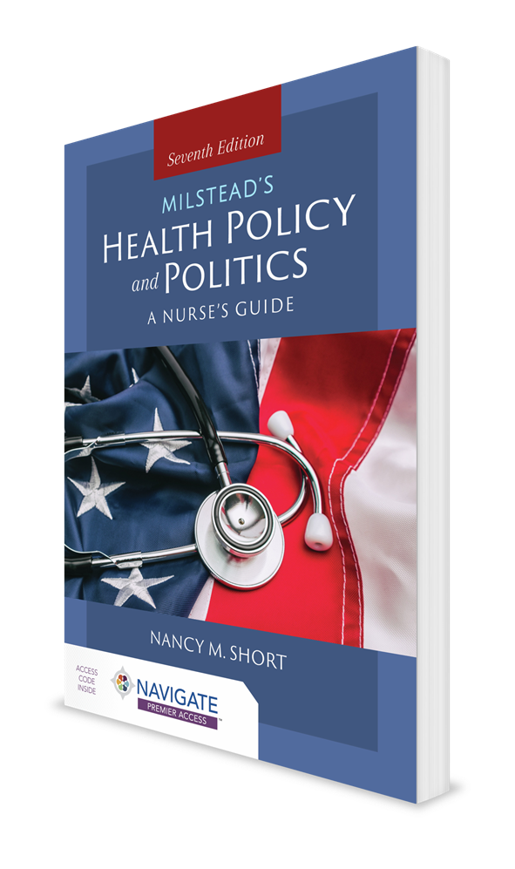
Informing Public Policy: An Important Role for Registered Nurses
CHAPTER 1

Slide 2
Introduction
COVID-19 pandemic
Essential worker status
On-the-fly innovation
Distribution/availability of personal protective equipment

Slide 3
The Politics of Clinical Practice (1 of 2)
Studies/initiatives
The Future of Nursing: Advancing Health, Leading Change (IOM)
Campaign for Action (Robert Wood Johnson Foundation [RWJF] and AARP)
RWJF study focused on the future of nursing
Public policy
Directs problems to the government’s attention and secures a response
Can be focused in many areas

Slide 4
The Politics of Clinical Practice (2 of 2)
Policy—a consciously chosen course of action
A law, regulation, rule, procedure, administrative action, incentive, or voluntary practice of governments and other institutions
Politics—process of influencing the allocation of scarce resources

Slide 5
Policy Instruments
Laws, or statutes
Serve as legal directives for public and private behavior
Made at the international, federal, state, and local levels
Instruments at the national level
Bills—proposed legislation
Act—statute, or law
Executive order—an instruction issued by the president
Presidential directive—specific type of executive order; carries the force and effect of law
Rules and regulations—guidelines or instructions
Rules: not legally binding
Regulations: legally binding
Resolution—used for the regulation of business only
U.S. Code—list of federal laws

Slide 6
Tools to Determine the Meaning of Ambiguous Statutes
Text of the statute
Legal interpretations of the statute
Context and structure of the statute
Purpose of the statute

Slide 7
Judicial Interpretation of Public Law
Court determines meaning of broadly written laws
Court determines how some laws are applied
Court interprets the Constitution and declares a law unconstitutional
Court resolves conflicts between states and the federal government

Slide 8
Six Processes of Policymaking
Problem identification and agenda setting
Policy analysis
Policy design
Policy enactment
Policy implementation
Evaluation of policy outcomes

Slide 9
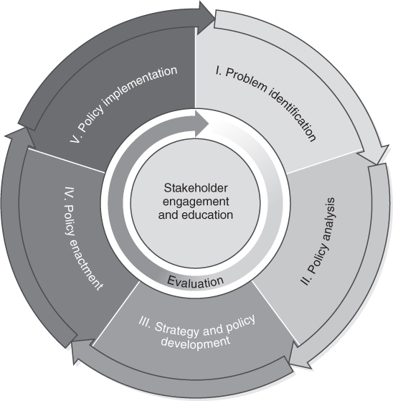
The Policy Process
Centers for Disease Control and Prevention. (2012). Overview of CDC’s Policy Process. Atlanta, GA: Centers for Disease Control and Prevention, U.S. Department of Health and Human Services. Retrieved from https://www.cdc.gov/policy/analysis/process/

Slide 10
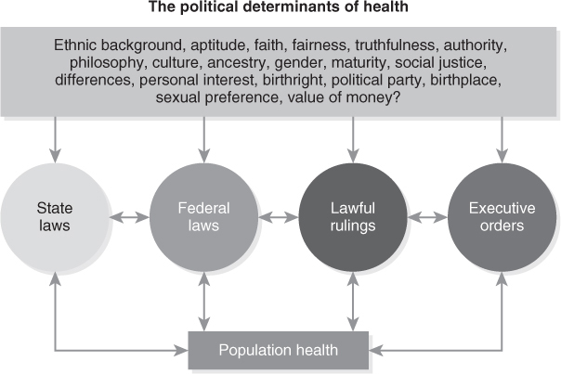
Public Policy, Political Determinants of Health, and Clinical Practice?
Political factors driving social determinants of health (SDoH)
Data from Mishori, R. (2019). The social determinants of health? Time to focus on the political determinants of health!. Medical care, 57(7), 491-493.

Slide 11
Case Study
Legislation to address health professional license portability during a public health emergency
Goal: improve access to care through:
Provider mobility
Interstate telehealth
Bills introduced by Congress during COVID-19 pandemic
Equal Access to Care Act (S.3993)
Temporary Reciprocity to Ensure Access to Treatment (TREAT) Act (S.421)

Slide 12
Why You Are the Right Person to Influence Health Policy
Power dynamics
Coercive
Blocking
Negative decision
Purchasing
Characteristics of nurses
Education
Communication skills
Rich history
Leadership skills
Trade association involvement
Practice venues

Slide 13
Practice and Policy (1 of 2)
Building relationships with policymakers
Power in numbers
Nurses represent the largest group of healthcare workers in the nation
Power of storytelling
Power of voting

Slide 14
Practice and Policy (2 of 2)
Federal Trade Commission key findings related to APRNs:
APRNs provide care that is safe and effective.
Physicians’ mandatory supervision of and collaboration with advanced nurse practice is not justified by any concern for patient health or safety.
Supervision and collaborative agreements required by statute or regulation lead to:
Increased costs
Decreased quality of care
Fewer innovative practices
Reduced access to services
APRNs collaborate effectively with all healthcare professionals without inflexible rules and laws.
APRN practice is “good for competition and consumers”

Slide 15
Organizational Involvement
Nurse-focused organizations include those in specialty areas, education-related organizations, and leadership-related organizations.
Organizational involvement can expand a nurse’s perspective toward a broader view of health and professional issues.
Political activism is a major expectation of most professional organizations.

Slide 16
Taking Action
Nurses need to share their perspectives with bureaucrats, agency staff, and legislators regarding:
What nurses do
What nurses and their patients need
How their cost-effectiveness has long-term impacts on health care

Slide 17
A Professional Nursing Workforce
Entry-level requirements
NSCBN: does not currently support legislation or regulation that requires a bachelor of science in nursing (BSN)
Healthcare agencies: may require BSN or require RNs with associate’s degrees or diplomas to complete a BSN within 5 years
Academic changes
Expanded or new RN-to-BSN programs

Slide 18
Innovation in Healthcare: Reform or Incrementalism?
Enactment of Patient Protection and Affordable Care Act, or “Obamacare”
Legislative efforts to weaken the act
Elimination of individual mandate to purchase insurance
Reduced support for marketing
Shorter enrollment period
Failure to follow through on financial commitments to health insurers
Increased access to lower-quality care
Current objectives of Biden administration

Slide 19
Developing a More Sophisticated Political Role for Nurses
Build relationships with legislators
Develop credibility
Utilize clinical network

Slide 20
Working With the Political System
Develop contacts with legislators, appointed officials, and their staffs
Participate in groups that interact with legislators
Stay alert to issues
Share information

Slide 21
Conclusion (1 of 2)
To function effectively in the policy arena, healthcare professionals must have expert knowledge and skills in:
Change management
Conflict resolution
Active listening
Assertiveness
Communication
Negotiation
Group processes

Slide 22
Conclusion (2 of 2)
The policy process is much broader and more comprehensive than the legislative process.
The question is not whether nurses should be involved in policy process, but to what extent.

