Slide 1

Sleuthing Journal - Community Health Promotion
Name
Course Title
Instructor
Date

Slide 2

Introduction
Health professionals including community workers are mandated to meet the unique needs they serve.
Community assessment allows:
Recognize strengths and resources available
Understand the gaps in the provision of care.
Develop strategies and an action plan.
Prioritize needs
Development and implementation of strategies should be aimed at promoting the health of the community across all populations.
The focus of the community health promotion journal is BOWIE CITY, MARYLAND.

Slide 3
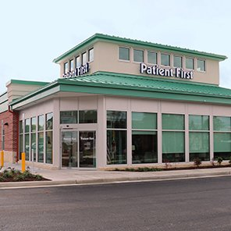
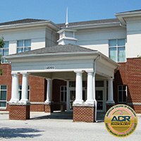
Health Care Access
There are numerous community clinics offering varying health services.
Varying care centres and community clinics offer general services.
The majority of the clinics offer specialized care.
Examples include;
Patient First Primary and Urgent Care
Community Radiology Associates (CRA)
Westside Health Center
TLC Pediatrics

Slide 4

Local Public Health Services
Bowie community has good access to health care services.
Care services are located within the city and hence accessible.
Prince George’s County under the Department of Health and Human Services offer varying services to vulnerable populations.
Example of Public Health Services;
Family health – Family planning.
Environmental health – Water supply and food safety
Social services - Food stamps
Behavioral Health – Alcohol and drug prevention
Legal Services

Slide 5

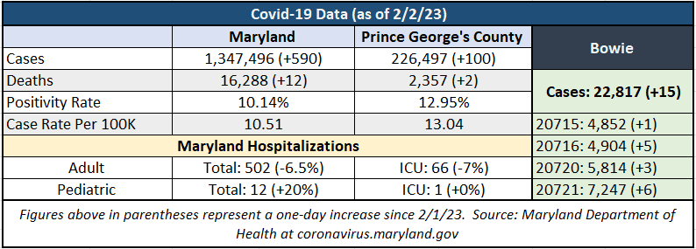
Vaccination Rates
School-children should receive;
Two doses of varicella (chicken pox)
Single dose of Tdap
Single dose of MCV4 (meningitis)
Bowie vaccination rate was not available to the public.
Residents receive varying vaccines;
Influenza
Tdap - tetanus, diphtheria, and acellular pertussis
COV1D-19
Residents receive COVID-19 jabs in all community clinics.
Flu shots are offered at clinics, local pharmacies, and primary care providers

Slide 6



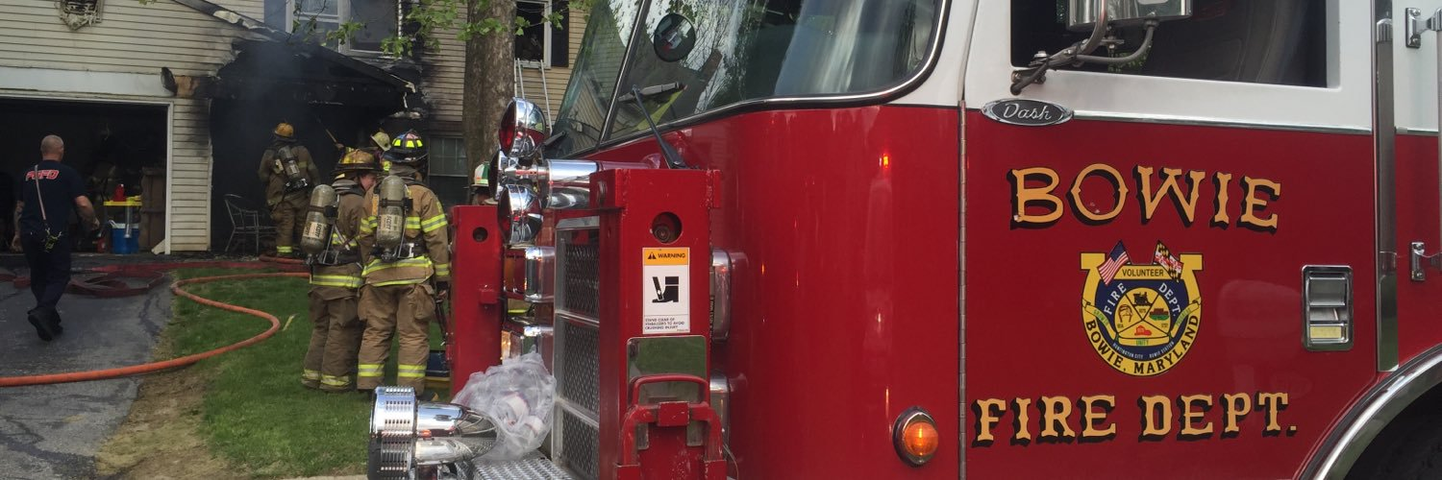


Disaster Planning
Emergency Communication and Preparedness
Fire safety on fire hazards such as space heaters and safe home heating and smoke detectors
Effective preparedness in severe thunderstorms, floods, extreme heat, hurricanes and winter storms
Accurate emergency alert system, public safety messages and new flash.

Slide 7
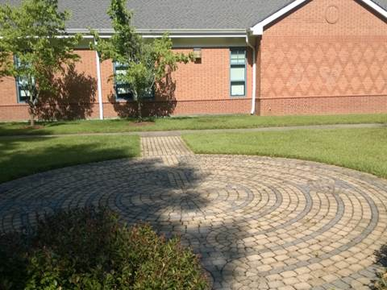
Health Education/ Promotion
Health and wellness programs – Fitness classes, seminars, and lectures
Nutrition program – Serving meals at centers
Recreational centers – Gymnasium, playhouse, public skating centers, and parks.
Special events – Farmer’s market

Slide 8

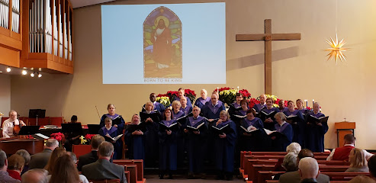
Community Engagement
Community residents engage in religious facilities in decision-making for the less privileged in society.
Education organizations such as universities assist in facilitating education.
Community engagement is crucial in reducing inequalities, improving social justice, enhancing benefits, and sharing responsibility toward health promotion.
Fosters addressing socioeconomic, cultural and ethnic issues, engages citizens in decision-making and improves access to preventative health care services.

Slide 9
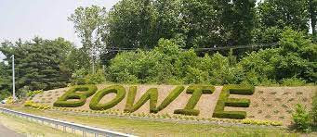
Reflection
In my opinion, Bowie community residents have access to public health services, school wellness programs, recreational facilities, nutritional programs, and community engagement.
Bowie residents have access to essential services.
Residents lead a better quality of life leading to increased productivity and prosperity.
There is need to conduct community needs assessment to enhance awareness and promote the population health

