Slide 1
Sleuthing Journal - Community Health Promotion
Name
Course Title
Instructor
Date

Slide 2

Introduction
Health professionals, including community workers, are mandated to meet the unique needs they serve.
Community assessment allows:
  Recognize strengths and resources available
  Understand the gaps in the provision of care.
  Develop strategies and an action plan.
  Prioritize needs
Development and implementation of strategies should promote the community’s health across all populations.
The community health promotion journal focuses on BOWIE CITY, MARYLAND.

Slide 3
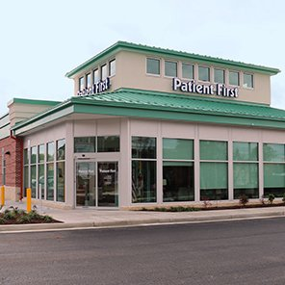
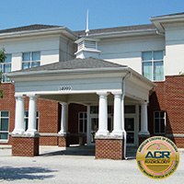
Health Care Access
numerous community clinics are offering varying health services.
Varying care centers and community clinics offer general services.
The majority of the clinics offer specialized care.
Examples include;
  Patient First Primary and Urgent Care
  Community Radiology Associates (CRA)
  Westside Health Center
  TLC Pediatrics

Slide 4

Local Public Health Services
Bowie community has good access to health care services.
Care services are located within the city and hence accessible.
Prince George’s County, under the Department of Health and Human Services, offers varying services to vulnerable populations.
Example of Public Health Services;
Family health – Family planning.
Environmental health – Water supply and food safety
Social services - Food stamps
Behavioral Health – Alcohol and drug prevention
Legal Services

Slide 5

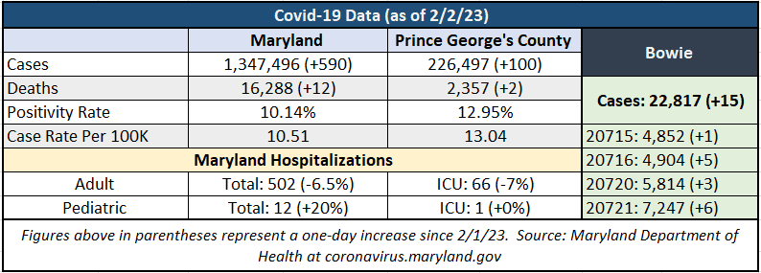
Vaccination Rates
Bowie vaccination rate was not available to the public.
Residents receive varying vaccines;
  Influenza
  Tdap - tetanus, diphtheria, and acellular pertussis
  COV1D-19
Residents receive COVID-19 jabs in all community clinics.
Flu shots are offered at clinics, local pharmacies, and primary care providers.

Slide 6



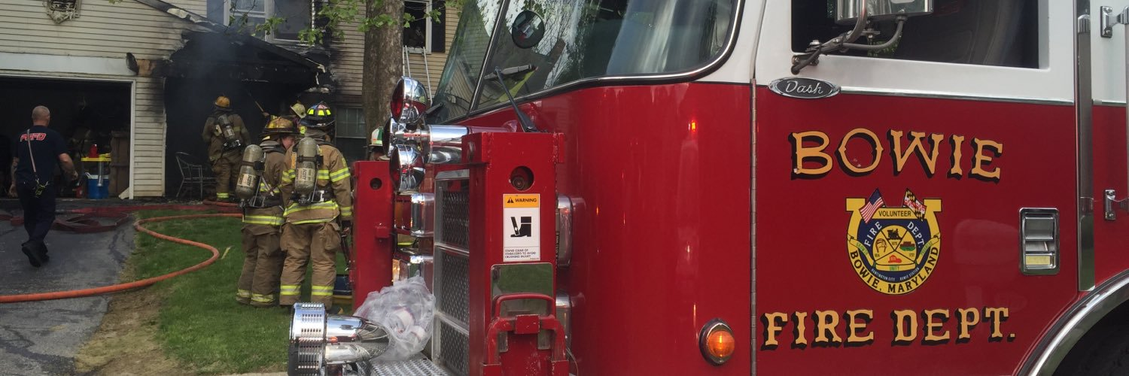


Disaster Planning
Emergency communication and Preparedness.
Fire safety on fire hazards such as space heaters and safe home heating and smoke detectors.
Effective preparedness in severe thunderstorms, floods, extreme heat, hurricanes, and winter storms.
The accurate emergency alert system on public safety messages and news flashes.

Slide 7

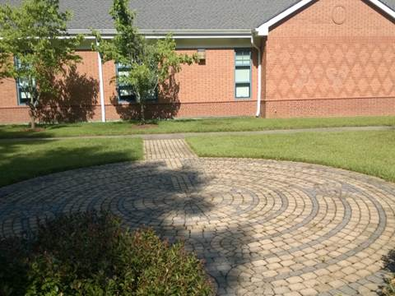
Health Education/
Promotion
Health and wellness programs – Fitness classes, seminars, and lectures.
Nutrition program – Serving meals at centers.
Recreational centers – Gymnasium, playhouse, public skating centers, and parks.
Special events – Farmer’s market

Slide 8

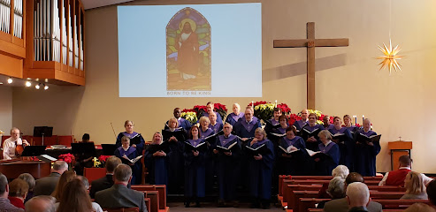
Community Engagement
Community residents engage in religious facilities in decision-making for the less privileged.
Education organizations such as universities assist in facilitating education.
Community engagement is crucial in reducing inequalities, improving social justice, enhancing benefits, and sharing responsibility toward health promotion.
Fosters to address socioeconomic, cultural, and ethnic issues, engages citizens in decision-making, and improves access to preventative healthcare services.

Slide 9
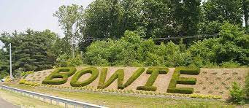
Reflection
In my opinion, Bowie community residents have access to public health services, school wellness programs, recreational facilities, nutritional programs, and community engagement.
Bowie residents have access to essential services.
Residents lead a better quality of life that increases productivity and prosperity.
There is a need to conduct a community needs assessment to enhance awareness and promote the population’s health

