Slide 1

use of exercise in the management of depression among adult patients integrating Pender’s Health Promotion Model.
Presented by Jimmie Bello
NOLA PENDER - NURSING THEORIST
Notes:
Hello Instructor and Fellow Classmates, my name is Jimmy Bello, I work as a forensic psychiatric nurse in the department of behavioral health at Elizabeth
hospital. My presentation focuses on the use of exercise in the management of depression among adult patients by integrating Pender’s Health Promotion Model.

Slide 2
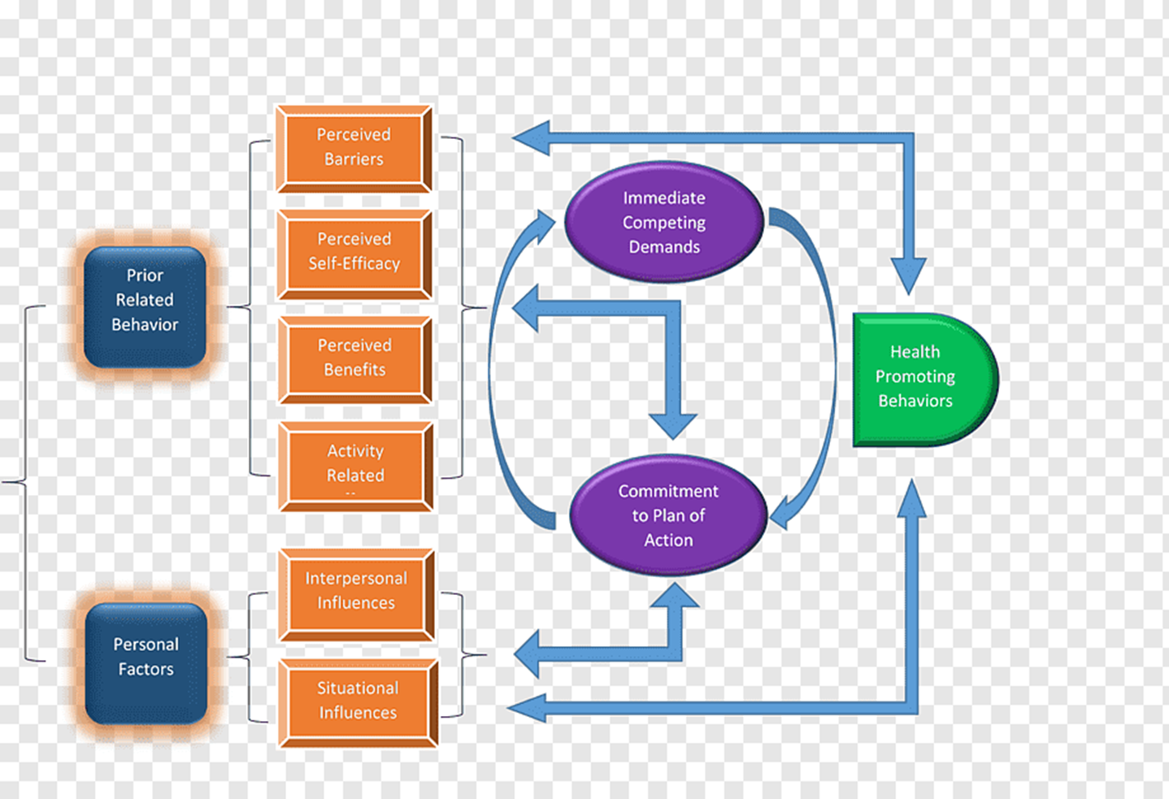
Overview
Overview of the Health Promotion Model
Designed by Nola J. Pender.
First appeared in 1982 and revised in 1996.
Purpose
To assist nurses to understand determinants of healthy behaviors for behavioral counseling to promote healthy lifestyles.
Concepts
  Individual characteristics and experiences,
  Behavior-specific cognitions and affect
  Behavioral outcomes.
Notes:
The Pender’s Health Promotion Model, often abbreviated HPM was designed by Nola Pender. The model first appeared in literature in 1982 and was later revised in 1996 to help nurses comprehend the main determinants of health behaviors as a foundation for behavioral counseling to promote healthy lifestyles. The Key concepts include individual characteristics and experiences, behavior-specific cognitions, and affect and behavioral outcomes. This implies that individual characteristics and life experiences shape behaviors and the environment associated with social, cultural, and physical aspects can be manipulated to create positive cues and facilitate health-promoting behaviors.

Slide 3
How the project aligns with Healthy people 2030 Objectives
The topic of the project
The use of exercise in the management of depression among adult patients.
use exercise is a complementary treatment for adults with depression through an intervention of at least 300 minutes/per week of brisk walking.
Healthy people 2030 Objectives
Second objective (PA-02) - “increase the proportion of adults who do enough aerobic physical activity for substantial health benefits.
Fifth objective (MHMD-05) - “Increase the proportion of adults with depression who get treatment” (Health.gov, 2023).
Notes:
My Clinical Scholarly Project (CSP) topic on the use of exercise in the management of depression among adult patients. The project seeks to use exercise as a complementary treatment for adults with depression through an intervention of at least 300 minutes/per week of brisk walking. The project aligns with Second objective (PA-02) and fifth objective. The second objective states that an increase the proportion of adults who do enough aerobic physical activity for substantial health benefits. The fifth objective states that an increase the proportion of adults with depression who get treatment” ((Health.gov, 2023).

Slide 4
Application of Health Promotion Model in the clinical scholarly Project
Application of Health Promotion Model
Intervention: brisk walking at least 300 minutes/per week
Patients’ feelings toward brisk walking
Perceived sensitivity
Perceived benefits
Perceived barriers
Perceived self-efficacy
Commitment to plan
Interpersonal & situational influences
Competitive preferences & desires
Brief introduction on the aims of the project and highlighting complications linked to depression.
Emphasize brisk walking using handouts
Benefits and importance of walking such as reduced depression.
Late or lack of brisk walking
Presence of influential factor per session such as dog walk
Distribution of handouts to build commitment.
Emphasize walking or cycling instead of using vehicles
Engage companions, and recommend available resources
Notes:
The application of the model in the project is aimed to promote healthy associated with personal experiences and features, behavioral outcomes, and precise feelings and cognitions of behavior. The primary intervention as mentioned earlier is brisk walking for a minimum of 300 minutes weekly. To influence patients'’ feelings, participants will be briefly introduced to the aim of the project and highlight complications, and prevalence of depression. On issues related to perceived sensitivity, handouts will be used to emphasize the importance of brisk walking (Rouholamini et al., 2020). On perceived benefits, patients with depression will be emphasized on the benefits and importance of brisk walking in reducing depression. Some of the perceived barriers include late or lack of brisk walking while perceived self-efficacy is factored on the presence of an influential companion or factor such as dog walking (Rouholamini et al., 2020). Handouts will be distributed to maintain a commitment to the plan. Some of the interpersonal and situational influences include emphasizing brisk walking or cycling instead of using vehicles. Some of the competitive preferences and desires can encourage being accompanied by companions or recommended resources for brisk walking.

Slide 5
Presentation Link

Slide 6
References
Health.gov (2023). Healthy people 2030: objectives and data.
https://health.gov/healthypeople/objectives-and-data/browse-objectives
Nursing Theory (n.d). Nola Pender - Nursing Theorist.
https://nursing-theory.org/nursing-theorists/Nola-Pender.php
Rouholamini, S., Gheibizadeh, M., Maraghi, E., & Jahanshahi, A. (2020). The effects of a training program based on the health promotion model on physical activity in women with type 2 diabetes: a randomized controlled clinical trial. Iranian journal of nursing and midwifery research, 25(3), 224. https://doi.org/10.4103%2Fijnmr.IJNMR_97_19

