Slide 1
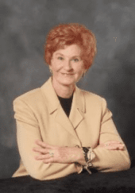
use of exercise in the management of depression among adult patients integrating Pender’s Health Promotion Model.
Presented by Jimmie Bello
NOLA PENDER - NURSING THEORIST
Notes:
Hello Instructor and Fellow Classmates, my name is Jimmy Bello, I work as a forensic psychiatric nurse in the department of behavioral health at Elizabeth
hospital. My presentation focuses on the use of exercise in the management of depression among adult patients by integrating Pender’s Health Promotion Model.

Slide 2
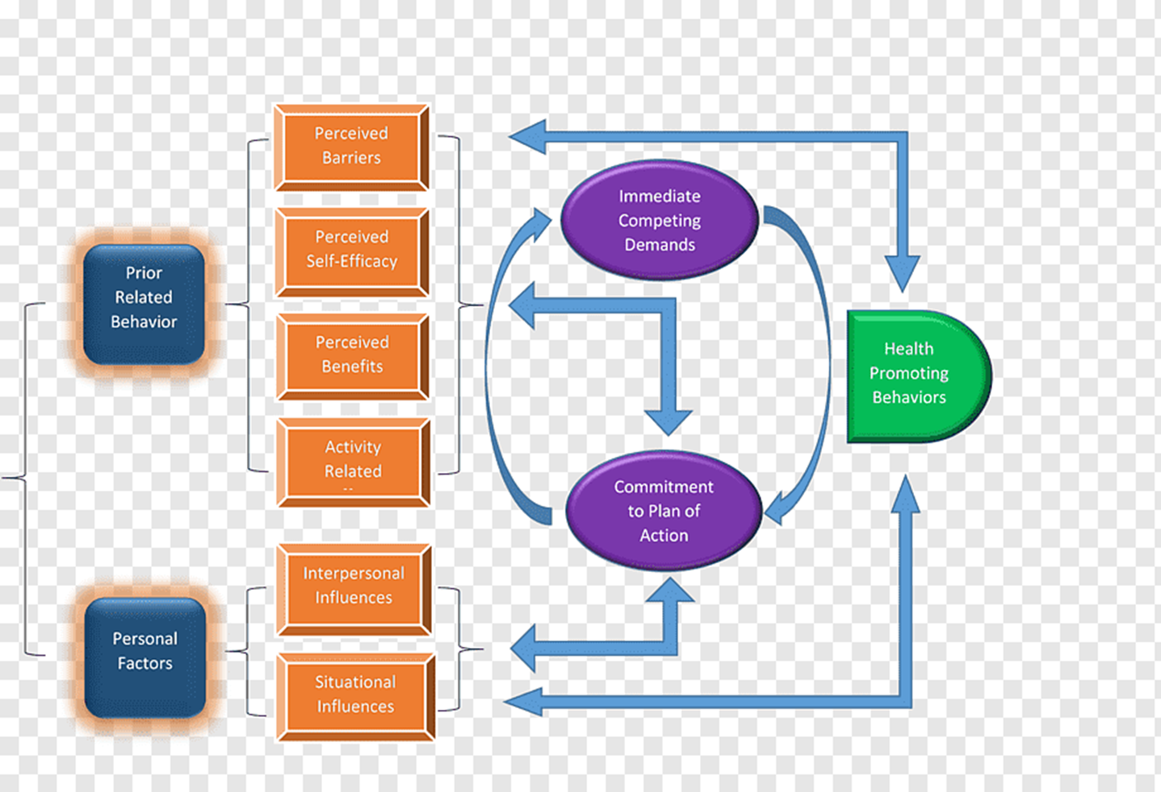
Overview
Overview of the Health Promotion Model
Designed by Nola J. Pender.
First appeared in 1982 and revised in 1996.
Purpose
To assist nurses to understand determinants of healthy behaviors for behavioral counseling to promote healthy lifestyles.
Concepts
  Individual characteristics and experiences,
  Behavior-specific cognitions and affect
  Behavioral outcomes.
Notes:
The Pender’s Health Promotion Model, often abbreviated HPM was designed by Nola Pender. The model first appeared in literature in 1982 and was later revised in 1996 to help nurses comprehend the main determinants of health behaviors as a foundation for behavioral counseling to promote healthy lifestyles. The Key concepts include individual characteristics and experiences, behavior-specific cognitions, and affect and behavioral outcomes. This implies that individual characteristics and life experiences shape behaviors and the environment associated with social, cultural, and physical aspects can be manipulated to create positive cues and facilitate health-promoting behaviors.

Slide 3
How the project aligns with Healthy people 2030 Objectives
The topic of the project
The use of exercise in the management of depression among adult patients.
use exercise is a complementary treatment for adults with depression through an intervention of at least 300 minutes/per week of brisk walking.
Healthy people 2030 Objectives
Second objective (PA-02) - “increase the proportion of adults who do enough aerobic physical activity for substantial health benefits.
Fifth objective (MHMD-05) - “Increase the proportion of adults with depression who get treatment” (Health.gov, 2023).
Notes:
My Clinical Scholarly Project (CSP) topic on the use of exercise in the management of depression among adult patients. The project seeks to use exercise as a complementary treatment for adults with depression through an intervention of at least 300 minutes/per week of brisk walking. The project aligns with Second objective (PA-02) and fifth objective. The second objective states that an increase the proportion of adults who do enough aerobic physical activity for substantial health benefits. The fifth objective states that an increase the proportion of adults with depression who get treatment” ((Health.gov, 2023).

Slide 4
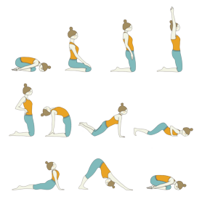
Inclusion in the clinical scholarly Project
Health Promotion Model in the Project
To motivate patients with depression to engage in wellness aligned with health promotion.
To assist depressed patients to understand their distinctive characteristics and how they affect their potential action, identify obstacles and understand how their interpersonal actions are affected by situational influences.
Understand previous behavioral actions, and why they struggle with challenging demands or preferences to develop a foundation for changes.
Promote awareness of health behaviors and encourage self-efficacy.
Educate patients on the benefits of change and the significance of building an environment that supports behavioral change and manages obstacles.
Notes:
The model will be used to motivate patients with depression to engage in wellness aligned with health promotion. The model will further be applied to assist depressed patients to understand their distinctive characteristics and how they affect their potential action, identify obstacles and understand how their interpersonal actions are affected by situational influences.
Patients will be educated to understand previous behavioral actions, and why they struggle with challenging demands or preferences to develop a foundation for changes. The model will be used to promote awareness of health behaviors and encourage self-efficacy and educate patients on the benefits of change and the significance of building an environment that supports behavioral change and manages obstacles

Slide 5
Presentation Link

Slide 6
References
Health.gov (2023). Healthy people 2030: objectives and data.
https://health.gov/healthypeople/objectives-and-data/browse-objectives
Nursing Theory (n.d). Nola Pender - Nursing Theorist.
https://nursing-theory.org/nursing-theorists/Nola-Pender.php
Dean, A. J. (2019). Exercise as treatment for depression, dissemination of evidence-based practice to providers.
https://scholarworks.montana.edu/xmlui/handle/1/15533

