Slide 1

Suicide Prevention Among Veterans: Taking Action, Saving Lives

Slide 2

Addressing The Crisis of Veteran Suicides
Each day we lose brave men and women who have served this great country to suicide.
Did You know?
We lose approximately 6,000 veterans to suicide annually (Ramchand, 2022).
Veterans have a 57% higher risk of committing suicide, 1.5× higher than the national average.
Behind each statistic, there is a life lost, a family shattered and a community left in grief.
Its time to unite and make a difference in the lives of veterans.

Slide 3

Understanding Our Veterans
Although veterans have served our country with honor, they often carry unseen burdens.
Risk Factors to Veteran suicide include (Caroll et al., 2020):
Post-traumatic stress disorder and combat-related trauma.
Challenges transitioning from Military to civilian life.
Substance abuse and mental health disorders.
Protective Factors that can support veterans’ mental health include (Ramchand, 2022):
Providing a strong social support through family, friends and fellow veterans.
Providing access to mental healthcare services for veterans.
Providing meaning employment.

Slide 4

Raising Awareness and Breaking Silence
Objective 1: The first objective is to raise awareness about the signs of suicide and encourage veterans to open up on matters relating to mental health.
Relevance of Awareness (Carioll et al.,2020):
To help the general public identify early warning signs and provide timely support for veterans.
To create a safe space for veterans to discuss their mental health issues openly.
Key messages:
Learn the signs
Speak up
Educate others

Slide 5
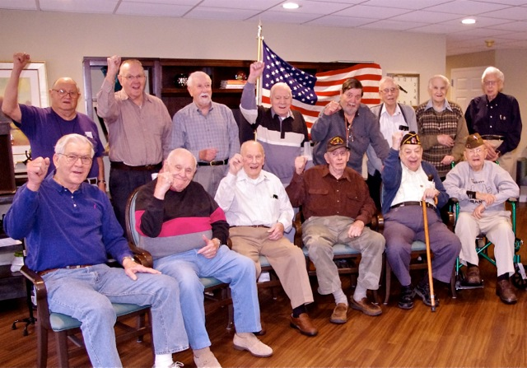
Reducing Stigma and Building Support
Objective 2: To reduce the stigma surrounding mental health and foster a supportive environment for veterans.
The power of support (Beehler et al., 2021):
Support networks provide a sense of belonging to veterans promoting their mental wellbeing.
Shows our veterans that seeking help is a sign of strength, not weakness.
Ways of Challenging stigma:
Share stories of veterans who have overcome health challenges to inspire others in similar situations.
Challenges the stereotypes and misconceptions surrounding mental health among veterans.
Encourage compassion and understanding towards veterans.

Slide 6

Connecting Veterans to Resources
Objective 3: Provide resource and interventions that can make a difference in the lives of veterans facing mental health challenges.
Available Resources:
Connect veterans to mental health services, support organizations and hotlines dedicated to their welfare.
Promote awareness of veteran-specific programs such as veteran support groups (Na et al., 2022).
Promote access to evidence based treatment for conditions like PTSD, anxiety and depression.

Slide 7

Conclusion: “Together, We Can Make a difference
Suicide prevention among veterans is an issue that requires our input and action.
We can make a positive impact and save the lives of veterans through raising awareness, reducing stigma and taking collective action towards the prevention of suicide.
Call to Action:
Join the fight against veteran suicide.
Give a listening ear, provide support.
United we can make a difference to ensure that no veteran feels alone in their struggle.

Slide 8
References
Beehler, S., LoFaro, C., Kreisel, C., Dorsey Holliman, B., & Mohatt, N. V. (2021). Veteran peer suicide prevention: A community‐based peer prevention model. Suicide and Life-Threatening Behavior, 51(2), 358–367. https://doi.org/10.1111/sltb.12712
Carroll, D., Kearney, L. K., & Miller, M. A. (2020). Addressing Suicide in the Veteran Population: Engaging a Public Health Approach. Frontiers in Psychiatry, 11. https://doi.org/10.3389/fpsyt.2020.569069
Na, P. J., Tsai, J., Southwick, S. M., & Pietrzak, R. H. (2022). Provision of social support and mental health in U.S. military veterans. Npj Mental Health Research, 1(1). https://doi.org/10.1038/s44184-022-00004-9
Ramchand, R. (2022). Suicide Among Veterans: Veterans’ Issues in Focus. Rand Health Quarterly, 9(3), 21. https://www.ncbi.nlm.nih.gov/pmc/articles/PMC9242579/

