Slide 1
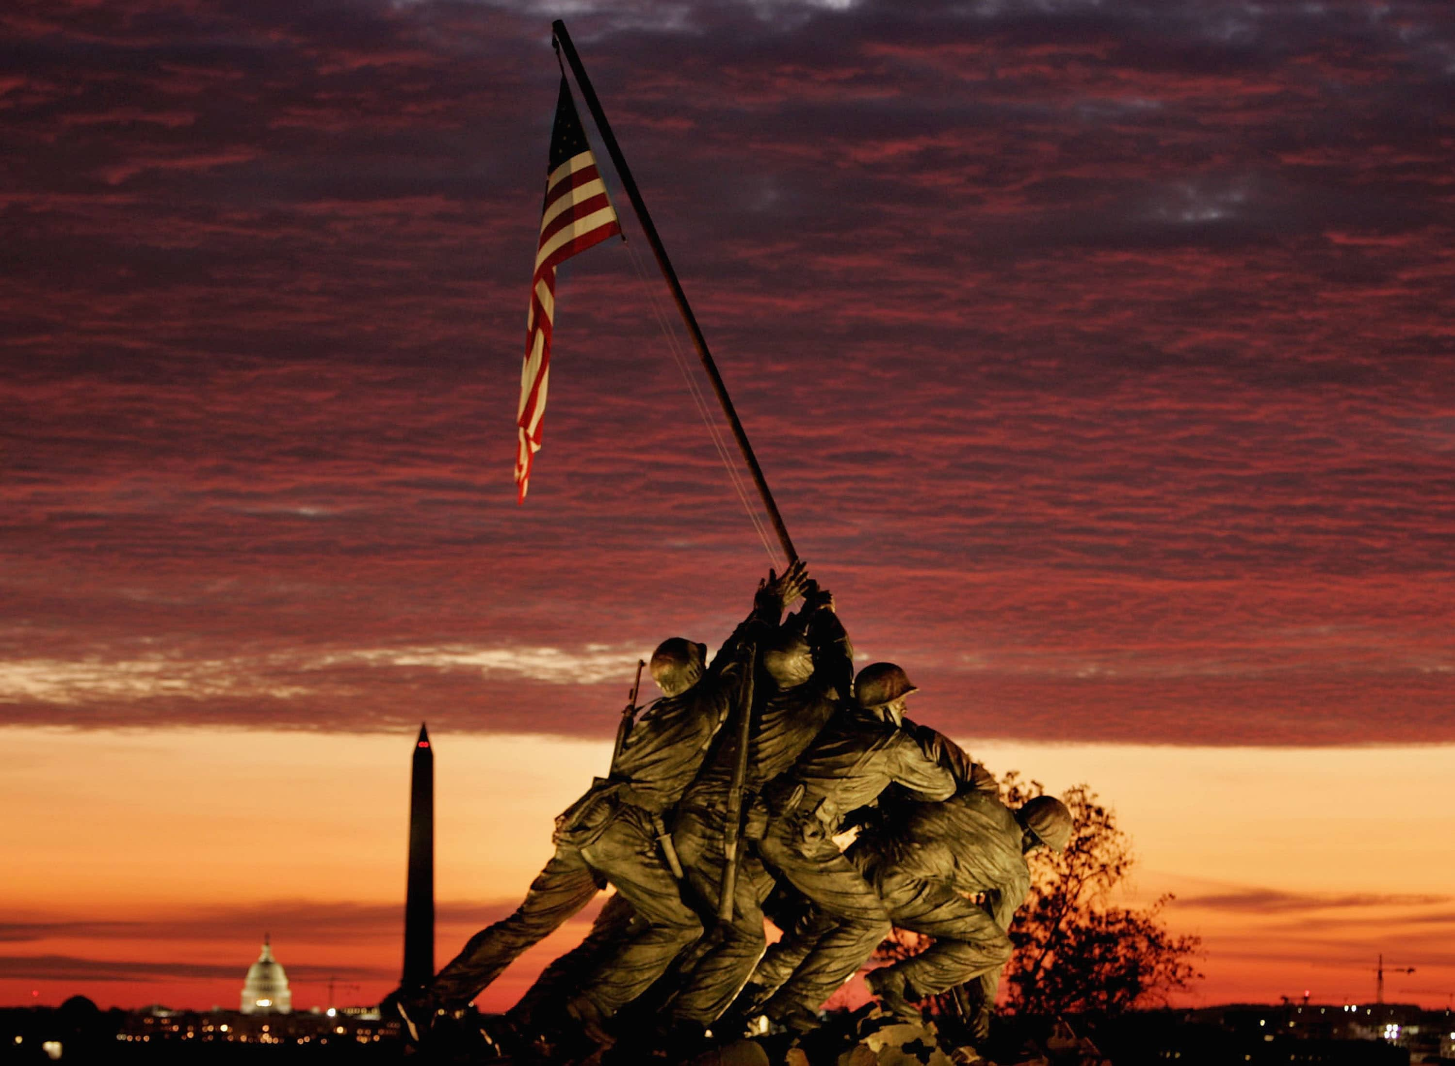
Suicide Prevention Among Veterans: Taking Action, Saving Lives

Slide 2

Addressing The Crisis of Veteran Suicides
Each day we lose brave men and women who have served this great country to suicide.
Did You know?
We lose approximately 6,000 veterans to suicide annually (Ramchand, 2022).
Veterans have a 57% higher risk of committing suicide, 1.5× higher than the national average.
Behind each statistic, there is a life lost, a family shattered and a community left in grief.
Its time to unite and make a difference in the lives of veterans.
Notes:
In the United States, suicide is among the top ten concerns related to top health and also a major cause of death. Despite various measures being implemented to reduce the suicide rates, the rates have been on the rise in the past decade (Ramchand, 2022).
Specifically, the men and women who have served in this country are disproportionally affected by the suicide rates.
Various governmental organizations such as Department of Veterans Affairs (VA) have recognized this crisis and has made it its first clinical priority (Ramchand, 2022).
The rate of suicide is significantly high among veterans (32 per 100,000) compared to non-veterans (17.2 per 100, 000) (Ramchand, 2022).

Slide 3

Understanding Our Veterans
Although veterans have served our country with honor, they often carry unseen burdens.
Risk Factors to Veteran suicide include (Caroll et al., 2020):
Post-traumatic stress disorder and combat-related trauma.
Challenges transitioning from Military to civilian life.
Substance abuse and mental health disorders.
Protective Factors that can support veterans’ mental health include (Ramchand, 2022):
Providing a strong social support through family, friends and fellow veterans.
Providing access to mental healthcare services for veterans.
Providing meaning employment.
Notes:
Despite veterans having dedicated their lives for the country, there are several factors that put them at higher risk of committing suicide than the general population.
Veterans are at a higher risk of developing mental-related illnesses such as combat-related post-traumatic stress disorder that is commonly associated with behaviors such as alcoholism and depression that further increase the suicide risk especially for those who have been wounded in the war (Caroll et al., 2020).
Furthermore, veterans find it challenging transitioning from military to civilian life because of poor psychosocial support such as the presence of adequate family income, marital support and a stable place to live (Caroll et al., 2020).
Their familiarity and availability of firearms makes it easy for them to execute their suicidal thoughts.

Slide 4

Raising Awareness and Breaking Silence
Objective 1: The first objective is to raise awareness about the signs of suicide and encourage veterans to open up on matters relating to mental health.
Relevance of Awareness (Carioll et al.,2020; Wasserman et al., 2020):
To help the general public identify early warning signs and provide timely support for veterans.
To create a safe space for veterans to discuss their mental health issues openly.
Key messages:
Learn the signs
Speak up
Educate others
Notes:
Increased awareness among the general public has been shown to reduce the suicide rates in the society.
Wasserman et al., (2020) highlights that strategies like increased awareness of self-care strategies through the media and the internet can help in the development of self-care strategies and positive coping.
Community-based programs increases the general public knowledge relating to suicide and mental health thereby promoting help-seeking behaviors, removing barriers to mental care and highlighting the relevance of providing both social and psychosocial support to veterans (Wasserman et al., 2020).
Community-based campaigns helps the general public to understand the situations veterans have gone through thereby helping them to understand different signs of suicidal ideation and give them support.

Slide 5
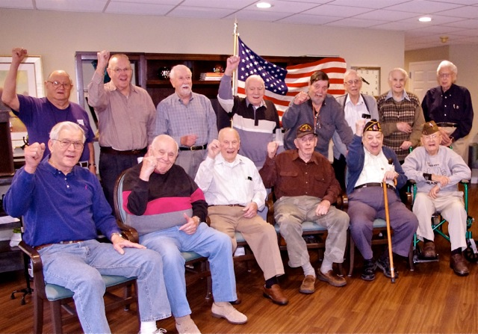
Reducing Stigma and Building Support
Objective 2: To reduce the stigma surrounding mental health and foster a supportive environment for veterans.
The power of support (Beehler et al., 2021):
Support networks provide a sense of belonging to veterans promoting their mental wellbeing.
Shows our veterans that seeking help is a sign of strength, not weakness.
Ways of Challenging stigma:
Share stories of veterans who have overcome health challenges to inspire others in similar situations.
Challenges the stereotypes and misconceptions surrounding mental health among veterans.
Encourage compassion and understanding towards veterans.
Notes:
Public stigma surrounding mental health and lack of support for veterans can lead to a higher suicidal ideation.
According to Ammerman et al., (2022), public stigma towards mental health problems is linked to negative personal and societal outcomes.
Public stigma may make veterans who have mental health problems develop limited help seeking behaviors, internalize stigmatizing beliefs (self-stigma), social isolation making it a common barrier in the development of help-seeking behaviors.
Thereby challenging this stigma by encouraging them to seek help, encouraging them to share their stories and promoting understanding towards veterans in the community can help them speak out thereby addressing mental health issues and suicide.

Slide 6

Connecting Veterans to Resources
Objective 3: Provide resource and interventions that can make a difference in the lives of veterans facing mental health challenges.
Available Resources:
Connect veterans to mental health services, support organizations and hotlines dedicated to their welfare.
Promote awareness of veteran-specific programs such as veteran support groups (Na et al., 2022).
Promote access to evidence based treatment for conditions like PTSD, anxiety and depression.
Notes:
Ensuring that there are sufficient resources and interventions for veterans who are experiencing mental health challenges can help reduce the suicide rates significantly.
There are various resources that are available for veterans to address their mental health challenges provided by different governmental institutions.
Through My VA access initiative, veterans can now gain same day mental health services access as part of their primary care which promotes timeliness of service delivery and also reduces stigma associated with mental health issues (Caroll et al., 2020).
Also, the veterans crisis line promotes same day access to services at VA facilities and helps connect veterans in crisis with qualified, caring VA responders through a confidential toll-free hotline.
Informing veterans of the existence of such services can help make a difference in the lives of veterans.

Slide 7

Conclusion: “Together, We Can Make a difference
Suicide prevention among veterans is an issue that requires our input and action.
We can make a positive impact and save the lives of veterans through raising awareness, reducing stigma and taking collective action towards the prevention of suicide.
Call to Action:
Join the fight against veteran suicide.
Give a listening ear, provide support.
United we can make a difference to ensure that no veteran feels alone in their struggle.
Notes:
As demonstrated, suicide among veterans is an issue that needs our collective efforts to minimize it. Everyone in the community has a role to play in ensuring that we prevent and create awareness of mental health issues and suicide among veterans.
Through actions such as raising awareness through community-based programs and other initiatives, reducing stigma, taking action towards preventing suicide among veterans and connecting them to the available resources for mental health prevention and help in issues related to life.
Some of the actions that we can all take to address this menace includes joining the fight for veteran suicide through giving a listening ear and providing support in any way that we can.

Slide 8
References
Ammerman, B. A., Piccirillo, M. L., O’Loughlin, C. M., Carter, S. P., Matarazzo, B., & May, A. M. (2022). The role of suicide stigma in self-disclosure among civilian and veteran populations. Psychiatry Research, 309, 114408. https://doi.org/10.1016/j.psychres.2022.114408
Beehler, S., LoFaro, C., Kreisel, C., Dorsey Holliman, B., & Mohatt, N. V. (2021). Veteran peer suicide prevention: A community‐based peer prevention model. Suicide and Life-Threatening Behavior, 51(2), 358–367. https://doi.org/10.1111/sltb.12712
Carroll, D., Kearney, L. K., & Miller, M. A. (2020). Addressing Suicide in the Veteran Population: Engaging a Public Health Approach. Frontiers in Psychiatry, 11. https://doi.org/10.3389/fpsyt.2020.569069
Na, P. J., Tsai, J., Southwick, S. M., & Pietrzak, R. H. (2022). Provision of social support and mental health in U.S. military veterans. Npj Mental Health Research, 1(1). https://doi.org/10.1038/s44184-022-00004-9
Ramchand, R. (2022). Suicide Among Veterans: Veterans’ Issues in Focus. Rand Health Quarterly, 9(3), 21. https://www.ncbi.nlm.nih.gov/pmc/articles/PMC9242579/
Wasserman, D., Iosue, M., Wuestefeld, A., & Carli, V. (2020). Adaptation of evidence‐based suicide prevention strategies during and after the COVID‐19 pandemic. World Psychiatry, 19(3), 294–306. https://doi.org/10.1002/wps.20801

