Slide 1

Introduction
Palliative Medicine: Relief of Suffering and Integration of Hope
Baptist Memorial Hospital, Memphis
August 2017-Present
Baptist Memorial Hospital, Desoto
Oct 2022-present
Brett Snodgrass, FNP-C,ACHPN,
Operations Director of Palliative Medicine, BMG

Slide 2
Definition of Palliative Medicine
Palliative Medicine focuses on improving quality of life by
reducing the suffering from physical symptoms
addressing the stress of serious illness
and providing this care to patients and families at any stage of the disease process.

Slide 3
Criteria for Identifying Appropriate Palliative Care Consults
Advanced disease process with severe organ dysfunction and poor quality of life
In a patient with a life-limiting illness
Persistent, moderate to severe pain not responding to current therapy
Other distressing symptoms for > 24 hours not responding to current therapies
Patient with uncontrolled psychosocial or spiritual issues
Sepsis with multi-system organ failure after 3 days, declining despite current supportive therapies
Patient is in an ICU setting with a documented poor prognosis
Acute neurologic injuries requiring ICU support
Post cardiopulmonary arrest with CNS damage
AMI not responding to therapy or unable to undergo therapy
Advanced Heart failure (NYHA IV symptoms)
Advanced dementia with comorbid condition requiring hospitalization
Stage IV malignancy or newly diagnosed cancer
Medical team/patient/family needing help with complex decision-making and determination of goals of care
Requested by patient or surrogate

Slide 4
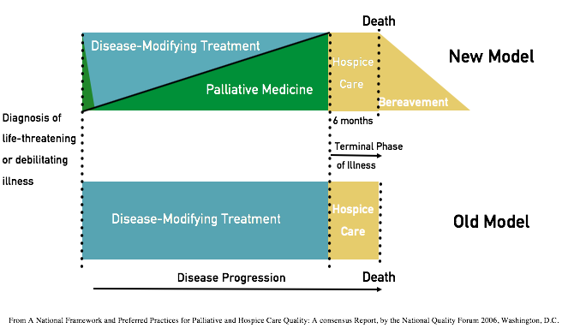
Concurrent Palliative Care Model
Notes:
In the past here at the bottoms you can see in the Old Model, the medical approach was curative therapies until all resources were exhausted or disease progression entered the terminal phase at which point hospice was initiated. In the New model, the important points are that palliative medicine begins at diagnosis and would address the increased psych-social and/or existential stress that accompanies a new diagnosis. The palliative care in the new model then shifts to intermittent follow up while disease treatment progresses but as the illness progresses the palliative interventions and needs increase as well. Both teams still maintain a relationship with the patient during the illness but the emphasis shifts from: How can we add more days to your life to how can we add more life to your days? Hospice, again, is palliative care during the projected last six months of life.

Slide 5
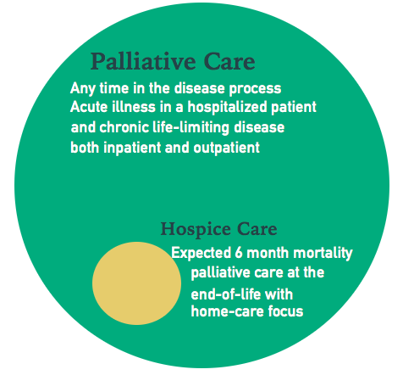
Palliative Care verses Hospice Care
Notes:
Lets look at some visual representations of palliative and hospice. Hospice is a subsystem of palliative medicine.

Slide 6
A Typical Palliative Inpatient Consult Includes
Goals of Care : What have you heard the doctors say about your illness? What are you hoping for?
Symptom management: What makes a good day for you?
Code Status/ Advance Care Planning: If you ever could not talk for yourself, who would you want to speak for you?
Quality of Life: What matters most to you?
Shared Medical Decision Making: What is the main medical decision that you and the medical team are facing?
Spiritual Assessment/ Existential Concerns: Where do you find your strength? Are you at peace?
Information Sharing: How do you and your family like to receive information?
Legacy Building: What do you want your loved ones to know?

Slide 7
Evidence for the Benefit of Palliative Medicine
The Temel study in oncology was a RCT of patients with Metastatic Non Small Cell Lung Cancer that compared usual care to early palliative consultations showed : increased survival (11.6 months vs. 8.9 months, P=0.02) and improvements in both quality-of-life and mood as compared with patients receiving standard care.
(Temel JS, et al. Early palliative care for patients with metastatic non-small-cell lung cancer. NEJM 2010;363(8),733-742)
The PAL-HF study was a randomized, controlled clinical trial of a palliative care intervention in HF patients that provides empirical evidence that palliative care improved health-related quality of life and shows the significant clinical benefit of embedding a palliative intervention in the overall management of patients with advanced heart failure with no increase in mortality.
(Rodgers,J.G.,MD, et,al, Palliative Care in Heart Failure, Pall-HF, J Am Coll Cardiol 2017;70:331-41)
In a meta-analysis of 84 studies from 1980-2009 which Compared Specialized Palliative Care to conventional care alone, significant improvements clinically were seen in: Pain Control, Improvement Non-pain symptoms, and patient/ family satisfaction
(Higginson et al, JPSM, 2010, Higginson et al, JPSM, 2003; Finlay et al, Ann Oncol 2002; Higginson et al, JPSM 2002.)

Slide 8
Overarching Goal
While all medicine seeks to add more days to a patient’s life, palliative medicine seeks to simultaneously add more life to every day a patient lives.

