Slide 1
Clinician-Patient Interviews: Prescriptions – To Fill or Not to Fill?
Notes:
Suggested script/talking points:
Introduction of the program

Slide 2
Introductions
Notes:
Suggested script/talking points:
Introduce Faculty

Slide 3
Learning Objectives
By the end of this session students will be able to:
Determine course of action regarding providing an early refill of opioid medication to patients presenting with different medical history and physical examination information
Critique the assessment and care of patients with pain and/or substance use disorders such as opioids based on three different physician-patient interactions presented
Describe the impact that physician biases have on patient care and medical decision-making
Notes:
Suggested script/talking points:
Read learning objectives

Slide 4

Door Note
Dr. Melvin Cullen completed residency training in Family Medicine 25 years ago and has recently taken over a suburban Primary Care practice from a retiring colleague this past July. It will take some time before Dr. Cullen gets a chance to meet with each patient, and it is becoming clear to him that this practice (as with many other primary care practices around the country) has a significantly large number of patients with chronic pain, many of whom are being treated with chronic opioid analgesic therapy.
Well aware of the opioid overdose epidemic facing our country today, Dr. Cullen keeps himself well-informed about current controversies regarding “liberal” prescribing of opioids in the past, the lack of good scientific evidence for long-term opioid analgesic therapy and has received a significant amount of continuing medical education regarding best practices for safe prescribing of opioids in a Primary Care setting. Because of concern regarding patient safety and potential regulatory scrutiny, many fellow Primary Care colleagues in his community are of the mindset that except for rare situations, it might be best from a liability perspective to “avoid prescribing opioids altogether”.
Image by Rawpixel, retrieved from https://www.rawpixel.com/image/3150736/premium-photo-psd-surgeon-doctor-gown-adult .9/17/2021. Royalty-free photo.
Notes:
Suggested script/talking points:
Read Door Note introducing Dr. Cullen
Emphasize:
Dr. Cullen is new to the practice and is making an earnest attempt to meet each patient, discovering that many patients in this Primary Care Practice are being treated for chronic pain with long-term opioid analgesic therapy
Dr. Cullen considers himself to be well-informed with respect to the controversies surrounding chronic opioid therapy in a Primary Care setting
There is a mindset among many of Dr. Cullen’s colleagues in the community that except for rare situations, it might be best to avoid regulatory scrutiny and liability by avoiding prescribing opioids completely

Slide 5
Door Note
Considering himself to be experienced and knowledgeable regarding protecting himself from potential regulatory scrutiny and from patients who might be drug-seeking or portraying aberrant drug-related behaviors (e.g., misuse, abuse, addiction, and diversion), Dr. Cullen has formulated his own opinions regarding his ability to “use his gut” to guide him in safe opioid prescribing, in addition to using information gathered during assessment, including a history and physical examination to assess risk of opioid prescribing on a case by case basis. In his opinion, he has a clear understanding of what would be potential “red flags” and considers himself to be a prudent prescriber with a high level of competency in “sizing up patients” based on his experience and skill sets. Dr. Cullen believes that opioid analgesics are an important component of a pain treatment plan, if are they deemed necessary and are prescribed responsibly.
On this particular day of office hours, 3 long-time patients in this practice who have been treated for chronic pain with long-term opioid analgesics present with a request for early refill of their opioid pain medication (meaning that they are requesting a refill for their medication earlier than expected based on the amount last prescribed and the dosing schedule).
Image by Rawpixel, retrieved from https://www.rawpixel.com/image/3150736/premium-photo-psd-surgeon-doctor-gown-adult .9/17/2021. Royalty-free photo.
Notes:
Suggested script/talking points:
Read Door Note
Emphasize:
Dr. Cullen considers himself knowledgeable regarding protecting himself from potential regulatory scrutiny regarding opioid prescribing
Dr. Cullen “trusts his gut” to guide him in safe opioid prescribing
He has awareness about what factors into an appropriate risk/benefit analysis involving opioid prescribing
Dr. Cullen also believes that when prescribed appropriately, opioids can be an important component of a pain treatment plan
Today we will encounter 3 long-time patients in the practice presenting with a request for an early refill of their opioid analgesic

Slide 6

Patient #1 James Spiegel
James Spiegel is a 39-year-old Caucasian male who has been treated with opioid analgesics for chronic recurring back pain for the past 5 years in this practice
Image by Rawpixel, retrieved from https://www.rawpixel.com/image/28198/premium-photo-image-adult-business-businessman 9/17/2021. Royalty-free photo.
Notes:
Suggested script/talking points:
Let’s meet Dr. Cullen’s first patient
James Spiegel is a 39-year-old male being treated in the practice with opioid analgesics for his back pain for the past 5 years in this practice

Slide 7
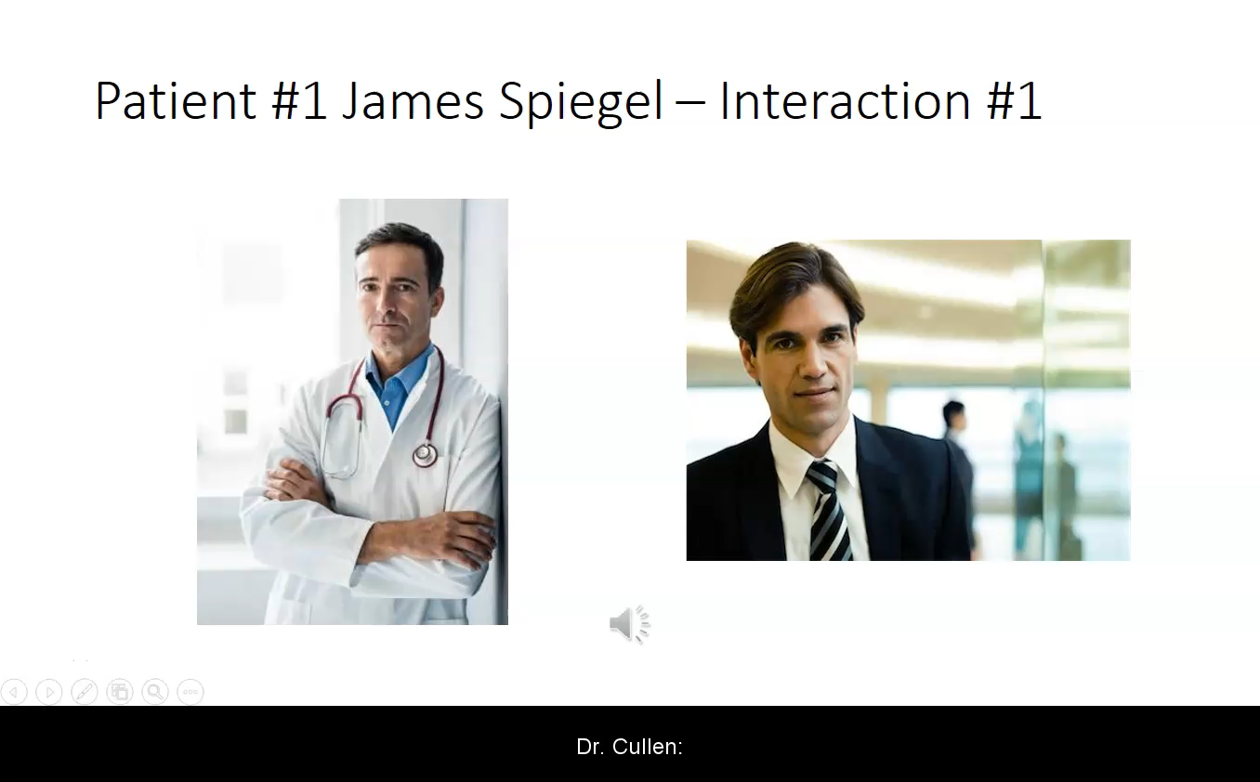
Patient interaction 1
Image by Rawpixel, retrieved from https://www.rawpixel.com/image/28198/premium-photo-image-adult-business-businessman 9/17/2021. Royalty-free photo.
Image by Rawpixel, retrieved from https://www.rawpixel.com/image/3150736/premium-photo-psd-surgeon-doctor-gown-adult .9/17/2021. Royalty-free photo.
Notes:
Suggested script/talking points:
Let’s listen to the first interaction between Dr. Cullen and Mr. Spiegel
Play the audio file

Slide 8
Past Medical History and Physical Examination
Review of the medical record reveals:
Prior comprehensive testing substantiates the diagnosis of multiple, symptomatic “bulging” lumbar discs
Medical history is positive for:
  Tobacco use (2 packs/day x 19 years)
  Alcohol consumption (between 2-5 drinks in an average day x 15 years)
  Periodic insomnia treated with Ambien® as needed
Social history:
  Employed as a hedge fund manager (states that he is very “successful”) for the past 10 years
  Single, engaged to be married for the past 7 years
  Functional status:
    Works out at the gym 3-4 times/week
    Plays tennis every Sunday
    Travels long-distances frequently for work
Notes:
Suggested script/talking points:
Let’s review Mr. Spiegel’s medical history and the findings of his physical examination:
Prior radiologic testing confirms the presence of multiple “bulging” lumbar discs, which are presumably responsible for his chronic back pain
His medical history is positive for:
2PPD smoker of cigarettes for the past 19 years
ETOH consumption averages between 2-5 mixed drinks or whiskey/day for the past 15 years
Periodic insomnia treated with Ambien® as needed at night for sleep
His social history reveals:
He is employed as a hedge fund manager for the past 10 years
He plays tennis every Sunday
He frequently travels long distances by air for work

Slide 9
AUDIENCE RESPONSE QUESTION #1
Which of the following would best describe your level of comfort with respect to this patient’s request for an early refill of an opioid medication?
Uncomfortable due to the current climate regarding the opioid epidemic
Somewhat uncomfortable based on this patient’s long-term opioid history and the reason for the early refill
Comfortable based on this patient’s documented pathology and medical history regarding his pain and function
Comfortable based on Dr. Cullen’s experience, education, and overall ability to detect problematic/risky patients
Notes:
Suggested script/talking points:
Audience Response Question #1
Reinforce the idea that this is “not a test” and this is just to get a perspective of the student’s impressions
Read the question and possible answers to the students, allowing enough time for all of them to select an answer with whatever response hardware/software is being utilized to capture their answers
Review the response results breakdown with the students (Best if displayed in bar graph or pie chart format)

Slide 10

Patient interaction 1
Image by Rawpixel, retrieved from https://www.rawpixel.com/image/28198/premium-photo-image-adult-business-businessman 9/17/2021. Royalty-free photo.
Image by Rawpixel, retrieved from https://www.rawpixel.com/image/3150736/premium-photo-psd-surgeon-doctor-gown-adult .9/17/2021. Royalty-free photo.
Notes:
Suggested script/talking points:
Let’s listen to the second interaction between Dr. Cullen and Mr. Spiegel
Play the audio file

Slide 11
AUDIENCE RESPONSE QUESTION #2
Which of the following best describes your course of action regarding providing an early refill of opioid medication to this patient?
Comfortable and would likely provide the prescription
Uncomfortable and would provide the prescription with a warning about not providing future early refill requests
More information would be needed before a refill could be provided
Under no circumstances should an early refill for these medications be provided
The patient is likely drug-seeking and should be discharged from the practice
Notes:
Suggested script/talking points:
Audience Response Question #2
Read the question and possible answers to the students, allowing enough time for all of them to select an answer with whatever response hardware/software is being utilized
Review the response results breakdown with the students (Best if displayed in bar graph or pie chart format if possible)

Slide 12
Assessment and Management Plan
Dr. Cullen’s assessment of this particular situation is that although early refill requests might sometimes be considered to be a “red flag” with respect to safe opioid prescribing and patient adherence, Mr. Spiegel seems to be a highly successful, highly functional, longstanding patient in this practice. Dr. Cullen trusts his ability to recognize someone who is medication-seeking and will likely write the prescription for the early refill.
Notes:
Suggested script/talking points:
Emphasize:
Dr. Cullen recognizes early opioid refill requests to be “red-flag behaviors” with respect to aberrant drug-related behaviors, safe prescribing, and regulatory scrutiny as well
Dr. Cullen’s impression of the situation is that Mr. Spiegel is a highly successful businessperson and highly functional capacity, along with his long-standing presence as a patient in this practice
Based on his ability to accurately identify someone with potential for displaying aberrant drug-related behavior his inclination is to likely provide the prescription for the early refill of the opioid medication

Slide 13

Image by Rawpixel, retrieved from https://www.rawpixel.com/image/3150736/premium-photo-psd-surgeon-doctor-gown-adult .9/17/2021. Royalty-free photo.
Image by Rawpixel, retrieved from https://www.rawpixel.com/image/28198/premium-photo-image-adult-business-businessman 9/17/2021. Royalty-free photo.
Notes:
Suggested script/talking points:
Let’s listen to the third interaction between Dr. Cullen and Mr. Spiegel
Play the audio file

Slide 14
AUDIENCE RESPONSE QUESTION #3
Do you think Dr. Cullen made an objective medical assessment and management plan with this patient?
Yes
No
Not sure, need more information
Notes:
Suggested script/talking points:
Audience Response Question #3
Read the question and possible answers to the students, allowing enough time for all of them to select an answer with whatever response hardware/software is being utilized
Reinforce the idea that they are being asked about Dr. Cullen’s decision, and not their impressions as medical students who might need guidance from Interns/Residents/Fellows or Attendings
Review the response results breakdown with the students (Best if displayed in bar graph or pie chart format)
If a significant % of respondents select not sure, more information needed, probe the group randomly for identification and discussion of what additional information might prove valuable to assist Dr. Cullen in his ability to make an objective decision

Slide 15

Patient #2 Darryl Whitcomb
Darryl Whitcomb is a 56-year-old African American male who has been treated with opioid analgesics in this practice for non-specific chronic neck and back pain related to a motor vehicle accident that occurred 7 years ago.
Mr. Whitcomb is typically seen every three months in the office due to the requirements of his “no-fault” insurance but presents today urgently requesting a refill for his opioid medication 3 weeks earlier than expected. He states that girlfriend and her two children recently moved in with him and “the place is upside-down” and his medication seems to be lost. He reports that without his prescription pain medication, he can barely get out of bed and certainly not be able to ride his motorcycle, which is his only form of transportation.
Image by Rawpixel, retrieved from https://www.rawpixel.com/image/2329456/premium-photo-psd-portrait-old-man-people 9/17/2021. Royalty-free photo.
Notes:
Suggested script/talking points:
Let’s meet Dr. Cullen’s second patient
Darryl Whitcomb is a 56-year-old male being treated in the practice with opioid analgesics for his neck and back pain for the past 7 years in this practice

Slide 16
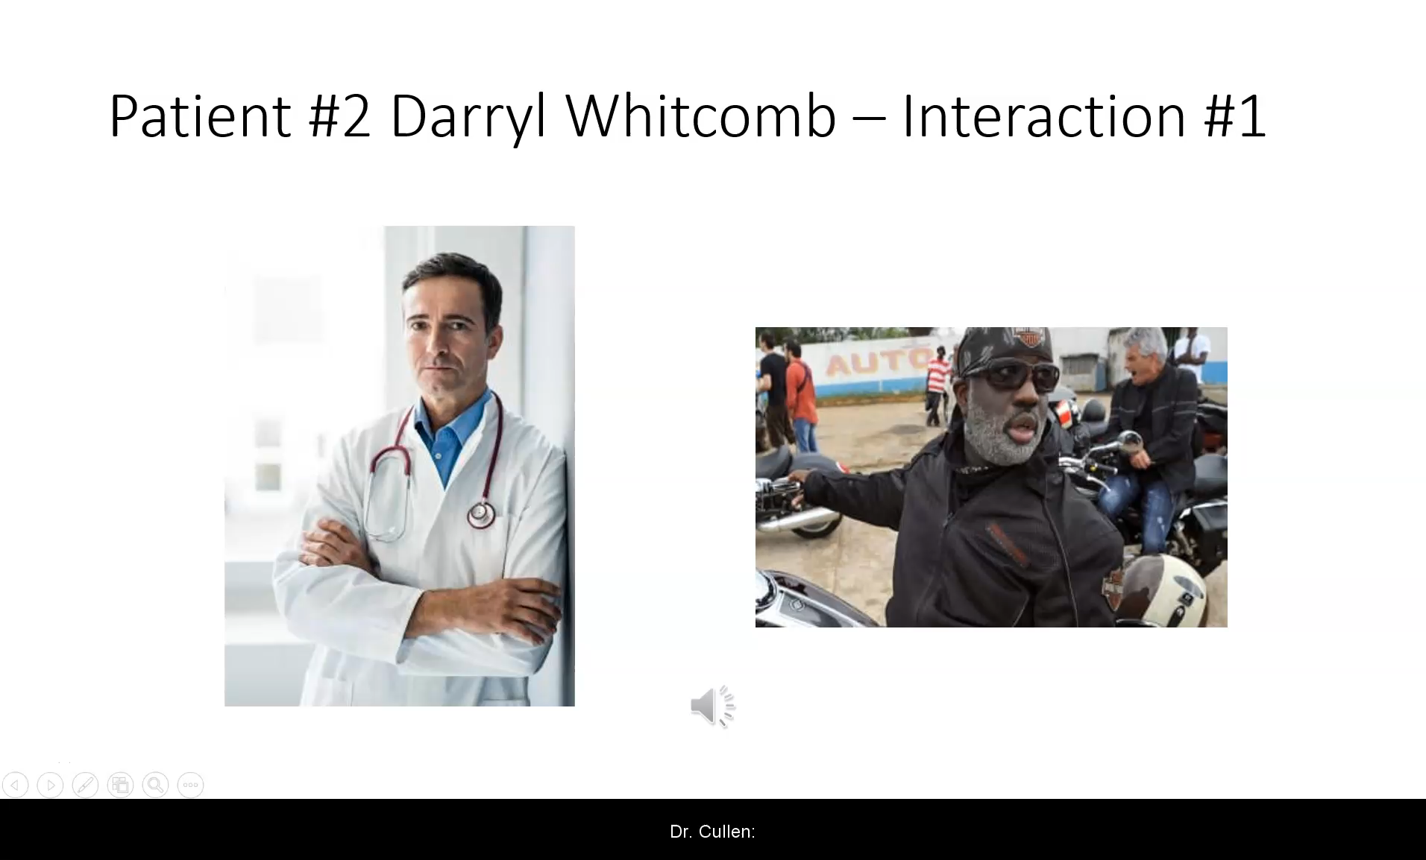
Image by Rawpixel, retrieved from https://www.rawpixel.com/image/2329456/premium-photo-psd-portrait-old-man-people 9/17/2021. Royalty-free photo.
Image by Rawpixel, retrieved from https://www.rawpixel.com/image/3150736/premium-photo-psd-surgeon-doctor-gown-adult .9/17/2021. Royalty-free photo.
Notes:
Suggested script/talking points:
Let’s listen to the first interaction between Dr. Cullen and Mr. Whitcomb
Play the audio file

Slide 17
Past Medical History and Physical Examination
Review of the medical record reveals:
Diagnostic testing inconclusive for identifying a pathophysiologic cause of the patient’s neck and back pain
The patient has been in litigation regarding the motor vehicle accident with several medical record requests by attorneys in the past 7 years
Medical history is positive for:
  Tobacco use (2-3 packs/day x 40 years)
  Alcohol consumption (3-6 beers/day for “years”)
  Hypertension treated with diuretic and beta-blocker
  Overweight (BMI 29.9)
  Elevated liver enzymes
  Frequent urinary tract infections
Social history:
  Sporadic employment
  Divorced with 5 children
  Does not participate in regular exercise
  “Has a girlfriend who just moved in with him for the next two years”
Notes:
Suggested script/talking points:
Let’s review Mr. Whitcomb’s medical history and the findings of his physical examination:
Diagnostic radiologic testing in the past has been inconclusive for identifying pathology responsible for Mr. Whitcomb’s chronic pain
The patient has been involved in legal proceedings since his motor vehicle accident, which is considered to be the triggering event of his pain
His medical history is positive for:
2-3 PPD smoker of cigarettes for the past 40 years
ETOH consumption averaging between 3-6 beers/day for “years”
Hypertension treated with:
Beta Blocker
Diuretic
Overweight – BMI 29.9
Elevated liver enzymes (chronic)
Frequent urinary tract infections
His social history reveals:
Sporadic employment/unemployment
Divorced with 5 children
His “girlfriend just moved in with him for the next two years”
He does not engage in regular exercise

Slide 18
AUDIENCE RESPONSE QUESTION #1
Which of the following would best describe your level of comfort with respect to this patient’s request for an early refill of an opioid medication?
Uncomfortable due to the current climate regarding the opioid epidemic
Somewhat uncomfortable based on this patient’s long-term opioid history and the reason for the early refill
Comfortable based on this patient’s documented pathology and medical history regarding his pain and function
Comfortable based on Dr. Cullen’s experience, education, and overall ability to detect problematic/risky patients
Notes:
Suggested script/talking points:
Audience Response Question #1
Reinforce the idea that this is “not a test” and this is just to get a perspective of the student’s impressions
Read the question and possible answers to the students, allowing enough time for all of them to select an answer with whatever response hardware/software is being utilized to capture their answers
Review the response results breakdown with the students (Best if displayed in bar graph or pie chart format)

Slide 19

Image by Rawpixel, retrieved from https://www.rawpixel.com/image/2329456/premium-photo-psd-portrait-old-man-people 9/17/2021. Royalty-free photo.
Image by Rawpixel, retrieved from https://www.rawpixel.com/image/3150736/premium-photo-psd-surgeon-doctor-gown-adult .9/17/2021. Royalty-free photo.
Notes:
Suggested script/talking points:
Let’s listen to the second interaction between Dr. Cullen and Mr. Whitcomb
Play the audio file

Slide 20
AUDIENCE RESPONSE QUESTION #2
Which of the following best describes your course of action regarding providing an early refill of opioid medication to this patient?
Comfortable and would likely provide the prescription
Uncomfortable and would provide the prescription with a warning about not providing future early refill requests
More information would be needed before a refill could be provided
Under no circumstances should an early refill for these medications be provided
The patient is likely drug-seeking and should be discharged from the practice
Notes:
Suggested script/talking points:
Audience Response Question #2
Read the question and possible answers to the students, allowing enough time for all of them to select an answer with whatever response hardware/software is being utilized
Review the response results breakdown with the students (Best if displayed in bar graph or pie chart format if possible)

Slide 21
Assessment and Management Plan
Dr. Cullen’s assessment of this situation is that early refill requests are considered to be a “red flag” with respect to safe opioid prescribing and patient adherence. Additionally, he is quite concerned about the patient’s lackadaisical demeanor, and the absence of a confirmed diagnosis responsible for the pain-related complaints. Based on his “gut feeling”, he is considering refusing to write the prescription for the early refill of opioids.
Notes:
Suggested script/talking points:
Emphasize:
Dr. Cullen recognizes early opioid refill requests to be “red-flag behaviors” with respect to aberrant drug-related behaviors, safe prescribing, and regulatory scrutiny as well
Dr. Cullen is concerned about Mr. Whitcomb’s lackadaisical perspective and the absence of any confirmatory testing indicating the reason for Mr. Whitcomb’s pain
Based on his “gut feeling,” Dr. Cullen is considering refusing the request for an early refill of the opioid medication

Slide 22

Image by Rawpixel, retrieved from https://www.rawpixel.com/image/2329456/premium-photo-psd-portrait-old-man-people 9/17/2021. Royalty-free photo.
Image by Rawpixel, retrieved from https://www.rawpixel.com/image/3150736/premium-photo-psd-surgeon-doctor-gown-adult .9/17/2021. Royalty-free photo.
Notes:
Suggested script/talking points:
Let’s listen to the third interaction between Dr. Cullen and Mr. Whitcomb
Play the audio file

Slide 23
AUDIENCE RESPONSE QUESTION #3
Do you think Dr. Cullen made an objective medical assessment and management plan with this patient?
Yes
No
Not sure, need more information
Notes:
Suggested script/talking points:
Audience Response Question #3
Read the question and possible answers to the students, allowing enough time for all of them to select an answer with whatever response hardware/software is being utilized
Reinforce the idea that they are being asked about Dr. Cullen’s decision, and not their impressions as medical students who might need guidance from Interns/Residents/Fellows or Attendings
Review the response results breakdown with the students (Best if displayed in bar graph or pie chart format)
If a significant % of respondents select not sure, more information needed, probe the group randomly for identification and discussion of what additional information might prove valuable to assist Dr. Cullen in his ability to make an objective decision

Slide 24

Patient #3 Helen Morgan
Helen Morgan is a 77-year-old Caucasian female who has been treated with a stable regimen of opioid analgesics in this practice for the past 15 years to treat chronic pain in multiple joints related to advanced diffuse degenerative joint disease.
Mrs. Morgan is typically seen once every 3-6 months in the office depending on her needs but presents accompanied by her daughter today urgently requesting a refill for her opioid medication 3½ weeks earlier than expected. She states that as she gets older, she misplaces things more than she used to, and while she normally keeps all of her medications in one place for safe keeping, somehow after the weekly cleaning of her apartment, the opioid medication is “nowhere to be found”. She stresses that she lives alone, takes care of all her needs including grocery shopping, house cleaning, etc., and she feels “very embarrassed” about the request, fearing that without her pain medication, her untreated pain might leave her virtually helpless.
Image by Rawpixel, retrieved from https://www.rawpixel.com/image/415483/premium-photo-image-woman-baking-grandmother-food .9/17/2021. Royalty-free photo.
Notes:
Suggested script/talking points:
Let’s meet Dr. Cullen’s third patient
Helen Morgan is a 77-year-old female being treated in the practice with opioid analgesics for pain related to diffuse, degenerative joint disease for the past 15 years in this practice

Slide 25
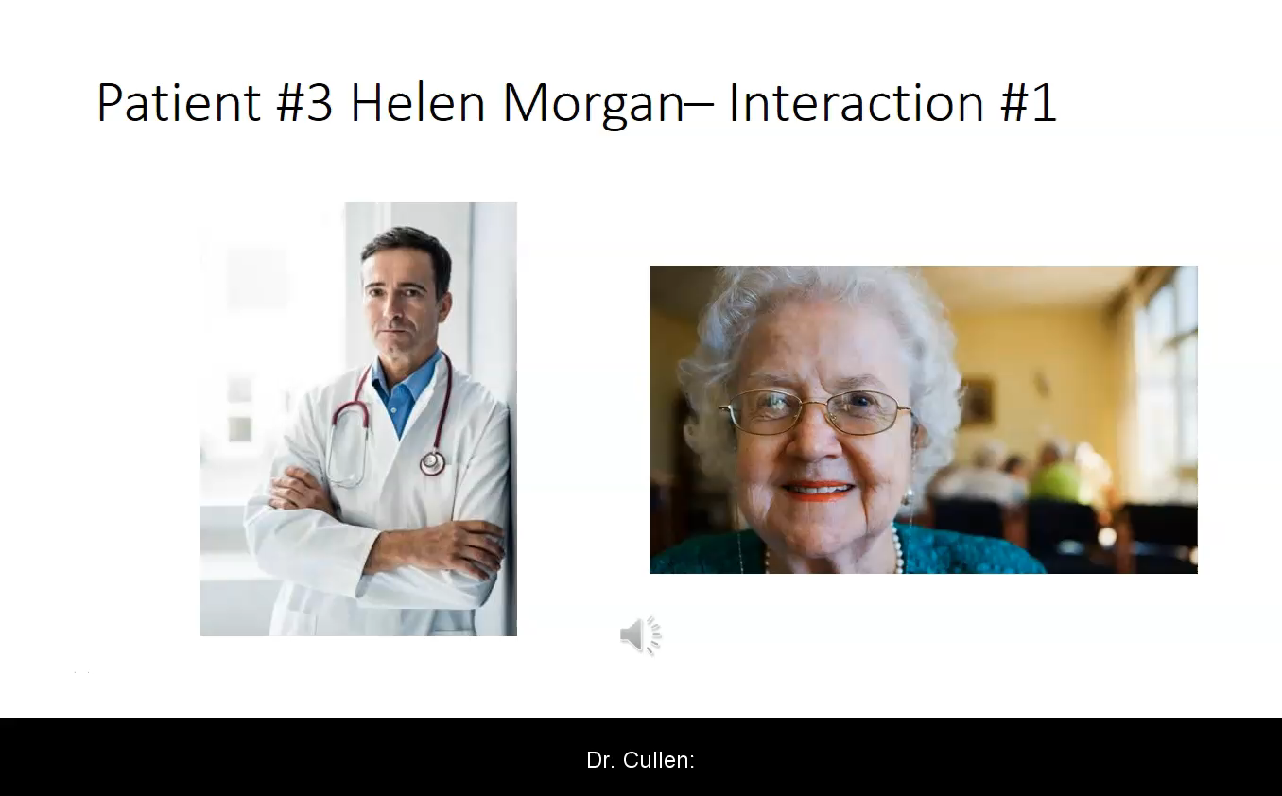
Image by Rawpixel, retrieved from https://www.rawpixel.com/image/3150736/premium-photo-psd-surgeon-doctor-gown-adult .9/17/2021. Royalty-free photo.
Image by Rawpixel, retrieved from https://www.rawpixel.com/image/415483/premium-photo-image-woman-baking-grandmother-food .9/17/2021. Royalty-free photo.
Notes:
Suggested script/talking points:
Let’s listen to the first interaction between Dr. Cullen and Mrs. Morgan
Play the audio file

Slide 26
Past Medical History and Physical Examination
Review of the medical record reveals:
Multiple radiographic studies demonstrating evidence of age-appropriate osteoarthritis and degenerative joint disease, most pronounced in the hips, knees, wrists, fingers, and shoulders
Medical history is positive for:
  Type II diabetes treated with an oral hypoglycemic
  Hypertension treated with a diuretic and calcium channel blocker
  Mild depression (since her husband of 59 years passed) treated with an antidepressant
  Asthma treated with and inhaled bronchodilator
  Iron-deficiency anemia treated with Iron
  Chronic atrial fibrillation treated with anticoagulant therapy
  Glaucoma treated with eye drops
  Moderate diabetic peripheral neuropathy treated with an anticonvulsant
  Mild to moderate hearing impairment treated with hearing aids
Social history:
  Retired
  Widowed
  Lives alone
  Exercise limited to walking, which she does daily
  One child
    Daughter age 54 (present in waiting area)
Notes:
Suggested script/talking points:
Let’s review Mrs. Morgan’s medical history and the findings of her physical examination:
Diagnostic radiologic testing in the past has demonstrated evidence of age-appropriate osteoarthritis and degenerative joint disease, most pronounced in the hips, knees, shoulders, wrists, and fingers
Her medical history is positive for:
Type II diabetes treated with an oral hypoglycemic
Hypertension treated with a diuretic and calcium channel blocker
Mild depression (since her husband of 59 years passed) treated with an antidepressant
Asthma treated with and inhaled bronchodilator
Iron-deficiency anemia treated with Iron
Chronic atrial fibrillation treated with anticoagulant therapy
Glaucoma treated with eye drops
Moderate diabetic peripheral neuropathy treated with an anticonvulsant
Mild to moderate hearing impairment treated with hearing aids
His social history reveals:
She is a retired
She is widowed
She lives alone and cares for herself
Her exercise is limited to walking, which she does daily
She has one child, a daughter age 54 (who is present in the waiting are during this visit)

Slide 27
AUDIENCE RESPONSE QUESTION #1
Which of the following would best describe your level of comfort with respect to this patient’s request for an early refill of an opioid medication?
Uncomfortable due to the current climate regarding the opioid epidemic
Somewhat uncomfortable based on this patient’s long-term opioid history and the reason for the early refill
Comfortable based on this patient’s documented pathology and medical history regarding his pain and function
Comfortable based on Dr. Cullen’s experience, education, and overall ability to detect problematic/risky patients
Notes:
Suggested script/talking points:
Audience Response Question #1
Reinforce the idea that this is “not a test” and this is just to get a perspective of the student’s impressions
Read the question and possible answers to the students, allowing enough time for all of them to select an answer with whatever response hardware/software is being utilized to capture their answers
Review the response results breakdown with the students (Best if displayed in bar graph or pie chart format)

Slide 28

Image by Rawpixel, retrieved from https://www.rawpixel.com/image/3150736/premium-photo-psd-surgeon-doctor-gown-adult .9/17/2021. Royalty-free photo.
Image by Rawpixel, retrieved from https://www.rawpixel.com/image/415483/premium-photo-image-woman-baking-grandmother-food .9/17/2021. Royalty-free photo.
Notes:
Suggested script/talking points:
Let’s listen to the second interaction between Dr. Cullen and Mrs. Morgan
Play the audio file

Slide 29
AUDIENCE RESPONSE QUESTION #2
Which of the following best describes your course of action regarding providing an early refill of opioid medication to this patient?
Comfortable and would likely provide the prescription
Uncomfortable and would provide the prescription with a warning about not providing future early refill requests
More information would be needed before a refill could be provided
Under no circumstances should an early refill for these medications be provided
The patient is likely drug-seeking and should be discharged from the practice
Notes:
Suggested script/talking points:
Audience Response Question #2
Read the question and possible answers to the students, allowing enough time for all of them to select an answer with whatever response hardware/software is being utilized
Review the response results breakdown with the students (Best if displayed in bar graph or pie chart format if possible)

Slide 30
Assessment and Management Plan
Dr. Cullen’s assessment of this situation is that early refill requests may be considered to be a “red flag” with respect to safe opioid prescribing and patient adherence. In this case, he is more concerned with age-related issues regarding medication adherence and potential lapses in medications that need to be taken for the myriad of medical conditions plaguing this patient. Based on “gut feeling”, he is considering writing the prescription for the early refill, with a gentle statement about his concerns.
Notes:
Suggested script/talking points:
Emphasize:
Dr. Cullen recognizes early opioid refill requests to be “red-flag behaviors” with respect to aberrant drug-related behaviors, safe prescribing, and regulatory scrutiny as well
Dr. Cullen is most concerned about Mrs. Morgan’s ability to maintain adherence to her opioid regimen along with the many other medications she takes for her other medical conditions
Based on his “gut feeling,” Dr. Cullen is agreeing to the request for an early refill of the opioid medication with a gentle statement to Mrs. Morgan about his concerns and the risk of taking an opioid medication other than as directed

Slide 31

Image by Rawpixel, retrieved from https://www.rawpixel.com/image/3150736/premium-photo-psd-surgeon-doctor-gown-adult .9/17/2021. Royalty-free photo.
Image by Rawpixel, retrieved from https://www.rawpixel.com/image/415483/premium-photo-image-woman-baking-grandmother-food .9/17/2021. Royalty-free photo.
Notes:
Suggested script/talking points:
Let’s listen to the third interaction between Dr. Cullen and Mrs. Morgan
Play the audio file

Slide 32
AUDIENCE RESPONSE QUESTION #3
Do you think Dr. Cullen made an objective medical assessment and management plan with this patient?
Yes
No
Not sure, need more information
Notes:
Suggested script/talking points:
Audience Response Question #3
Read the question and possible answers to the students, allowing enough time for all of them to select an answer with whatever response hardware/software is being utilized
Reinforce the idea that they are being asked about Dr. Cullen’s decision, and not their impressions as medical students who might need guidance from Interns/Residents/Fellows or Attendings
Review the response results breakdown with the students (Best if displayed in bar graph or pie chart format)
If a significant % of respondents select not sure, more information needed, probe the group randomly for identification and discussion of what additional information might prove valuable to assist Dr. Cullen in his ability to make an objective decision

Slide 33
AUDIENCE RESPONSE QUESTION #4
Which, if any of the three patients presented do you think was drug-seeking?
James Spiegel
Darryl Whitcomb
Helen Morgan
All of them
None of them
Notes:
Suggested script/talking points:
Audience Response Question #4
Read the question and possible answers to the students, allowing enough time for all of them to select an answer with whatever response hardware/software is being utilized
Reinforce the idea that they are being asked about their impressions regarding drug-seeking behavior
Review the response results breakdown with the students (Best if displayed in bar graph or pie chart format)

Slide 34
Follow-Up
Notes:
Title Slide

Slide 35

Image by Rawpixel, retrieved from https://www.rawpixel.com/image/3150736/premium-photo-psd-surgeon-doctor-gown-adult .9/17/2021. Royalty-free photo.
Image by Rawpixel, retrieved from https://www.rawpixel.com/image/28198/premium-photo-image-adult-business-businessman 9/17/2021. Royalty-free photo.
Notes:
Suggested script/talking points:
In finalizing his plan regarding whether to provide the early refill request, Dr.
Cullen is reminded about the beneficial role that urine toxicology screening can make in both affirming his “gut feeling” and documenting safe practices regarding opioid prescribing
Let’s listen to the follow-up interaction between Dr. Cullen and Mr. Spiegel
Play the audio file

Slide 36

Image by Rawpixel, retrieved from https://www.rawpixel.com/image/2329456/premium-photo-psd-portrait-old-man-people 9/17/2021. Royalty-free photo.
Image by Rawpixel, retrieved from https://www.rawpixel.com/image/3150736/premium-photo-psd-surgeon-doctor-gown-adult .9/17/2021. Royalty-free photo.
Notes:
Suggested script/talking points:
In finalizing his plan regarding whether to provide the early refill request, Dr. Cullen is reminded about the beneficial role that urine toxicology screening can make in both affirming his “gut feeling” and documenting safe practices regarding opioid prescribing
Let’s listen to the follow-up interaction between Dr. Cullen and Mr. Whitcomb
Play the audio file

Slide 37
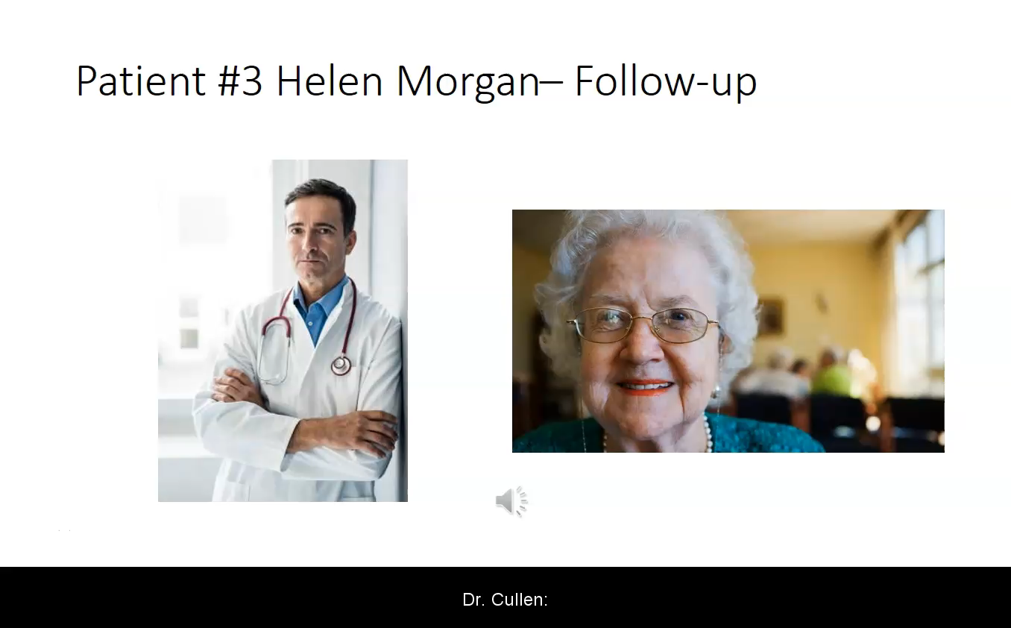
Image by Rawpixel, retrieved from https://www.rawpixel.com/image/3150736/premium-photo-psd-surgeon-doctor-gown-adult .9/17/2021. Royalty-free photo.
Image by Rawpixel, retrieved from https://www.rawpixel.com/image/415483/premium-photo-image-woman-baking-grandmother-food .9/17/2021. Royalty-free photo.
Notes:
Suggested script/talking points:
In finalizing his plan regarding whether to provide the early refill request, Dr. Cullen is reminded about the beneficial role that urine toxicology screening can make in both affirming his “gut feeling” and documenting safe practices regarding opioid prescribing
Let’s listen to the follow-up interaction between Dr. Cullen and Mrs. Morgan
Play the audio file

Slide 38
Urine Toxicology Results
Notes:
Title Slide

Slide 39
Patient #1 James Spiegel
Urine toxicology results showed the following:
Positivity for metabolites of the prescribed opioid indicating consumption of doses higher than prescribed
Cannabis
Cocaine
Positivity of metabolites for one unprescribed opioid analgesic
Notes:
Suggested script/talking points:
Mr. Spiegel’s urine toxicology results showed:
Positivity for the prescribed opioid metabolites at levels higher than expected, indicating likely consumption of dosages higher than prescribed
Positivity for cannabis, indicating marijuana or similar substance use
Positivity for cocaine use
Positivity for metabolites of an unprescribed opioid, indicating that he was also taking an unprescribed opioid in addition to his prescriber opioid

Slide 40
Patient #2 Darryl Whitcomb
Urine toxicology results showed the following:
Positivity for metabolites of the prescribed opioid indicating doses taken at intervals and doses as prescribed
No other substances present
Image by Rawpixel, retrieved from https://www.rawpixel.com/image/2329456/premium-photo-psd-portrait-old-man-people 9/17/2021. Royalty-free photo.
Notes:
Suggested script/talking points:
Mr. Whitcomb’s urine toxicology results showed:
Positivity for the prescribed opioid metabolites at expected levels, indicated adherence to the prescribed opioid regimen

Slide 41
Patient #3 Helen Morgan
Urine toxicology results showed the following:
No metabolites detected indicating that the patient was not taking her prescribed opioid
No other substances present
Image by Rawpixel, retrieved from https://www.rawpixel.com/image/415483/premium-photo-image-woman-baking-grandmother-food .9/17/2021. Royalty-free photo.
Notes:
Suggested script/talking points:
Mrs. Morgan’s urine toxicology results showed:
No presence of any opioid metabolites, indicating that she was not taking her prescribed opioid

Slide 42
Debrief
Notes:
Suggested script/talking points:
In the final analysis:
Mr. Spiegel was using multiple substances in addition to taking more opioid than prescribed, and likely ran out of his medication early because of it
Mr. Whitcomb was taking his medication exactly as prescribed
Mrs. Morgan was selling her opioids in order to help pay for all the other medications she was taking

Slide 43
Discussion
Notes:
Suggested script/talking points:
Pain is one of the most common reasons that people seek medication attention
When prescribing a controlled substance, such as an opioid analgesic, it is important to keep in mind that there are things considered to be “red-flag” behaviors which may increase the suspicion of unhealthy or aberrant drug use, such as taking the medication in higher doses than prescribed, using a substance for a non-medical purpose (such as getting “high”, using unprescribed medications and/or illicit substances, etc.
Some common “red-flag” behaviors may be:
Requesting and early refill
Requesting a specific drug by name
Requesting higher/more frequent doses to achieve analgesia
Family reports of unnatural behavior patterns (e.g., drowsiness, stupor, etc.)
Often education about pain and the use of opioid analgesics to treat both acute and chronic pain are often deficient, and it is likely that Dr. Cullen’s education was likely at best fragmented in his clinical practice, and absent from his training 25 years ago
Further, education about unhealthy drug use, including use of illicit substances has been and continues to be lacking today in healthcare professional education
Regulatory scrutiny is a major concern for non-expert clinicians faced with treating acute and chronic pain in the face of significant educational deficits
Concerns about prescribing opioids in the context of today’s opioid epidemic
Discuss the role of tools to assist the opioid analgesic risk/benefit decision-making process
Urine Toxicology Screens – periodically and/or randomly when opioids are prescribed on a long-term basis
Prescription Drug Monitoring Programs
Pill Counts
Talking with patient’s family members (with patient consent), such as Mrs. Morgan’s daughter regarding concerns about adherence, etc.
Prescribing smaller quantities more frequently to monitor for adherence
Psychometric tools, such as the Opioid Risk Tool (ORT), the Screener and Opioid Assessment for Patients with Pain (SOAPP), etc.
Discuss the fact that “gut feelings” about opioid risk assessment should be avoided and may often be inaccurate and biased or both
Discuss how we typically make clinical decisions
What typically informs the clinical decision-making process?
Experiential thinking – based on our own experience
Empirical thinking – based on our previous clinical experience
Evidence basis – based on scientific evidence
Judgment – our own impression of our ability to make “right” decisions
Fear of regulatory scrutiny
Personal feelings – mood, judgment, prejudice, bias, etc.
Biases
Discuss how heuristics (mental shortcuts) may lead to cognitive biases that influence decision-making
Factors that may increase the reliance on cognitive biases
Include:
Cognitive overload
Fatigue
System/practice- related time constraints
Regulatory scrutiny/liability regarding opioid prescribing
Some examples of cognitive biases:
Anchoring bias - is a cognitive bias that causes us to rely too heavily on the first piece of information we are given about a topic
Attribution bias - is a cognitive bias that refers to the systematic errors made when people evaluate or try to find reasons for their own and others' behaviors. People constantly make attributions—judgements and assumptions about why people behave in certain ways. In many cases, this may be based on a certain attribute, such as race, age, gender, or socioeconomic status to name a few
Confirmation bias - is the tendency to search for, interpret, favor, and recall information in a way that confirms or supports one's prior beliefs or values
Expectancy bias – when there is a tendency to conclude based on conscious or sub-conscious expectations
Other pertinent topics

Slide 44
Take-Away Points
Pain is one of the most common reasons that people seek medication attention
When prescribing a controlled substance, such as an opioid analgesic, it is important to keep in mind that there are things considered to be “red-flag” behaviors which may increase the suspicion of unhealthy or aberrant drug use, such as taking the medication in higher doses than prescribed, using a substance for a non-medical purpose (such as getting “high”, and/or using unprescribed medications and/or illicit substances, etc.)
  Some common “red-flag” behaviors include:
    Requesting and early refill
    Requesting a specific drug by name
    Requesting higher/more frequent doses to achieve analgesia
    Family reports of unnatural behavior patterns (e.g., drowsiness, stupor, etc.)
Notes:
Suggested script/talking points:
It is important to remember that pain is one of the most common reasons that people seek medical attention in the U.S. The majority of patients will seek care from clinicians in Primary Care disciplines including Family Medicine and Internal Medicine, as there are a very limited number of Board-Certified Pain Specialists and Pain Clinics
When prescribing opioid analgesics, part of safe and effective prescribing practices means being vigilant for “red-flag” behaviors which may indicate the presence of aberrant drug-related behaviors such as taking the medication in higher doses or intervals than prescribed, using it for non-medical purposes, diverting it or sharing with others, etc.
Common “red-flag” behaviors include:
Requesting an early prescription refill
Requesting a specific opioid medication by name
Requesting higher/more frequent doses to be prescribed to achieve analgesia
Family reports of unnatural behavior patterns, such as increased drowsiness, stupor, etc.

Slide 45
Take-Away Points
Often education about pain and the use of opioid analgesics to treat both acute and chronic pain are often deficient, and it is likely that Dr. Cullen’s education was at best fragmented in his clinical practice, and absent from his training 25 years ago
Further, education about unhealthy drug use, including use of illicit substances has been and continues to be lacking today in healthcare professional education
Regulatory scrutiny is a major concern for non-expert clinicians faced with treating acute and chronic pain in the face of significant educational deficits
There are justified concerns about prescribing opioids in the context of today’s overdose epidemic
There are tools and practices at our disposal¹ to assist the opioid analgesic risk/benefit decision-making process to help stratify risk of aberrant drug-related behaviors including:
  Urine Toxicology Screens – periodically and/or randomly when opioids are prescribed on a long-term basis
  Prescription Drug Monitoring Programs
  Pill Counts
  Talking with patient’s family members (with patient consent), such as Mrs. Morgan’s daughter regarding concerns about adherence, etc.
  Prescribing smaller quantities more frequently to monitor for adherence
  Psychometric tools, such as the Opioid Risk Tool (ORT), the Screener and Opioid Assessment for Patients with Pain (SOAPP), etc.
About AHRQ's Six Building Blocks: A Team-Based Approach To Improving Opioid Management in Primary Care Program. Content last reviewed November 2021. Agency for Healthcare Research and Quality, Rockville, MD. https://www.ahrq.gov/patient-safety/settings/ambulatory/improve/six-building-blocks-about.html
Notes:
Suggested script/talking points:
Uniformity of education about pain, the use of opioid analgesics in its management, and substance use disorder is lacking in healthcare education today
It is likely that Dr. Cullen’s education was at best fragmented during his 25 years in clinical practice and virtually absent from his training 25 years ago
Fear of regulatory scrutiny is a major concern for non-expert clinicians faced with treating both acute and chronic pain with opioid analgesics in today’s environment, especially in light of the overdose epidemic
We do have tools and recommendations for safe and effective opioid prescribing at our disposal, and to help us stratify risk of an aberrant drug-related behavior when opioid analgesics are determined to be an appropriate component of pain treatment, including:
Urine toxicology screening
Access to Prescription Drug Monitoring Programs in all 50 States
Talking with family members about specific concerns they might have, or behavioral changes noticed
Prescribing smaller quantities of opioids more frequently to enable more stringent assessment and monitoring
Psychometric tools , such as the Opioid Risk Tool, (ORT) Screener and Opioid Assessment for Patients with Pain (SOAPP), etc. that along with a history and physical examination can improve the likelihood of predicting aberrant behaviors

Slide 46
Take-Away Points
“Gut feelings” about opioid risk assessment should be avoided and may often be inaccurate and biased or both
Consider how we typically make clinical decisions
Think about what typically informs the clinical decision-making process?
  Experiential thinking – based on our own experience
  Empirical thinking – based on our previous clinical experience
  Evidence basis – based on scientific evidence
  Judgment – our own impression of our ability to make “right” decisions
  Fear of regulatory scrutiny
  Personal feelings – mood, judgment, prejudice, bias, etc.
  Biases
Notes:
Suggested script/talking points:
Using “gut feelings” to guide safe and effective opioid prescribing and/or risk of portraying an aberrant drug-related behavior should be avoided:
May often be inaccurate
Biased
Overly subjective
Some combination of all of these
If we consider how we typically make medical decisions, we’ll find common influences include
Experiential thinking – decisions made based on our own past experiences with similar situations and patients
Empirical thinking – decisions made based on our previous clinical experiences
Good or bad
Evidence-based thinking – based on scientific evidence
Not much in the literature about the effectiveness of long-term opioid analgesic therapy and its benefits
Judgment – our own assessment of our ability to make the “right” decisions
Fear of regulatory scrutiny
Our personal feelings:
Our mood on a given day
Our judgment about certain patient attributes
Prejudice
Biases

Slide 47
Take-Away Points
Heuristics (mental shortcuts) may lead to cognitive biases that influence our clinical decision-making
Factors that may increase the reliance on cognitive biases Include:
  Cognitive overload
  Fatigue
  System/practice- related time constraints
  Regulatory scrutiny/liability regarding opioid prescribing
Some examples of cognitive biases:
  Anchoring bias - is a cognitive bias that causes us to rely too heavily on the first piece of information we are given about a topic
  Attribution bias - is a cognitive bias that refers to the systematic errors made when people evaluate or try to find reasons for their own and others' behaviors. People constantly make attributions—judgements and assumptions about why people behave in certain ways. In many cases, this may be based on a certain attribute, such as race, age, gender, or socioeconomic status to name a few
  Confirmation bias - is the tendency to search for, interpret, favor, and recall information in a way that confirms or supports one's prior beliefs or values
  Expectancy bias – when there is a tendency to conclude based on conscious or sub-conscious expectations
Notes:
Suggested script/talking points:
We always need to consider that mental shortcuts may lead to cognitive biases that potentially can influence our clinical decision-making
Some factors that may increase our reliance on cognitive biases include:
Cognitive overload
Work demands
Demands for efficiency
Fatigue
System/practice-related time constraints
Regulatory scrutiny, feeling of liability when prescribing opioids
Examples of cognitive biases include:
Anchoring bias – we rely too heavily on the first piece of positive pertinent information we identify
Attribution bias – systematic errors in judgment that occur when people evaluate or try to find reasons for others’ behaviors
Assumptions are made about why people might behave in certain ways based on certain attributes: such as
Race
Age
Gender
Socioeconomic status
Literacy
Etc.
Confirmation bias – the tendency to favor information that supports our prior beliefs, values, and experiences
Expectancy bias – the tendency to make a conclusion based on conscious or sub-conscious expectations

Slide 48
Take-Away Points
Ultimately, much more plays a role in our decision-making than information gathered from a comprehensive history and physical assessment
“Gut checks” based are unreliable measures in clinical decision-making
  As the cases illustrate, utilizing non-standardized approaches and could lead to inappropriately prescribing of an early refill
Using objective tools such as urine drug testing can help mitigate biased subjectivity in order to make the most safe and effective decisions possible
Making decisions based on biases and judgments we bring with us into the clinical interaction could potentially corrupt ethical decision-making processes
Reflecting upon our own biases is an important part of safe, effective, ethical, and equitable delivery of care when presented with requests for early refills of controlled substances such as opioid analgesics
Notes:
Suggested script/talking points:
Ultimately, much more than just the information we gather from a comprehensive history and physical examination has the potential to influence the clinical decisions we make
“Gut checks” about opioid risk may often be unreliable, and certainly are not standardized processes
Utilizing objective tools to contribute information to assist us in making the most safe and effective decisions regarding opioid prescribing and opioid risk as possible
It is important to remember that biases and judgments that we bring with us to the clinical interaction can potentially corrupt our decisions, especially from an ethical perspective
It is important for us to reflect on potential biases, and to realize that in order to provide safe, effective, ethical, and equitable care to patients presenting with a “red-flag” behavior, such as a request for an early refill of an opioid analgesic, we need to consider the impact our biases may have in terms of making the best decisions possible

Slide 49
Questions?
Notes:
Suggested script/talking points:
Ask the group for questions

