Slide 1
Implementation of Nurse Educational Program to Improve and Treat Alcohol Use Disorder (AUD)
Doris Onyima
Chamberlain University
NR 706: Health Informatics and Information Systems
Dr. Katie Hooven
Date
Revised 4/20/2021
Notes:
Hello Everyone, My name is Doris Onyima, a student at Chamberlain University pursuing a course namely NR 706: Health Informatics and Information Systems under Dr. Katie Hooven. The presentation focuses on implementation of nurse educational program to improve and treat alcohol use disorder (AUD).

Slide 2
Practice Problem Idea Identification
In patients with a history or at risk of AUD (P), does implementation of nurse educational program(I) compared to no training (C) impact nurses & knowledge on alcohol misuse (O) within four weeks (T)?
Notes:
The PICOT (Population, Intervention, Comparison, Outcome, and Time) framework was used to construct an effective research question. The PICOT question reads as follows:
In patients with a history of AUD (P), does implementation of nurse educational program (I) compared to no training (C) impact nurses knowledge or on alcohol misuse (O) within four weeks (T)

Slide 3
PICOT FRAMEWORK
The PICOT (Population, Intervention, Comparison, Outcome, and Time) framework was
The patients with AUD (P),
Does implementation of nurse educational program on Screening, Brief Intervention, and Referral to Treatment (SBIRT) (I)
compared to no training (C)
Impact nurses with knowledge on alcohol misuse assessment and care (O)
Within eights weeks (T)?
Notes:
The aspects of PICOT question for the presentation states as includes patient diagnosed with AUD, implementation of nurse education program on SBIRT protocols compared to usual care to improve nurse knowledge on AUD and treatment or care within eight weeks.

Slide 4
Background and Significance
Alcohol consumption is a prevalent issues in the United States
Excessive use of alcohol leads to alcohol use disorder (AUD) leads to advanced chronic diseases related to cardiovascular events, cerebrovascular accidents, liver injuries and cancer (Gomez et al., 2023).
The instruction criteria: Nurse in AUD unit or at risk use of alcohol, willing to volunteer, those willing to participate in the educational program, and be able to commit in the educational program
The exclusion criteria: Non-staff members, caregivers, non registered staff and staff from other facilities were excluded.
Notes:
Alcohol consumption is a prevalent issues in the United States. Excessive use of alcohol leads to alcohol use disorder (AUD) or unhealthy use of alcohol has significant impact in development of advanced chronic diseases related to cardiovascular events, cerebrovascular accidents, liver injuries and cancer. The inclusion criteria involved nurses in psychiatric unit able to read, write, willing to provide informed consent, Be physically stable to participate in the educational program exercise, be able to commit in the educational program. The exclusion criteria for population of interest included non-staff members, caregivers, non registered staff and staff from other facilities were excluded.

Slide 5
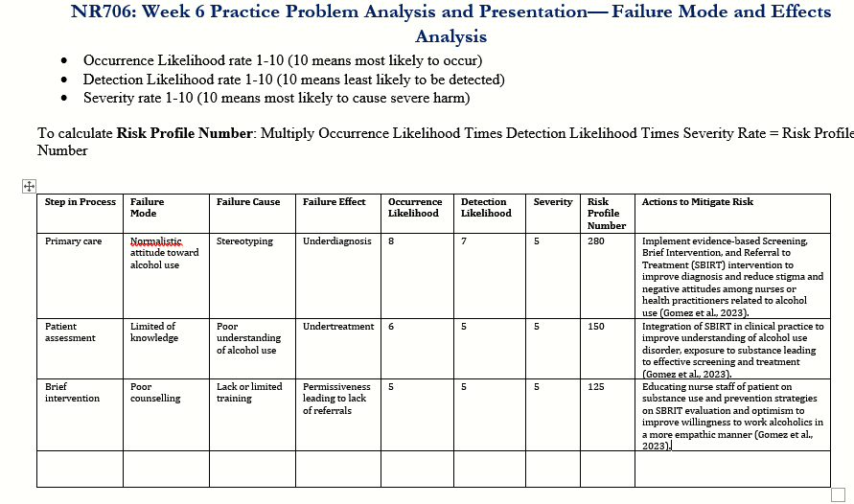
Failure Mode & Effects Analysis (FMEA)
Notes:
The chart above demonstrates the failure mode and Effects Analysis (FEMA) related to nurse educational program on evidence based intervention on Screening, Brief Intervention and Referral Intervention on alcohol use disorder (AUD). The chart demonstrates the step in processes used by nurses in AUD assessment including failure mode, failure cause, failure effect and multiplication of occurrence likelihood, detection likelihood and severity to achieve risk profile number. Besides, there are actions needed to mitigate the risks as demonstrated above including implementation of SBIRT to improve diagnosis, integration of the intervention to improve screening and treatment and educating staff on prevention strategies to improve optimism and willingness to increase referrals ().

Slide 6
Failure Mode & Effects Analysis (FMEA)
Primary care - normalistic attitude leads to stereotyping and consequently lead to underdiagnosis.
Patient assessment – limited knowledge due to poor understanding on AUD lead to undertreatment.
Brief intervention – Poor counselling due to lack of training leading to lack of referral or permissiveness.
Improved analysis between an intervention and impact including risks.
(Gomez et al., 2023)
Notes:
Primary care due to normalistic attitude leads to stereotyping and consequently lead to underdiagnosis. Implementation of the evidence-based Screening, Brief Intervention, and Referral to Treatment (SBIRT) intervention to improve diagnosis and reduce stigma and negative attitudes among nurses or health practitioners related to alcohol use (Gomez et al., 2023). Poor patient assessment is caused by limited knowledge due to poor understanding on AUD lead to undertreatment. As such, Integration of SBIRT in clinical practice to improve understanding of alcohol use disorder, exposure to substance leading to effective screening and treatment (Gomez et al., 2023). Brief intervention – Poor counselling due to lack of training leading to lack of referral or permissiveness. Educating nurse staff of patient on substance use and prevention strategies on SBRIT evaluation and optimism to improve willingness to work alcoholics in a more empathic manner (Gomez et al., 2023). The analysis improved assessment skill in determining an effective intervention and its significant impact including risk factors

Slide 7
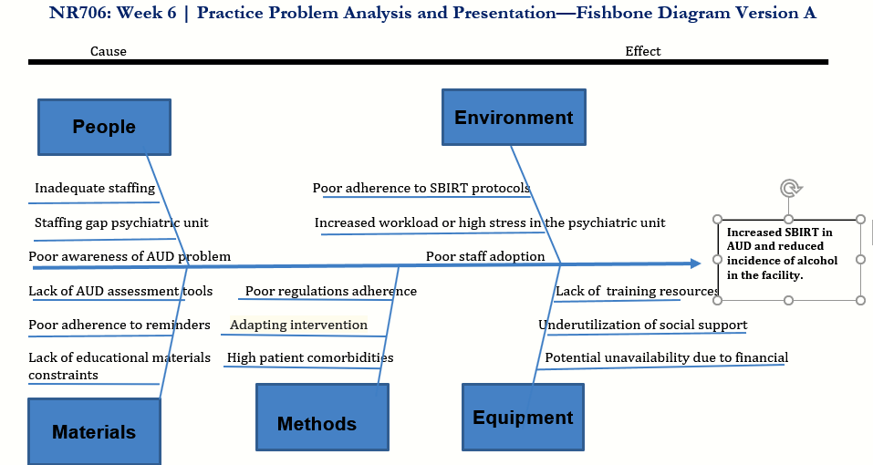
Ishikawa (Fishbone) Diagram
Notes:
Based on the diagram above there are various related to implementation of SBIRT in clinical practice dependent on people, environment, materials, methods and equipment. The goal is to improve AUD treatment and reduce incidence of alcohol abuse in the facility.

Slide 8
Ishikawa (Fishbone) Diagram
Most significant barrier:
People: Inadequate staffing, staffing gap, and lack of awareness.
Leverage support to address AUD problem.
Improved understanding on the need and delivery of training health professionals on SBIRT as a process and facilitate sustainability.
Other factors
  Poor adherence to SBIRT protocols
  poor regulations adherence,
  Lack of training resources,
  High patient comorbidities,
  Lack of AUD assessment tools
  Poor adaptation of the intervention.
(Keen et al., 2021)
Notes:
Based on the five categories including people, environment, materials, methods and equipment, the most significant factor to implementation of SBIRT in addressing AUD include Inadequate staffing, staffing gap, and lack of awareness among nurses. Health professionals leverage support and opportunity as frontline staff to implement SBIRT, treat and referral to treatment (). The analysis has improved understanding on the need and delivery of training health professionals on SBIRT as a process and facilitate sustainability. Other factors include Poor adherence to SBIRT protocols, poor regulations adherence, Lack of training resources, High patient comorbidities, Lack of AUD assessment tools and poor adaptation of the intervention.

Slide 9
Feasibility of Evidence-based SBIRT Intervention
SBIRT is feasible and Effective
A form of treating AUD integrated in primary care.
Expands access and trust among patients.
Reduces stigma in AUD patients seeking help.
Familiarize clinicians with referrals and related costs.
Closer proximity with patients compared to external referral.
Promised reduction of harm measures such as pharmacological management.
Develop relationship with referral partners.
Defined communication with details in each SBIRT step.
(Kamath et al., 2022)
Notes:
SBIRT is a feasible and effective method of treating AUD integrated in primary care setting. The SBIRT intervention is another way of expanding access and championed in utilized in primary care settings. Some of the benefits associated with the intervention include expanded access and trust among AUD patients, reduced stigma in AUD patients seeking help and clinicians familiarizes with referrals and related costs. The intervention as a form of treatment embedded in primary care provides a closer proximity with patients compared to external referral and promises reduced harm measures such as medications in treatment of AUD (Kamath et al., 2022). SBIRT allows development of relationship with referral partners and define communication with details in each SBIRT step.

Slide 10
Barriers overcome By SBIRT
Identification and addressing alcohol use.
Acceptance and buy-in by clinicians in primary care.
Flexible and adaptability of process in workflow.
Allows universal screening prioritizing treatment referrals.
Sacrifices fidelity and quality to deal with unintentional consequences.
Differentiate patient characteristics to improve overall care.
Improves understanding and endorsement of certain protective behaviors related to AUD such impact bias, stigma and culture.
(Evans et al., 2023)
Notes:
Barriers overcome by SBIRT include identification and addressing alcohol use along with acceptance and buy-in by clinicians in primary care. It enhances flexibility and adaptability of process in workflow and allows universal screening prioritizing treatment referrals. The intervention address sacrifices fidelity or quality to deal with unintentional consequences compared to other interventions. The approach allows clinicians to differentiate patient characteristics to improve overall care. It also improves understanding and endorsement of certain protective behaviors related to AUD such impact bias, stigma and culture.

Slide 11
Conclusion
Implementation of SBIRT Educational Program to Improve and address AUD.
Alcohol is a prevalent problem with significant impact health issues.
FMEA reveal normalistic due to stereotyping in primary is the most risk factors in implementing SBIRT
Ishikawa fishbone analysis reveals inadequate staffing, staffing gap, and lack of awareness problem as the pillar to patient care.
SBIRT is a feasible and effective is an form of treating AUD integrated in primary care and expands access and trust among patients.
Addresses identification, treatment, acceptance, buy-in and universal screening prioritizing treatment referrals in primary care.
Notes:
The implementation of SBIRT Educational Program to Improve and address AUD. Alcohol is a prevalent problem with significant impact health issues. The FMEA reveal normalistic due to stereotyping in primary is the most risk factors in implementing SBIRT. The Ishikawa fishbone analysis reveals inadequate staffing, staffing gap, and lack of awareness problem as the pillar to patient care. SBIRT is a feasible and effective is an form of treating AUD integrated in primary care and expands access and trust among patients. The intervention addresses identification, treatment, acceptance, buy-in and universal screening prioritizing treatment referrals in primary care.

Slide 12
References
Evans, B., Kamon, J., & Turner, W. C. (2023). Lessons in Implementation from a 5-Year SBIRT Effort Using a Mixed-Methods Approach. The Journal of Behavioral Health Services & Research, 50(4), 431-451. https://doi.org/10.1007%2Fs11414-023-09835-6
Gomez, E., Gyger, M., Borene, S., Klein-Cox, A., Denby, R., Hunt, S., & Sida, O. (2023). Using SBIRT (Screen, Brief Intervention, and Referral Treatment) training to reduce the stigmatization of substance use disorders among students and practitioners. Substance Abuse: Research and Treatment, 17. https://doi.org/10.1177%2F11782218221146391
Kamath, C. C., Kelpin, S. S., Patten, C. A., Rummans, T. A., Kremers, H. M., Oesterle, T. S., ... & Breitinger, S. A. (2022, October). Shaping the screening, behavioral intervention, and referral to treatment (SBIRT) model for treatment of alcohol use disorder in the COVID-19 era. In Mayo Clinic Proceedings (Vol. 97, No. 10, pp. 1774-1779). Elsevier. https://doi.org/10.1016%2Fj.mayocp.2022.07.006
Keen, A., Thoele, K., Oruche, U., & Newhouse, R. (2021). Perceptions of the barriers, facilitators, outcomes, and helpfulness of strategies to implement screening, brief intervention, and referral to treatment in acute care. Implementation Science, 16(1), 44. https://doi.org/10.1186%2Fs13012-021-01116-0
Varghese, J., & Dakhode, S. (2022). Effects of Alcohol Consumption on Various Systems of the Human Body: A Systematic Review. Cureus, 14(10). https://doi.org/10.7759%2Fcureus.30057

