Slide 1
Chapter 11: Well Woman’s Health

Slide 2
Components of a Well-Woman Visit
Preliminary considerations
Remember to promote health and educate the patient
Arrange to have an interpreter available if needed
Conduct the health history while the patient is dressed
Sit at eye level and face the patient
Interview patient alone to ensure candid responses
Components
Health history
Review of medications
Counseling/education
Health screening
Physical examination

Slide 3
Health History
Medical history
Medical
Medications
Allergies
Surgery
Immunizations
Family history
Mother and father
Siblings
Social history
Occupation
Diet
Exercise
Tobacco
Alcohol
Illicit drugs
Sexual history
Last menstrual period
Last Pap smear

Slide 4
Routine Health Screening
Lipid profile assessment
Assesses risk for coronary heart disease (CHD)
Conduct every 5 years for women aged 20 to 45 years with increased risk for CHD
Endocrine system
Ambulatory BP
Blood glucose screening
Colorectal screening
Colonoscopy, starting at age 50 (then every 10 y)
Sigmoidoscopy every 5 years
Screening mammography
For women with no increased risk for breast cancer, based on history
Cervical cancer: Pap test
Begin at age 21 years

Slide 5
Sexual and Reproductive Health (SRH) Examination
Clinical breast examination
Have client sit up, place her hands on hips
Assess entire breast using:
Inspection
Palpation
Assess for:
Size
Symmetry
Contour
Skin color
Texture
Venous patterns
Lesions
Note especially:
Dimpling
Nipple retraction
Puckering
Vascular pattern changes
Have client lie supine and raise her arm above head
Document all findings

Slide 6
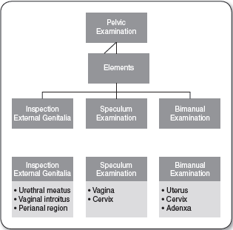
Pelvic Examination

Slide 7
Bimanual Examination
Place client in lithotomy position
Assess uterus and ovaries for:
Size
Shape
Lie
Location
Mobility
Tenderness

Slide 8
Rectovaginal Examination
Place client in lithotomy position
Inspect external anus
Ask client to bear down
Insert gloved, lubricated finger into anus
Assess for:
Polyps
Hemorrhoids
Tone of anal sphincter

Slide 9
Special Considerations
Adolescent well-woman examination
Pap test
< 21 years: Do NOT perform
21–29 years: every 3 years
Reproductive age
Annual wellness visit
SRH education
Immunizations
Health screening
Family planning services
One Key Question Initiative
Pelvic and bimanual examinations indicated before:
Insertion of an IUD
Fitting of a diaphragm
An endometrial biopsy
Mature women (46–64 y)
Assess for menopause
Counsel about
Hormone therapy
Sexual concerns

Slide 10
Summary and Future Directions
Accomplishments in well women’s health
Improved preventive health care services for women
Paradigm shift from reactive to proactive care
Annual well-woman visit is covered under the Patient Protection and Affordable Care Act (ACA)
No out-of-pocket cost requirements allow greater access
In 2016, > 55 million women have access to birth control
Future directions
Patient-centered medical homes
Emphasis on coordination and communication
Women as active participants in their health care decision making

