Slide 1
Culture Paper: Care for Urban Population Living in Poverty
Course Number and Title
Student Name
Notes:
Hello all. I am Martin Mutesasira. In this presentation, I will be providing a summary of the culture paper with a focus on the care for the urban population living in poverty.

Slide 2
Assignment Objectives
At the end of this presentation, the participant will be able to:
Understand the characteristics of the urban population living in poverty
Understand the Campinha-Bacote transcultural theoretical model
Analyze the use of the model in the care for urban population living in poverty
Evaluate the role of cultural competence in Advanced Practice Nursing as a DNP
Notes:
At the end of this presentation, the participant will be able to understand the characteristics of the urban population living in poverty, understand the Campinha-Bacote transcultural theoretical model, analyse the use use of the model in the care for the urban population living in poverty, and evaluate the role of cultural competence in Advanced Nursing Practice as a DNP.

Slide 3
Definition of Group
Urban population living in poverty experience limited economic security and social mobility
Demographic and socioeconomic status
  Racial/ethnic minorities and undocumented immigrants overrepresented (Christie-Mizell, 2022)
  High levels of social exclusion and inequality
  Limited access to healthcare services
  High unemployment rates and unstable employment status
  Barriers to educational advancement
  Housing insecurity and high risk of homelessness
Notes:
The urban population living in poverty is highly diverse but the primary characteristics include experiences of limited economic security and social mobility. Demographically, racial/ethnic minorities and undocumented immigrants are overrepresented in the urban population living in poverty (Christie-Mizell, 2022). The group faces high levels of social exclusion and inequality, limited access to healthcare services, high unemployment rates or unstable employment status, barriers to educational advancement, housing insecurity, and a high risk of homelessness.

Slide 4
Definition of Group
Cultural Norms and Traditions
  Vary depending on race/ethnicity, language, immigration status, and historical experiences
  Both collectivist and individualistic values upheld
    Community bonding, family closeness, solidarity, and autonomy
    Kinship ties influence care-seeking behaviors (Lopez et al., 2022)
  Religion, faith, and spirituality serve as a coping mechanism (Johnson & Carter, 2020)
Notes:
The cultural norms and traditions vary within the group pertinent to race/ethnicity, language, immigration status, and historical experiences such as racism and discrimination. Broadly, the group espouses both collectivist and individualistic values. For example, values such as community bonding, family closeness, solidarity, and autonomy are common within this group. Kinship ties often influence care-seeking behaviors based on the support given by family and community members (Lopez et al., 2022). In addition, the group also uses religion, faith, and spirituality as a coping mechanism against racism and mental health problems (Johnson & Carter, 2020).

Slide 5
Definition of Group
Health Disparities
  Poverty increases risk of chronic diseases
  Exposure to multiple stressors
    Housing insecurity, food insecurity, social isolation, violence, crime, and unemployment (Egede et al., 2021)
  Disparities in access to optimal mental health services
    Financial constraints, stigma, and shortage of culturally competent mental health providers (Jimenez et al., 2022)
Notes:
Poverty is a direct cause of health disparities and could also influence the occurrence of health disparities indirectly. For example, poverty is associated with a high risk of chronic diseases, including cardiovascular disease, diabetes, and hypertension, as well as mental health problems. In addition, the group is exposed to multiple stressors, including housing insecurity, food insecurity, social isolation, violence, crime, and unemployment that exacerbate the risk of mental health disorders (Egede et al., 2021). Disparities in accessing optimal mental health services are also well documented, with financial constraints, stigma, and shortage of culturally competent providers contributing to the disparity (Jimenez et al., 2022).

Slide 6
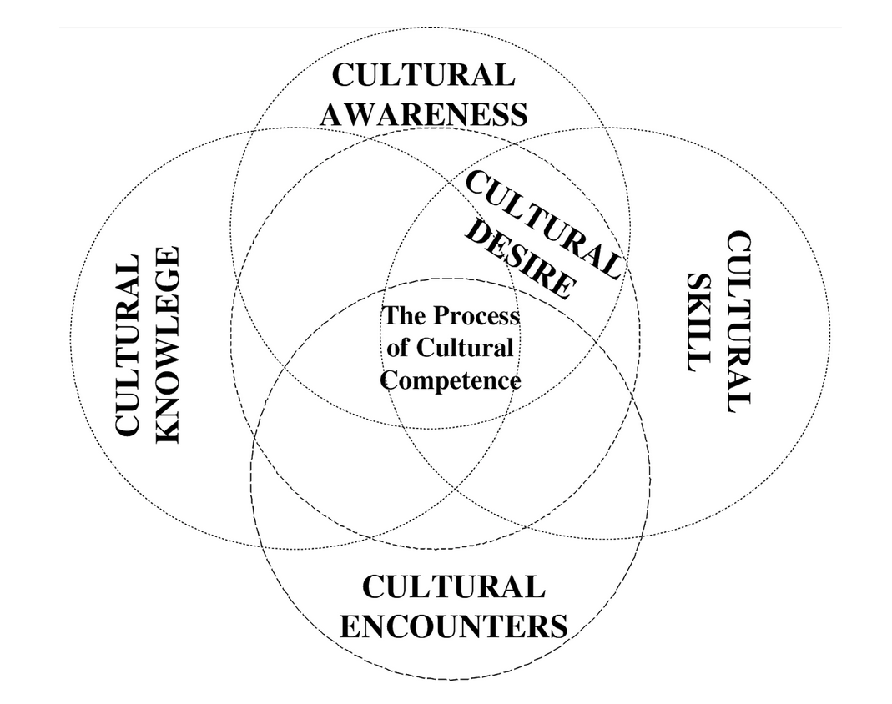
The Campinha-Bacote Model
Referred to as the Process of Cultural Competence in the Delivery of Healthcare Services model (Campinha-Bacote, 2002)
  Cultural awareness
  Cultural skills
  Cultural knowledge
  Cultural encounters, and
  Cultural desire
Notes:
The Campinha-Bacote (2002) model, also referred to as the Process of Cultural Competence in the Delivery of Healthcare Services, is essential to improving cultural competence among nurses. The model incorporates five components: cultural awareness, cultural skills, cultural knowledge, cultural encounters, and cultural desire. I will discuss the components in detail

Slide 7
Campinha-Bacote Model
Model Components
Cultural awareness: Understanding personal biases
Cultural knowledge: Acknowledging differences in beliefs
Cultural skill: Adjusting care to align with patient’s cultural beliefs, values, and practices
Cultural encounters: Engagement and encouragement of interactions with diverse groups
Cultural desire: Inclination to interact with culturally diverse groups
Notes:
The first component, cultural awareness, involves a conscious introspection of individual cultural background to ensure an understanding of personal biases towards people from different cultures. Secondly, cultural knowledge involves maintain open-mindedness, resulting in the acknowledgment of differences in cultural beliefs and traits that shape individual’s attitudes to health and illness. Thirdly, cultural skills involves adjusting care to match with patients’ cultural beliefs, values, and practices that they express during care episodes. Cultural encounters involve proactive engagement and encouragement of interactions with people from culturally diverse backgrounds. Finally, cultural desire involves personal inclination to interact with culturally diverse groups with the goal of enhancing one’s self-efficacy in delivering culturally congruent care.

Slide 8
Campinha-Bacote Model
Application to Urban Population Living in Poverty
Acknowledging different cultural dimensions
  Beliefs about psychiatric disorders and attitudes to treatment
  Religious and cultural factors that influence health-seeking behaviors
  Historical experiences of stigma and discrimination
Cultural encounters improve knowledge about group beliefs
Self-reflection can improve awareness of biases
Notes:
The model could be applied in the care for the urban population living in poverty. For example, this would require acknowledging different cultural dimensions of mental health. For instance, this could focus on beliefs about psychiatric disorders and attitudes to Western treatments, religious and cultural factors that influence health-seeking behaviors, and historical experiences of stigma and discrimination. In addition, the model would inform cultural encounters (engagement with the group) to improve knowledge about the diverse beliefs that could influence health. The model would also inform engagement in reflective practices to acknowledge personal biases that could influence care delivery to the group.

Slide 9
Cultural Competence as a DNP
Adopt a vision for transcultural synergy (Teixera et al., 2023)
  Culturally safe care environment, acknowledge differences, support a therapeutic relationship
Case scenario
  Care for a recent immigrant from a conflict affected part of Nigeria
    Food insecurity and housing instability
    Recent experience of discrimination
    Mistrust of the healthcare providers and Western medication
Notes:
The model highlights the importance of demonstrating cultural competence among DNP-prepared nurses. At the advanced level of practice, cultural competence would require DNP-prepared nurses to adopt a vision for transcultural synergy (Teixeira et al., 2023). The vision would ensure a culturally safe care environment, acknowledgment of cultural differences, and support for therapeutic relationship with culturally diverse groups. The case scenario of a recent immigrant from a conflict-affected part of Nigeria could illustrate the use of the model and expectations of a DNP-prepared nurse. The patient presents with multiple challenges, including food insecurity, housing insecurity, recent experiences of discrimination in the immigration and healthcare systems, and mistrust of healthcare providers and Western medications.

Slide 10
Cultural Competence as a DNP
Expectations for a DNP
Establish a culturally safe environment for trust-based relationships
  Cultural encounters to improve cultural knowledge
  Introspection of personal biases and prejudices (awareness)
  Commitment to lifelong learning and self-evaluation (desire)
  Tailoring care to meet patient needs (skill)
Notes:
One of the expectations for a DNP-prepared nurse would involve establishing a culturally safe environment that would lead to the development of a trust-based relationship. Based on the conceptualization of cultural competence as a process (Campinha-Bacote, 2002), this expectation would require frequent cultural encounters to enhance knowledge about the beliefs and values of the group in which the patient belongs. Secondly, this would require self-reflection to address personal biases and prejudices towards the group. Thirdly, the care would benefit from commitment to lifelong learning (cultural desire) and tailoring care to meet the patient’s needs (cultural skill).

Slide 11
Cultural Competence as a DNP
Expectations for a DNP
Acknowledge patient’s experiences
  Understanding of language or assessment items that could be stigmatizing (Kaiser et al., 2020)
Contextualize assessment to cultural context and address broader social determinants
  Fosters embedment of culturally relevant language during assessment (Kyrillos et al., 2023)
  Ensure collaborative and integrated care (Rishki Kemmak et al., 2021)
Notes:
The second critical expectation is to acknowledge the patient’s experiences, which would inform the assessment process. As noted by Kaiser et al. (2020), cross-culturally translated assessment tools may contain stigmatizing items that may hinder optimal care. The third expectation is to contextualize the assessment to the patient’s cultural context and address the broader social determinants of health. Contextualizing assessment allows the embedment of culturally relevant language or idioms (Kyrillos et al., 2023). In addition, a broader perspective to addressing social determinants would foster collaborative efforts and integrated care (Rishki Kemmak et al., 2021).

Slide 12
Conclusion
Urban population living in poverty highly diverse
Exposed to multiple social determinant risks
Disparate experiences of systemic racism, discrimination, and marginalization
Campinha-Bacote model offers a framework for cultural competence
The components provide basis for culturally congruent care
DNPs obliged to use cultural competence in reducing health disparities
Notes:
In summary, the presentation has shown that the urban population living in poverty is highly diverse. Regardless, the members are exposed to multiple social determinant risks, including unemployment, housing insecurity, violence, and crime. In addition, the population characterizes disparate experiences of systemic racism, discrimination, and marginalization. The Campinha-Bacote model offers a framework for cultural competence that could be applied to this group. DNP-prepare nurses are obliged to use cultural competence as an approach to reducing health disparities that relate to cultural diversity.

Slide 13
References
Christie-Mizell C. A. (2022). Neighborhood disadvantage and poor health: The consequences of race, gender, and age among young adults. International Journal of Environmental Research and Public Health, 19(13), 8107. https://doi.org/10.3390/ijerph19138107
Egede, L. E., Walker, R. J., Campbell, J. A., Dawson, A. Z., & Davidson, T. (2021). A new paradigm for addressing health disparities in inner-city environments: Adopting a disaster zone approach. Journal of Racial and Ethnic Health Disparities, 8(3), 690–697. https://doi.org/10.1007/s40615-020-00828-1

Slide 14
References
Jimenez, D. E., Park, M., Rosen, D., hui Joo, J., Garza, D. M., Weinstein, E. R., Conner, K., Silva, C., & Okereke, O. (2022). Centering culture in mental health: Differences in diagnosis, treatment, and access to care among older people of color. The American Journal of Geriatric Psychiatry, 30(11), 1234-1251. https://doi.org/10.1016/j.jagp.2022.07.001
Johnson, V. E., & Carter, R. T. (2020). Black cultural strengths and psychosocial well-being: An empirical analysis with Black American adults. Journal of Black Psychology, 46(1), 55-89. https://doi.org/10.1177/0095798419889752

Slide 15
References
Johnson, V. E., & Carter, R. T. (2020). Black cultural strengths and psychosocial well-being: An empirical analysis with Black American adults. Journal of Black Psychology, 46(1), 55-89. https://doi.org/10.1177/0095798419889752
Kaiser, B. N., Ticao, C., Anoje, C., Minto, J., Boglosa, J., & Kohrt, B. A. (2020). Adapting culturally appropriate mental health screening tools for use among conflict-affected and other vulnerable adolescents in Nigeria. Global Mental Health (Cambridge, England), 6, e10. https://doi.org/10.1017/gmh.2019.8

Slide 16
References
Kyrillos, V., Bosqui, T., Moghames, P., Chehade, N., Saad, S., Abdul Rahman, D., Karam, E., Karam, G., Saab, D., Pluess, M., & McEwen, F. S. (2023). The culturally and contextually sensitive assessment of mental health using a structured diagnostic interview (MINI Kid) for Syrian refugee children and adolescents in Lebanon: Challenges and solutions. Transcultural Psychiatry, 60(1), 125–141. https://doi.org/10.1177/13634615221105114
Lopez, C., Vazquez, M., & McCormick, A. S. (2022). Familismo, respeto, and bien educado: traditional/cultural models and values in Latinos. In Family literacy practices in Asian and latinx families: Educational and cultural considerations (pp. 87-102). Cham: Springer International Publishing.

Slide 17
References
Rashki Kemmak, A., Nargesi, S., & Saniee, N. (2021). Social determinant of mental health in immigrants and refugees: A systematic review. Medical Journal of the Islamic Republic of Iran, 35, 196. https://doi.org/10.47176/mjiri.35.196
Teixeira, G., Cruchinho, P., Lucas, P., & Gaspar, F. (2023). Transcultural nursing leadership: A concept analysis. International Journal of Nursing Studies Advances, 5, 100161. https://doi.org/10.1016/j.ijnsa.2023.100161

