Slide 1

DNP Project Education Plan
Name
Institutional Affiliation
Course
Instructor
Date of Presentation

Slide 2
Introduction
Aim: Enhance CBT knowledge and skills
Target population: Nursing staff
Learner outcomes:
  Understand core CBT principles
  Understand application of CBT in practice
  Understand use of Patient Health Questionnaire (PHQ-9)
Notes:
The overall aim of the educational sessions is to enhance nursing staff’s knowledge and skills in cognitive behavioral therapy. By the end of the sessions, the learner will understand the core principles of CBT, its application in practice, and the use of the Patient Health Questionnaire (PHQ-9) in the assessment of depression severity.

Slide 3
Evidence-Based Intervention
Cognitive Behavioral Therapy (CBT)
First-line psychotherapy (Brown et al., 2021)
  Behavioral activation
    Motivate engagement in meaningful activities (Malik et al., 2021)
  Cognitive restructuring
    Supplant of dysfunctional cognitions (Crum, 2021)
Notes:
Before delving into the educational content, let us recap about cognitive behavioral therapy (CBT), which will serve as the evidence-based intervention in the project. CBT is considered the first-line or gold standard psychotherapeutic intervention for depression and can be used alone or in combination with pharmacotherapy (Brown et al., 2021). The intervention works through cognitive restructuring and behavioral activation. Behavioral activation can simply be understood as an approach that focuses on overt behaviors. It involves motivating individuals to engage in meaningful activities, which could involve routine activities, pleasurable activities, or necessary activities (Malik et al., 2021). On the other hand, cognitive restructuring involves supplanting dysfunctional thoughts or cognitions with adaptive thoughts (Crum, 2021).

Slide 4
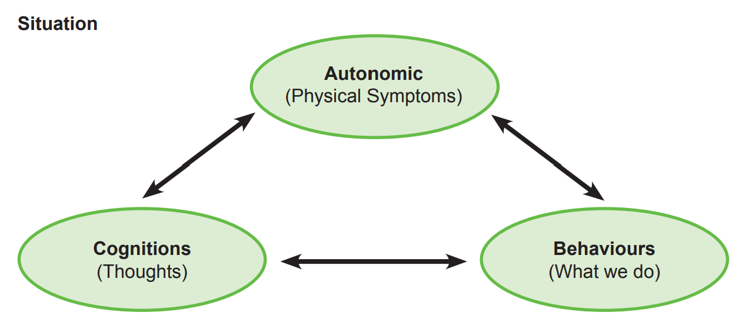
The ABC Model
Interpretation of situations that cause distress
Analyzing situations that lead to NATs
Linking NATs with behaviors, and physical symptoms
  Focus on where, when, what, with whom?
Guiding patients to challenge the beliefs
Notes:
Now let us focus on the ABC model of CBT. Applying the ABC model implies supporting patients in understanding their cognitions, physical symptoms, and behaviors through the interpretations of situations that cause distress. In other words, this implies helping them to analyze situations that cause negative automatic thoughts (NATs). NATs are unhelpful thoughts that occur without effort. After analyzing the situations and the association thoughts, the next step involves helping clients in linking NATs with behaviors and physical symptoms. In making the link, we should focus clients on the where, when, what, and with whom about the identified situation. This serves as the foundation to guide patients in challenging their beliefs.

Slide 5
SMART Goal Setting
Self-help goals as a roadmap
Identification of triggers
Set goals
  What do they hope to achieve?
  What will be different?
  How can they achieve the changes?
Frequent review of goals
Notes:
The next step involves helping patients in setting goals. Self-help goals serve as a roadmap for change and assessment of progress. Goal-setting should start with the identification of triggers. For example, this could involve prompting clients to identify and list triggers that lead to low mood. In turn, this leads to the development of SMART goals that focus on what the client hopes to achieve, what will be different, and how they can achieve the changes. It is essential to encourage clients to set goals relevant to their problems and set a timeline for the achievement to evoke commitment.

Slide 6
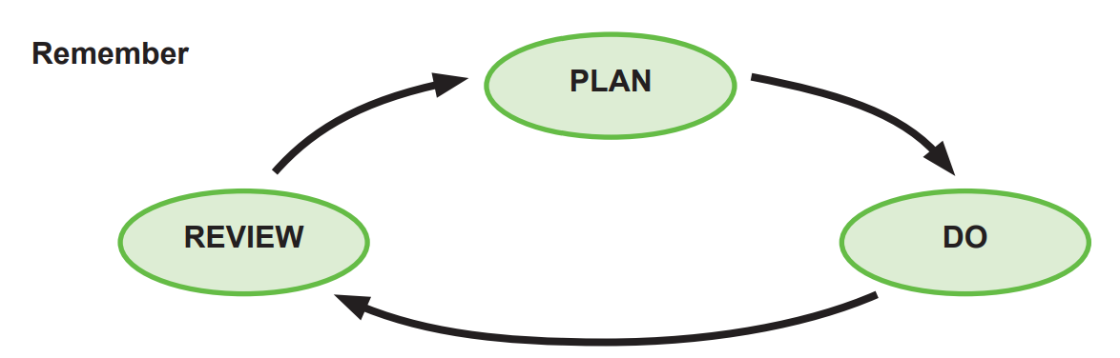
Behavioral Activation
Positive reinforcement through meaningful activities
  List routine, necessary, and pleasurable activities
  Rank them in order of difficulty
  Schedule activities in an activity diary
  Act and review weekly progress
Notes:
Now, let us focus on what behavioral activation would involve when implementing CBT. BA involves positive reinforcement to motivate clients to engage in meaningful activities. As we have learnt, the activities could be routine (general hygiene, cooking, waking up), pleasurable activities such as hobbies, or necessary activities such as paying bills. Depressive symptoms could reduce motivation to engage in any of these activities. In using BA, the first task is to guide patients in listing the activities and ranking them in their order of difficulty. In turn, clients should be encouraged and helped in scheduling the activities. For example, they could list the activities in a blank activity diary, dedicating specific days or hours for specific activities. They should be continually motivated to act on the scheduled activities, with the nurse reiewing weekly progress collaboratively with the patient.

Slide 7
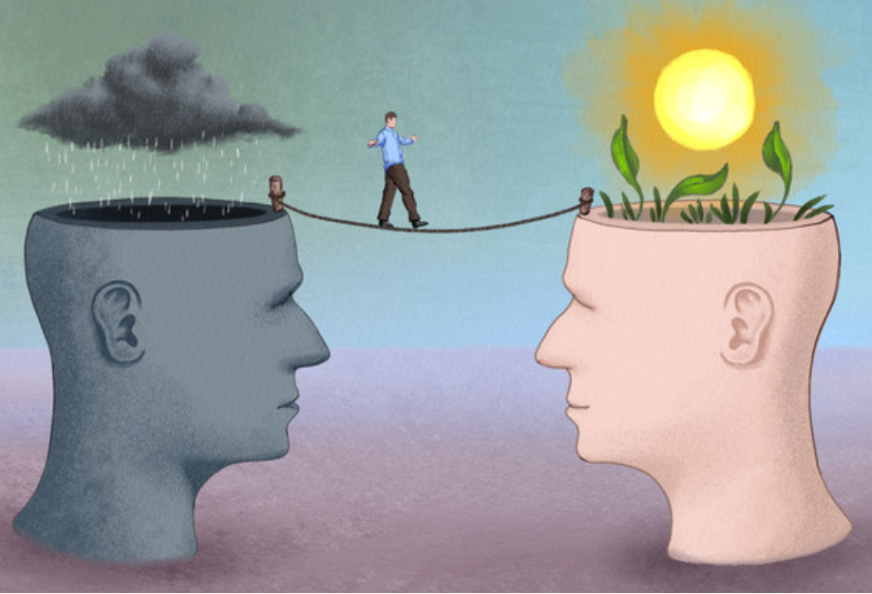
Cognitive Restructuring
Step 1
  Identify specific situation causing negative thoughts
  Label and rate intensity of the emotion (0-100%)
  Identify NATs related to situation
  Rate belief in the thoughts (0-100%)
  Identify “hot thought”
Notes:
Cognitive restructuring is probably is the most essential component of CBT we should understand. It can be considered as a problem-solving approach that should aim at helping clients to manage negative automatic thoughts. Based on previous sessions, the client would be expected to have identified situations that cause negative thoughts but can also be a continuous process. After the identification of the thoughts, the client should be prompted to label the emotions associated with the situation and rate their intensity, for example, in a scale of 0-100%. In turn, the patient should identify the NATs and rate their belief in the thoughts (0-100%). From these thoughts, patients should select a “hot thought”, which the the thought that causes most distress and requires challenging.

Slide 8
Cognitive Restructuring
Step 2
  Identify facts for and against “hot thought”
Step 3
  Reconsider thought pertinent to the facts
  Create a balanced thought using the facts
  Rate belief in thought and re-rate emotion
Notes:
The second step in cognitive restructuring involves identifying facts for and against the “hot thought.” At this point, the client could be given a notebook or be prompted to verbalize the evidence rather than opinions. This would require a measure of depth to ensure the client identifies both sides of the situation to find the truth. The third step focuses on restructuring thoughts based on the facts. A balanced thought can be developed from the facts. Focusing on the balanced or positive thoughts would counter the effects of the NATs on behavior. The next slide provides an example of how cognitive restructuring could be used across the three stages.

Slide 9
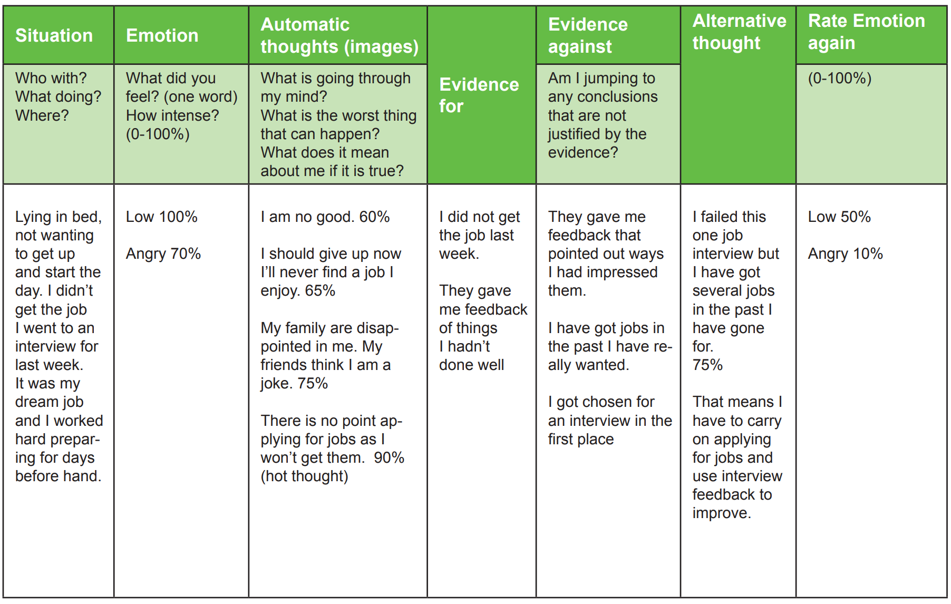
Cognitive Restructuring
Example of cognitive restructuring
Source: HPFT (

Slide 10
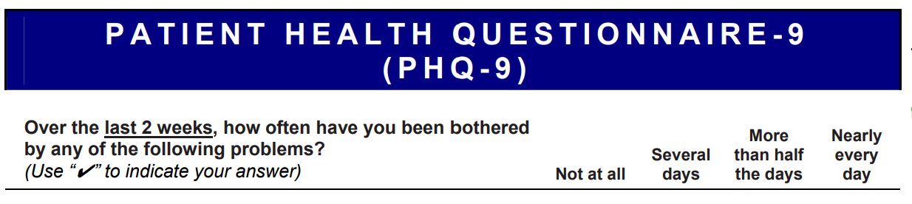
Use of the PHQ-9 Tool
Assessment of depression severity using 9 items
Scored from 0 (not at all) to 3 (nearly every day)
Total scores range from 0-27
Individual score indicates depression severity
Inform treatment planning and monitoring
Notes:
Finally, let us recap on the use of PHQ-9, which we all have knowledge about. The tool is used in assessing depression severity based on 9 items that are aligned to the DSM-V diagnostic criteria. Each item is rated from 0 (not at all) to 3 (nearly every day). The figure on the slide illustrates the four-point scale of the PHQ-9. The total scores should range from 0-27. The individual score, which is the sum of all the scores from all items, provides insights into the severity of depressive symptoms. Scores of 0-4 indicate no (minimal) depression, 5-0 mild depression, 10-14 moderate depression, 15-19 moderately severe depression, and 20-27 severe depression. The individual score will inform treatment planning and monitoring, with those with severe depression requiring additional support.

Slide 11

Evaluation
Teach back method and feedback
Role-playing scenarios
  Demonstration of ABC model
  Exercise with cognitive restructuring
Personal exercise with PHQ-9
Notes:
The evaluation of the achievement of outcomes will involve three primary strategies. Firstly, the teach back method and formative feedback will be used to assess participants’ understanding of some of the concepts and their application. Secondly, role-playing scenarios will also be used. For instance, this will involve a demonstration of the ABC model and an exercise with cognitive restructuring in pairs. Finally, participants will take personal exercises with the PHQ-9 to reinforce their understanding of the tool and interpretation of the scores.

Slide 12
References
Brown, L. K., Chernoff, M., Kennard, B. D., Emslie, G. J., Lypen, K., Buisson, S., Weinberg, A., Whiteley, L. B., Traite, S., Krotje, C., Harriff, L., Townley, E., Bunch, A., Purswani, M., Shaw, R., Spector, S. A., Agwu, A., Shapiro, D. E., & IMPAACT 2002 team. (2021). Site-randomized controlled trial of a combined cognitive behavioral therapy and a medication management algorithm for treatment of depression among youth living with HIV in the United States. Journal of Acquired Immune Deficiency Syndromes (1999), 88(5), 497–505. https://doi.org/10.1097/QAI.0000000000002790
Crum J. (2021). Understanding mental health and cognitive restructuring with ecological neuroscience. Frontiers in Psychiatry, 12, 697095. https://doi.org/10.3389/fpsyt.2021.697095
Malik, K., Ibrahim, M., Bernstein, A., Venkatesh, R. K., Rai, T., Chorpita, B., & Patel, V. (2021). Behavioral Activation as an 'active ingredient' of interventions addressing depression and anxiety among young people: a systematic review and evidence synthesis. BMC Psychology, 9(1), 150. https://doi.org/10.1186/s40359-021-00655-x

