Slide 1
Unmanaged/Uncontrolled Diabetes
Name and Credentials Here
NR706 Week 6 Practice Problem Analysis and Presentation Assignment
Instructor’s Name Here

Slide 2
Practice Problem Idea Identification
    P: In adults with unmanaged diabetes
    I: How will the participation in the diabetes self-management education and support program
    C: Compared to standard care
    O: Reduce diabetes-related complications
    T: Over the net six months
Notes:
The practice problem has been set in the form of a question to determine the effectiveness of the proposed evidence-based intervention compared to other standard forms of care. This is because of the main goal focused on reducing complications arising from unmanaged or uncontrolled diabetes among adults recently tested and recorded to have high blood glucose levels.

Slide 3
Background and Significance
Global burden and prevalence
Economic impact
Complications related to unmanaged/uncontrolled diabetes
Benefits of the intervention
Notes:
Unmanaged/uncontrolled diabetes is a significant public health issue because of the severities and complications which leads to increased mortality. Unmanaged diabetes refers to the inability to maintain the expected blood glucose levels thereby resulting in chronic hyperglycemia which could damage various organs. For this reason, a significant number of individuals globally experience unmanaged diabetes. The CDC mentions that about 8.7 million adults suffering from diabetes in the United States do not manage their glucose levels, an issue that contributes to substantial resource utilization (CDC, 2024). On the other hand, uncontrolled diabetes has complications such as cardiovascular diseases, nerve damage, vision problems and an increased vulnerability to infections (Ferreira et al., 2024). Consequently, the proposed intervention is significant to the practice problem since creating awareness will facilitate positive health outcomes.

Slide 4
Background and Significance
Inclusion and Exclusion Criteria
Adults aged 18 and above
Adults confirmed with type 2 diabetes for six months
Patients with uncontrolled diabetes
Patients currently being treated for diabetes
Individuals under 18 years excluded
Individuals with prediabetes
Pregnant women
Notes:
The study included adults aged 18 years and above confirmed with type 2 diabetes within the last six months. Patients with uncontrolled diabetes and those who are currently receiving treatment were also included. The rationale behind the inclusion is to determine and evaluate the presence of complications and the impact of medication when managing symptoms. However, pregnant women, individuals under 18 years and those with prediabetes were not included in the study. The inclusion an exclusion criteria therefore helps to ensure that the population studied involves adults with uncontrolled diabetes and those who will benefit from the intervention.

Slide 5
Failure Mode & Effects Analysis (FMEA)
Step in Process | Failure Mode | Failure Cause | Failure Effect | Occurrence Likelihood | Detection Likelihood | Severity | Risk Profile Number | Actions to Mitigate Risk
Patient education and diabetes self-management training | Inadequate tailoring of the education that will fit each individual patient needs | Limited time during clinical visits | Poor self-management | 5 | 8 | 7 | 280 | Implementation of multimodal and tailored education programs
Medication monitoring and adherence | Missed medication due to lack of regular or frequent monitoring | High cost of medications | Uncontrolled blood sugar levels | 4 | 8 | 7 | 224 | Provide support programs and financial assistance
Interdisciplinary care coordination and follow-up | Communication breakdown between healthcare providers | Limited availability of standardized communication systems | Inconsistent or delayed treatment adjustments | 3 | 5 | 5 | 75 | Implementation of standardized communication protocols
Notes:
The Failure Mode and Effects Analysis (FMEA) is crucial as it outlines the steps in process, possible failures, their cause and effect. Such an analysis is important as it outlines the occurrence of likelihood and severity of the failure to employ strategies that will mitigate the effects. Consequently, the step in process with the highest risk profile number should be considered as the first issue to be resolved to reduce the potential risks outlined.

Slide 6
Failure Mode & Effects Analysis (FMEA)
Most important step to focus on;
Patient education and diabetes self-management training
Practice problem idea requires a multifaceted approach
Practice problem affects healthcare providers
Practice problem affects the healthcare system
Notes:
The most important step to focus on involves patient education and diabetes self-management training. One of the reasons is that the step has the highest risk profile number. However, the major reason for choosing to focus on the first step is that it involves mobilizing individuals to take action regarding their health by offering tailored services based on patients needs. Research indicates that education interventions could increase knowledge about diabetes thereby leading to improved glycaemic control levels (Shiferaw et al., 2021). On other hand, limited input of resources on the step regarding medication monitoring and adherence could limit the intervention’s efficiency in fulfilling its purpose of improving the overall health outcomes of individuals with uncontrolled diabetes. According to the analysis, there needs to be a balance between the steps in process despite focusing on the most important step to ensure that the problem is mitigated as it requires a multifaceted approach due to its impact on the healthcare system, healthcare providers and community members.

Slide 7
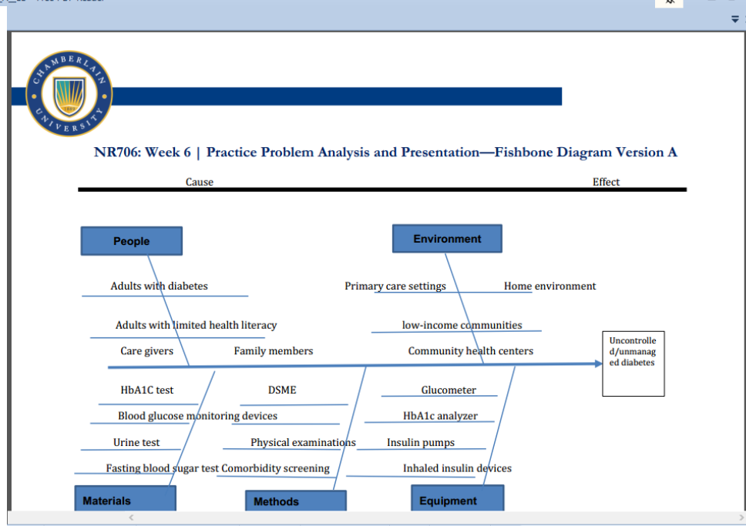
Ishikawa (Fishbone) Diagram
Notes:
The diagram illustrates the practice problem by explaining the cause and effect of uncontrolled diabetes in the form of people and environmental factors that influence the practice problem. Additionally, the materials, methods and equipment have also been outlined to demonstrate the ways in which uncontrolled diabetes has been detected. The diagram has therefore been used as a point of analyzing the factors affecting the prevalence of diabetes by outlining the cause and effect of the practice problem.

Slide 8
Analysis of the Ishakwa Fish Diagram
The most important to focus on in the Ishakwa fish diagram are the people and environment.
Benefits of analysis
Root cause of the problem identified
Factors contributing to the problem revealed
People and environment directly related to the practice problem
Notes:
Uncontrolled/ unmanaged diabetes is influenced by environmental factors and individuals based on their socioeconomic setting. Analysing the practice problem is beneficial as it has revealed the relationship between socioeconomic statuses and uncontrolled diabetes in addition to the contributing factors. According to Liu et al. (2023), diabetes mostly affects individuals with low income statuses since most of the community members have low health literacy from limited access to education and other resources. For this reason, the people and environment are directly related to the practice problem where the materials, methods and equipment used are necessary tools to screen and detect unmanaged diabetes.

Slide 9
Evidence-based Intervention
Evidence-based intervention
diabetes self-management education and support program (DSME)
Feasibility
Cost-effective
Encourages patient engagement
Accessible
Notes:
The identified evidence-based intervention is the diabetes self-management education and support program (DSME) that will be useful in creating awareness to the selected population. Studies indicate that managing diabetes focuses on aspects such as education about physical activity, changes in lifestyle and meal planning as a form of empowering people to sustain lifestyle changes (Ernawati et al., 2021; Tamiru et al., 2023). The intervention is feasible as it is accessible, cost effective and encourages patient engagement to ensure positive outcomes at the individual and organization level. For instance, DSME programs can be delivered in online settings, community centers and clinics where patients can actively participate in improving their health thereby reducing healthcare costs from decreased hospitalizations (Whitehouse et al., 2020).

Slide 10
Evidence-based Intervention
Barriers to overcome
Health literacy
Patient motivation and engagement
Language and cultural barriers
Limited access to care
Notes:
Implementing DSME is beneficial as it improves health outcomes but also involves various barriers to overcome so the intervention may be effective. One of the barriers is health literacy where patients with limited knowledge about the constructs of diabetes may find it challenging to understand the information being communicated in the programs (Coningsby et al., 2022). Additionally, the lack of patient motivation to participate in the education programs may hinder the full exploitation of the program since patients may not wish to be involved in the DSME. Language and cultural barriers in addition to limited access to care from geographic barriers could limit the effectiveness of the education programs (Coningsby et al., 2022). Therefore, it is crucial to strategize on how to overcome the barriers such as improving access to telehealth services and having interpretation or culturally sensitive approaches for improved outcomes.

Slide 11
Conclusion
    Effective implementation of DSME
    DSME requires a multifaceted approach
    Implementation of strategies to overcome barriers
    DSME is an effective intervention for any population
Notes:
Uncontrolled/unmanaged diabetes requires an intervention that will cater to adults from low-income backgrounds including those that find it challenging to access healthcare services. This means that DSME requires a multifaceted approach and collaboration between caregivers, family members and healthcare professionals to ensure that patients access adequate information about diet, medication and physical activity among others to reduce the complications that could arise if blood glucose levels are not regulated. Despite barriers such as cultural, language, health literacy and limited access to care, DSME is an effective intervention as it is cost effective and can fit individuals from any population or socioeconomic background.

Slide 12
References
Ernawati, U., Wihastuti, T. A., & Utami, Y. W. (2021). Effectiveness of diabetes self-management education (DSME) in type 2 diabetes mellitus (T2DM) patients: Systematic literature review. Journal of Public Health Research, 10(2), jphr-2021. https://journals.sagepub.com/doi/pdf/10.4081/jphr.2021.2240
Coningsby, I., Ainsworth, B., & Dack, C. (2022). A qualitative study exploring the barriers to attending structured education programmes among adults with type 2 diabetes. BMC Health Services Research, 22(1), 584. https://doi.org/10.1186/s12913-022-07980-w
CDC. (2024). National diabetes statistics report. https://www.cdc.gov/diabetes/php/data-research/index.html#:~:text=Prevalence%20of%20both%20diagnosed%20and%20undiagnosed%20diabetes&text=Among%20the%20U.S.%20population%20overall,Table%201a%3B%20Table%201b).
Ferreira, P. L., Morais, C., Pimenta, R., Ribeiro, I., Amorim, I., Alves, S. M., & Santiago, L.
(2024). Knowledge about type 2 diabetes: its impact for future management. Frontiers in Public Health, 12, 1328001. https://doi.org/10.3389/fpubh.2024.1328001
Liu, C., He, L., Li, Y., Yang, A., Zhang, K., & Luo, B. (2023). Diabetes risk among US adults with different socioeconomic status and behavioral lifestyles: evidence from the National Health and Nutrition Examination Survey. Frontiers in Public Health, 11, 1197947. https://doi.org/10.3389/fpubh.2023.1197947
Shiferaw, W. S., Akalu, T. Y., Desta, M., Kassie, A. M., Petrucka, P. M., & Aynalem, Y. A. (2021). Effect of educational interventions on knowledge of the disease and glycaemic control in patients with type 2 diabetes mellitus: a systematic review and meta-analysis of randomised controlled trials. BMJ open, 11(12), e049806. doi:10.1136/ bmjopen-2021-049806
Tamiru, S., Dugassa, M., Amsalu, B., Bidira, K., Bacha, L., & Tsegaye, D. (2023). Effects of Nurse-Led diabetes Self-Management education on Self-Care knowledge and Self-Care behavior among adult patients with type 2 diabetes mellitus attending diabetes follow up clinic: A Quasi-Experimental study design. International Journal of Africa Nursing Sciences, 18, 100548. https://doi.org/10.1016/j.ijans.2023.100548
Whitehouse, C. R., Long, J. A., Maloney, L. M., Daniels, K., Horowitz, D. A., & Bowles, K. H. (2020). Feasibility of diabetes self-management telehealth education for older adults during transitions in care. Research in gerontological nursing, 13(3), 138-145. https://doi.org/10.3928%2F19404921-20191210-03

