Slide 1
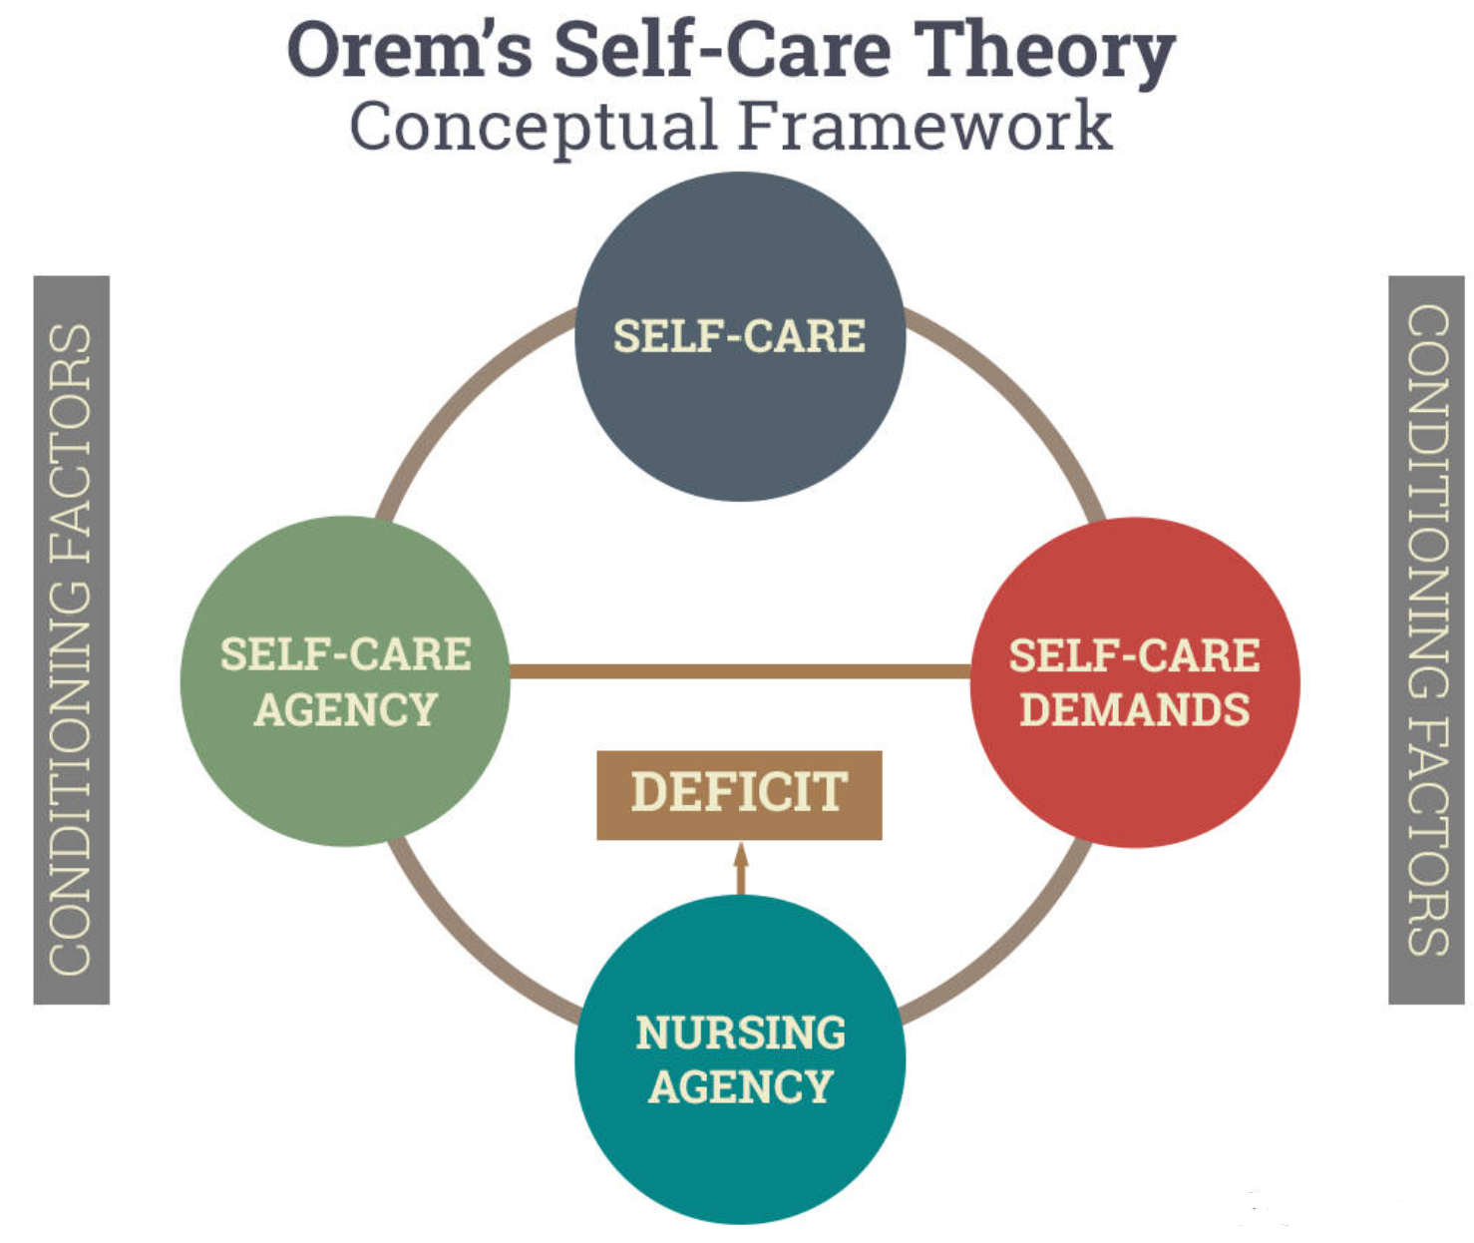
IMPACT OF AN EDUCATIONAL PROGRAM ON MOTIVATIONAL INTERVIEWING ON KNOWLEDGE, SKILLS, AND ADHERENCE
Martin Mutesasira
Young School of Nursing | Regis College
Weston, Massachusetts
regiscollege.edu
PURPOSE
PROCESS
OUTCOMES
The purpose of this scholarly practice project is to implement a training program on motivational interviews for the nursing staff and assess its impact on knowledge and skills changes and subsequent adherence to psychotropic medications among patients served. Consequently, it will seek to fulfill the following objectives.
Recruit mental health nurses at the practice site to participate in the educational program
Conduct the educational and training program on MI skills with the nursing staff
Implement and coordinate ongoing personalized MI sessions for patients over eight weeks
Assess post-implementation staff knowledge and skills changes and patient’s adherence behaviors
Underpinning Theoretical Framework
The project will be guided by Orem’s Self-Care Deficit Theory (SCDT) (Orem, 2001), outlined in Figure 1. The model considers individuals as reliable, capable, and responsible agents who can make independent decisions. The project will adopt a supportive-educative system to address the components of the theory. The primary focus will be on nursing agency in which the staff will receive education, guidance, and support on using MI to empower person-centered adherence counseling. It is expected that improving the staff knowledge and skills in MI will reflect on their ability to use the intervention. In turn, competent use of MI is expected to enhance patient-self-care agency to meet their deficits in medication adherence.
Evidence-Based Model
The SPP follow’s Graham et al. (2006) knowledge-to-action (KTA) model. The model allows iterative implementation process, with knowledge gained at each stage influencing subsequent processes. With the identified problem (lack of a supportive staff training program), nurses will receive evidence-based education and training on the use of MI. In turn, this will inform the embedment of MI in the clinical practice through a tailored approach that addresses individual needs and preferences. Formative assessment conducted every week will be used for ongoing education and support to ensure successful use of the Spirit of MI. Finally, outcomes will be evaluated using a modified version of the Motivational Interviewing Knowledge and Attitudes Test (MIKAT) (Leffingwell, 2006) and Morisky’s Medication Adherence Scale (MMAS-8) (Morisky et al., 2008). This will enable the identification of changes in MI knowledge and skills among the nurses and medication adherence in the patient population.
Add your information, graphs and images to this section.
Add
BACKGROUND
Nonadherence to psychotropic medications remains a concerning issue among individuals with mental health disorders. Up to 85% of patients on psychotropic medications are nonadherence (Foley et al., 2021), the rates varying across conditions. For instance, the rate are 44% to 52% for bipolar disorder, 50% to 52% for major depressive disorder, and 56% to 61% for schizophrenia (Malik et al., 2019; Semahegn et al., 2021). Nonadherence is associated with multiple negative effects, including worsening of symptoms, high hospitalization rates, frequent emergency department (ED) visits, high risk of readmission, and increased cost of care (Ali et al., 2023; Eshtehardi et al., 2021; Semahegn et al., 2022). According to Stewart et al. (2023), nonadherence costs an excess of $300 million in the US. Therefore, optimal adherence to psychotropic medications is essential for recovery and wellbeing.
A range of patient-, clinician-, and system-related factors contribute nonadherence. According to Stewart et al. (2023), an interaction between these factors influence adherence via patient motivation and ability and competence of nurses in supporting adherence. Patient factors such as forgetfulness, negative attitudes and beliefs towards psychotropic medications, poor insight, and lack of innate motivation could lead to nonadherence (Fiszdon et al., 2022; Hsieh et al., 2020). Besides, low levels of mental health literacy, low levels of education, and older age also increase the risk of nonadherence (Dou et al., 2020; Gudeta et al., 2023). At the clinician and system levels, lack of supportive programs to enhance clinicians knowledge and skills in empowering patients significantly contribute to nonadherence (Dobber et al., 2020; Dou et al., 2020). Multiple interventions, including cost-sharing interventions, reminder systems, and dose simplifications have been used but may be ineffective in addressing the complex causes of nonadherence (Anderson et al., 2020; Baryakova et al., 2023). Consistent with the literature (Li et al., 2023; Konstantinou et al., 2020; Kvarnström et al., 2023), addressing the culture of nonadherence requires empowering the nursing staff with knowledge and skills to deliver personalized adherence support to the patient population.
Implementing an educational program would have significant implications for nursing practice, research, education, leadership. Increasing staff knowledge and skills would ensure the delivery of person-centered, high-quality adherence support based on therapeutic relationships (Molina-Mula & Galo-Estrada, 2020; Montori et al., 2023; Munear et al., 2022). It would also contribute to the growing body of evidence on the importance of staff training on MI implementation and enhance proactive efforts to enhance staff competence (Sijkstra et al., 2020; Strand & Tvieit, 2020).
NEXT STEPS
Add
Orem’s Self-Care Deficit Theory (SCDT) (Orem,, 2001)

