Slide 1
Implementation of an Enhanced Cultural Humility Intervention for Registered Nurses to Increase Cultural Competence and Confidence
Ayoola Ogedengbe, BSN, RN
Regis College
April 7th, 2025

Slide 2
Scholarly Committee
Chair: Dr. Peterson, Miranda DNP, RN, CNE
Mentor: Dr. Mensah, Akosua DNP, FNP-C, PMHNP-BC
Second Reader: Dr. Baldwin, Celeste M. PhD, MS, APRN-CNS, GHNA

Slide 3


Slide 4
Introduction
Importance of Cultural Competence in Healthcare: Improving healthcare outcomes and addressing pervasive health disparities (Berger & Miller, 2021; Jongen et al., 2018).
Role of Nurses in Multicultural Healthcare Environment: Nurses navigate the complex web of cultural nuances, beliefs, and expectations (Baker et al., 2022).
Challenges and Gaps in Cultural Competence Training:
-Inadequate curriculum integration
-lack of standardized assessment tools
-challenge of translating theoretical knowledge into practical application
(Brottman et al., 2020; González-Davies & Raído, 2018; Henderson et al., 2018; Meyer et al., 2018).
Call for a Multifaceted Approach: Curriculum reform, reliable assessment tools, and ongoing support for nurses (Shahzad et al., 2021).

Slide 5
Background
In today's diverse healthcare environment, nurses must be culturally competent to meet patients' and families' requirements (Kaihlanen et al., 2019; Markey, 2021; Young & Guo, 2020).
Due to various patient populations, nurses must increase cultural awareness in global healthcare.
Improving nurses' cultural competency improves patient outcomes, treatment adherence, and satisfaction.
Cultural competency is essential for nurses' professional development, employability, and ethical requirements to provide patient-centered care (Berger & Miller, 2021).

Slide 6
Problem Statement
Present training and evaluation techniques are inadequate, with fragmented teaching and inconsistent assessment instruments (Prince et al., 2023; Rios, 2021).
The limitations impair patient-centered care and perpetuate health inequities (Mitchell & Perry, 2020; Mora & Maze, 2024)
Enhanced cultural humility intervention promote equitable treatment for all patients (Cronell, 2023; Nolan et al., 2021; Solchanyk et al., 2021)

Slide 7
Significance
🏥 Nursing Practice
🔹 Enhancing patient care through cultural humility (Narayan & Mallinson, 2022).
🔹 Addressing health disparities.
📊 Nursing Research
🔹 Investigating long-term impacts of cultural humility training (Willis et al., 2022).
🔹 Exploring applications across diverse healthcare settings (Johnson, 2021).

Slide 8
Significance cont.
📚 Nursing Education
🔹 Integrating cultural humility frameworks (e.g., Jeffreys' CCC) into nursing curricula
🔹 Preparing future nurses for multicultural patient care (Webb et al., 2023).
👩‍⚕️ Nursing Leadership
🔹 Advocating for cultural humility initiatives in healthcare organizations (Moreno et al., 2024; Nikpour et al., 2022).
🔹 Promoting diversity and inclusivity in nursing practice (Foulkrod & Lin, 2024).

Slide 9
Project Objectives/Aims
To create an educational intervention.
To increase nurses’ confidence levels.
To increase motivation to practice.
To disseminate the findings of the project to the stakeholders at the external site, through presentation at a conference, and through publication.

Slide 10
Empirical Literature
Challenges
Diverse cultural beliefs and practices
Limited training time/resources (Shepherd, 2019)
Resistance to change (Kruse et al., 2018)
Difficulties in assessment
Key Study Findings
Brottman et al., 2020 identified 11 educational strategies for cultural competence training.
Less than 50% of studies reviewed reported favorable training outcomes.

Slide 11
Empirical Literature cont.
Opportunities for Improvement
E-learning and flexible training modules
Collaborative Learning Communities (Haiyan & Allan, 2021).
Tailored training for specific settings
Leadership advocacy and cultural liaisons (White et al., 2018).
Continuous feedback and self-reflection (Srivastava, 2022, p. 104).

Slide 12
Supporting Literature
Cultural Competence Contributions to Policy Development: Healthcare policies that ensure equitable access. (Harvey et al., 2022).
Current Models of Cultural Competence Training: Cross-Cultural Health Care Program, Campinha-Bacote's model (Campinha-Bacote, 2019), and the Purnell Model.
Organizational Policies that Recognize Intersectionality: Intersectionality in cultural competence guidelines addresses the complex interplay of multiple identity factors (Ruiz et al., 2021).
American Nurses Association (ANA) : Promotes individualized care (Marion et al., 2016), supports continuous education. ethical practice (Linton et al., 2020), and supports policy advocacy (Kreitzer et al., 2020).

Slide 13
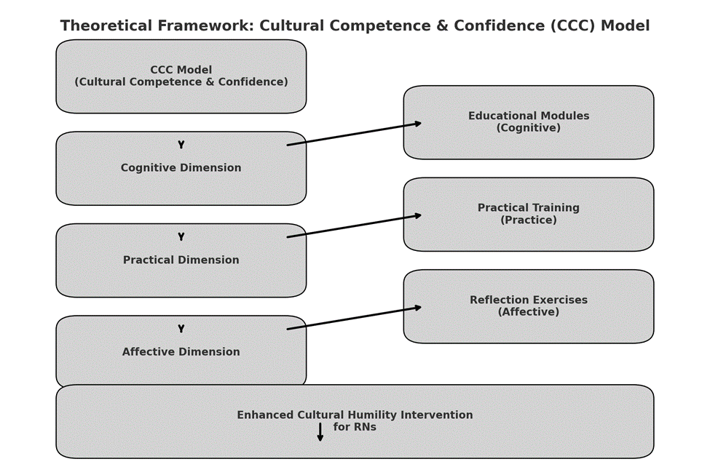
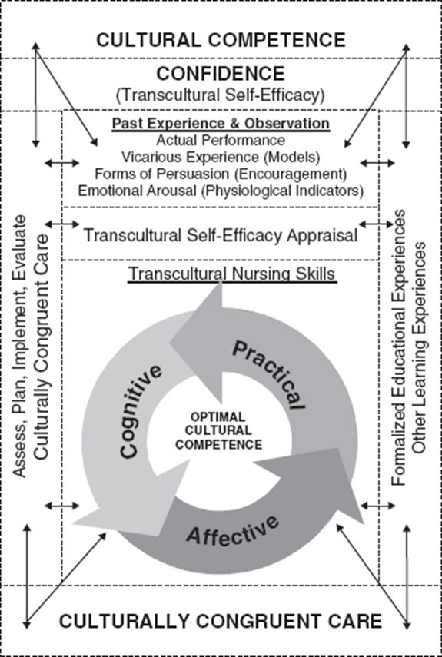
Theoretical/Conceptual Framework
Jeffreys’s Cultural Competence and Confidence (CCC) Model—(2016)

Slide 14
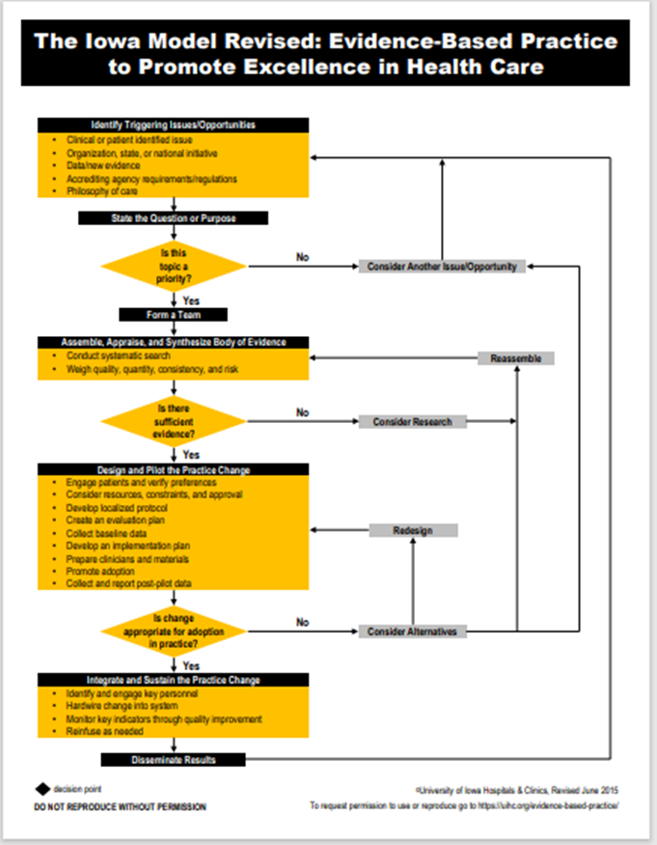
Evidence Based Practice Model
Used/reprinted with permission from the University of Iowa Hospitals and Clinics, copyright 2015. For permission to use or reproduce, please contact the University of Iowa Hospitals and Clinics at 319-384-9098.

Slide 15
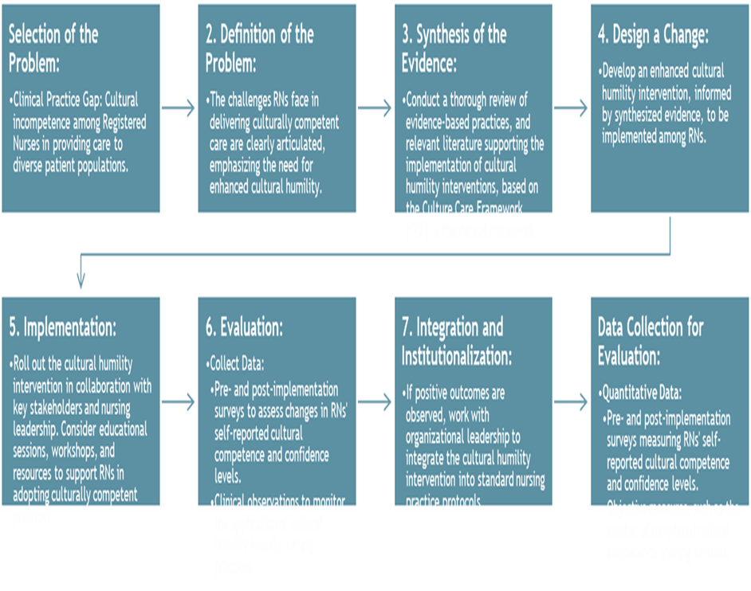
The Iowa Model
.

Slide 16
Project Methods
Project Design: This project utilized an Evidence-based practice quantitative pre- and post- test design.
The Transcultural Self-Efficacy Tool TSET toolkit (83 questions) was utilized.
Pre-implementation surveys assessed nurses' cultural competence and confidence levels using the TSET toolkit
Cultural humility intervention rolled out through a 25-minutes video.
Data collection by post-implementation surveys using Qualtrics

Slide 17
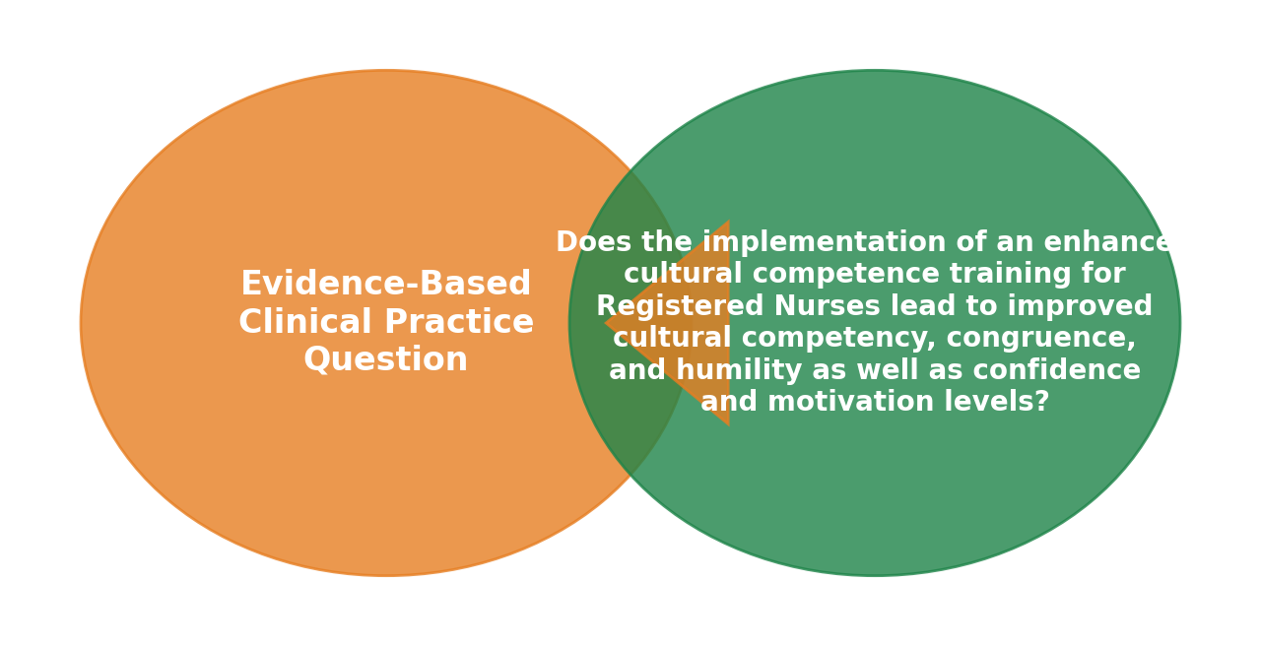
Project Question
Does the implementation of an enhanced cultural humility training for Nurses lead to improved cultural competence and confidence levels?

Slide 18
Sample/Setting
Sampling Design
Purposive and Convenience Sampling: Nigerian Nurse Practitioners USA-Arizona Chapter (NANNPU-AZ) members.
Recruitment Method
Email Invitations and Flyers
Sample size: 24 participants completed the pre- and post- questionnaires
Inclusion Criteria:
Nurse and Nurse Practitioners.
Exclusion Criteria:
Non-registered nurses.
NANNPU members not directly involved in patient care

Slide 19
Ethical Considerations
Informed Consent
Beneficence
Privacy
Integrity and Oversight

Slide 20
Research Variables
Independent Variables
Cultural Humility Training - Participation in the enhanced education intervention
Demographic Characteristics Personal traits like age, gender, race/ethnicity, education, and nursing experience. Data collected through questionnaires.
Dependent Variables
Cultural Competence The ability to interact effectively with diverse cultures, showing awareness and sensitivity. Scores from TSET in Qualtrics.
Confidence Levels Self-assurance in providing culturally competent care. Measured ratings on a Likert scale.

Slide 21
Measurements
Name of Instrument
Transcultural Self-Efficacy Tool (TSET)
Author, Year
Dr. Jefferys Marianne, 2000
Number of Questions
83 items

Slide 22
Quantitative Data Analysis
Qualtrics was used for questionnaires and data collection.
The analysis was conducted in R software version 4.3.2
Demographic variables was analyzed using descriptive statistics.
Paired t-test for Self-Efficacy Strength for each domain (affective, cognition, and practical) and the total.
Wilcoxon analysis performed to validate findings

Slide 23
Results: Demographics Characteristics
.

Slide 24
Results: Comparison of TSET scores

Slide 25
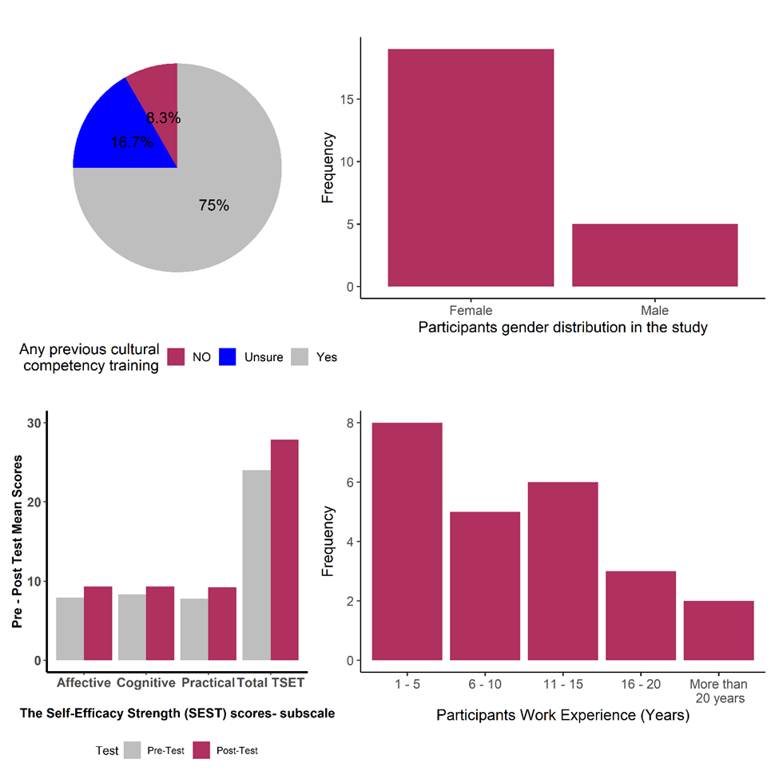
Data Chart
.

Slide 26
Discussion of findings
The intervention significantly improved cultural competence and confidence.
Participants reported higher self-efficacy post-intervention.
Findings support Jeffreys' Cultural Competence and Confidence (CCC) framework
Participants with prior cultural competence training showed notable improvement, emphasizing the need for continuous reinforcement.

Slide 27
Discussion of findings cont.
Literature supports that cultural competence training enhances:
✅ Patient satisfaction (Burgener, 2020)
✅ Trust & communication (Henderson et al., 2018)
✅ Shared decision-making (Jongen et al., 2018)
Tang et al. (2019) Found strong associations between cultural competence and patient trust & satisfaction.

Slide 28
Limitations
The project was limited by:
Sample Size and Composition
Geographic Specificity
Self-Reported Data
External Factors

Slide 29
Transferability
Scope & Sample Size: Insights from 24 NANNPU-AZ nurses and practitioners are valuable but limit transferability; larger, diverse samples are needed.
Contextual Limitations: Selection bias may restrict applicability to other nursing specialties and healthcare settings.
Future Recommendations
Conduct longitudinal studies to assess lasting effects.
Include more diverse participant samples.
Compare outcomes across different healthcare settings.

Slide 30
Conclusion
The project indicated that cultural humility training improved nurses' competence, and confidence. This highlights the importance of continuous self reflection and education in fostering culturally responsive care and enhancing patient outcomes.

Slide 31

References
.

Slide 32
Questions and Acknowledgements
First and foremost, I would like to express my deepest appreciation to God Almighty for His grace throughout this journey. I extend my sincere gratitude to my project chair, Dr. Peterson, and my committee members, Dr. Mensah, and Dr Baldwin for your mentorship, insightful feedback, and encouragement throughout this process. Your expertise and commitment to excellence have played a crucial role in shaping this project. I also thank the NANNPU-AZ for participating in this study. Special thanks to my colleagues and peers for their support. I am indeed grateful to my family, church family, military family and friends for their support, prayers, and encouragement. Lastly, a heartfelt thank you to my parents, my children, and my husband, whose constant motivation, prayers and understanding have been a source of strength throughout this endeavor. This project is a collective support and dedication of your selfless service, and I am truly grateful to each of you for your role in its success.

