Slide 1

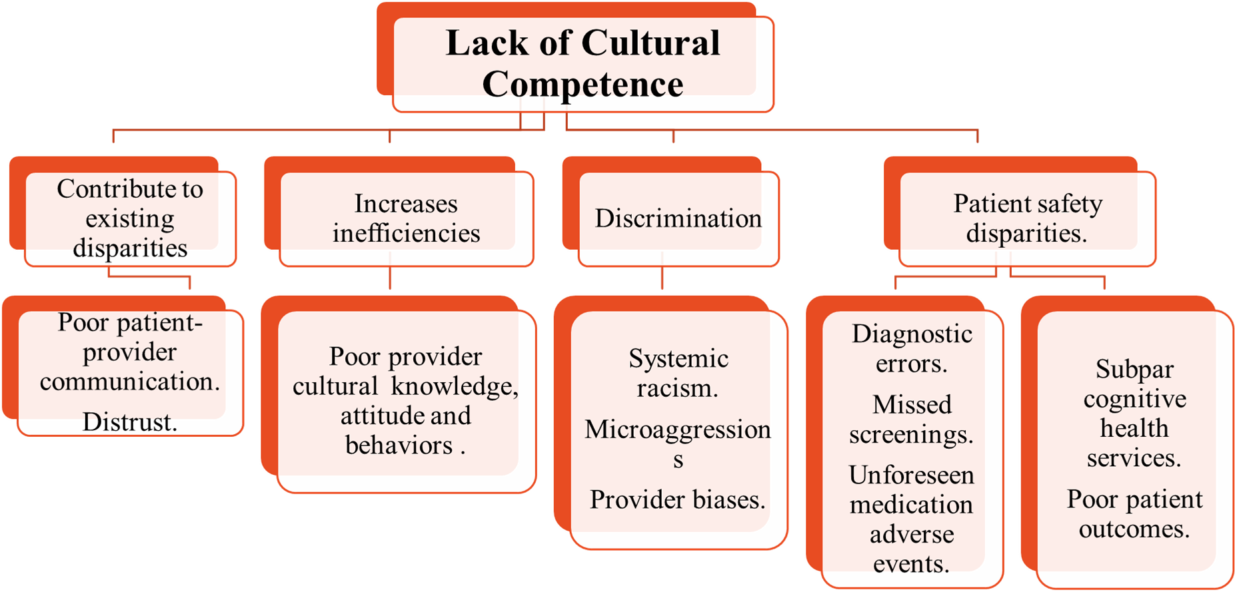
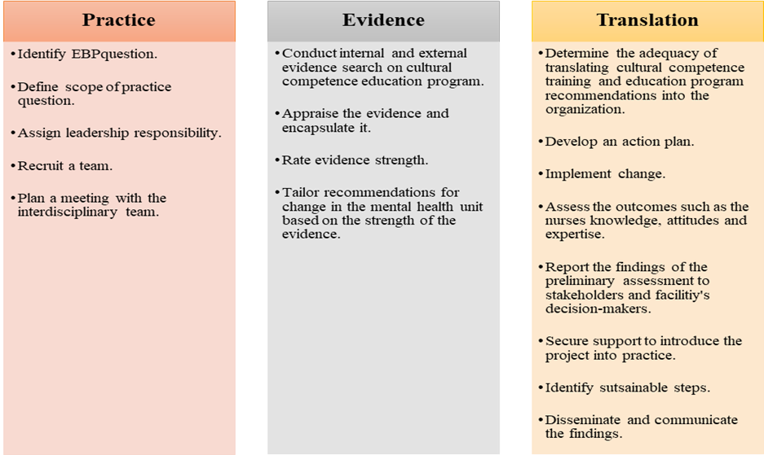
The Implementation of a Cultural Competence Educational Intervention for Nurses in a Psychiatric Mental Health Setting
Bruce Nsubuga, DNP(candidate), RN
Young School of Nursing | Regis College
Weston, Massachusetts | regiscollege.edu
PURPOSE
Plan and Procedures
INTENDED OUTCOMES
Add the theory and EBP graphic here!!!
To train psychiatric registered mental health nurses on culturally competence.
To boost their levels of cultural competence.
To assess nurse confidence levels.
To create a cultural competence educational intervention.
To share the findings with the stakeholders.
Familiarize with Qualtrics to collect data.
Send invitation link via Qualtrics, inviting participants.
Once the participants sign the informed consent, the data will be stored in Qualtrics.
Data will be deidentified once the participants sign informed consent and each participant will receive a numerical code in Qualtrics.
Participants will then complete the demographic survey.
Pre- and post-survey will be conducted using Vancouver cultural competence self-assessment checklist.
Create the educational intervention based on Leininger power point.
Obtain external site permission.
Obtain permission to use instrument the Vancouver cultural competence self-assessment checklist and confidence scale.
Create open-ended questions for the nurses about their feelings.
Become familiar with Intellectus Statistics and secure a Statistician consult
Increased levels of cultural competence and confidence.
Increased nurses’ cultural awareness, knowledge, and skills.
BACKGROUND
References
Arruzza, E., & Chau, M. (2021). The effectiveness of cultural competence education in enhancing knowledge acquisition, performance, attitudes, and student satisfaction among undergraduate health science students: A scoping review. Journal of Educational Evaluation for Health Professions, 18. https://doi.org/10.3352/jeehp.2021.18.3
Dang, D., Dearholt, S., Bissett, K., Ascenzi, J., & Whalen, M. (2022). Johns Hopkins evidence-based practice for nurses and healthcare professionals: Model and guidelines. 4th ed. Sigma Theta Tau International
Handtke, O., Schilgen, B., & Mösko, M. (2019). Culturally competent healthcare – A scoping review of strategies implemented in healthcare organizations and a model of culturally competent healthcare provision. PLoS ONE, 14(7). https://doi.org/10.1371/journal.pone.0219971
USE a QR code!!!
PROCESS
Plan For Data Collection
PI will collect data in Qualtrics software.
Participants will get access to informed consent and after they agree to participate they will be deidentified and granted random numerical value.
Data will be collected in May of 2025.
Only the PI and project chair will have access to the data in a password protected computer.
Data will be stored for three years and then destroyed.
Evaluation
Use a paired t-test to assess pre- and post- intervention scores.
Disseminate the findings to stakeholders and the organization.
(Arruzza & Chau, 2021; Handtke et al., 2019)
(Dang et al., 2022)

