Slide 1

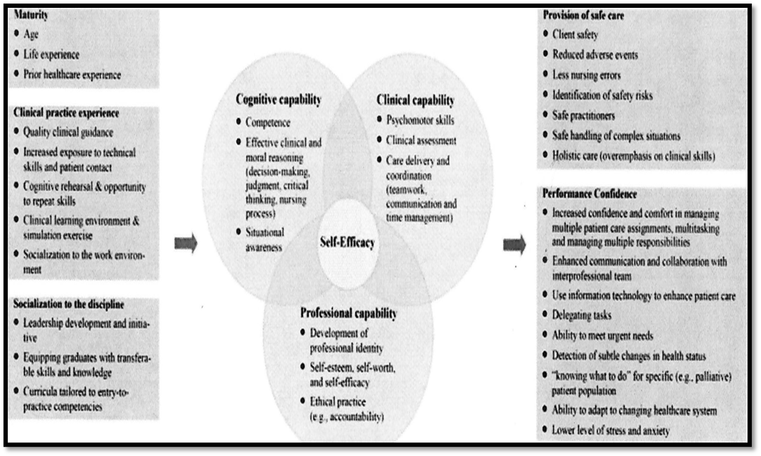
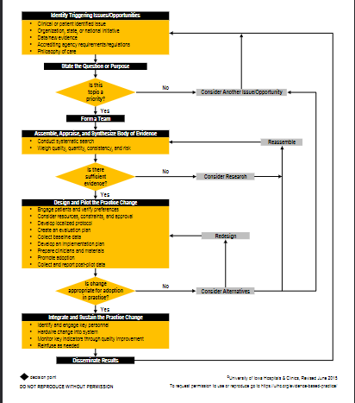


Providing an Educational Intervention Aimed at Improving Undergraduate Nursing Student Readiness for Practice and Self-Efficacy in Clinical Judgment Prior to Graduation
Deborah Delaney-Mullett DNP(c), MSN, BSHSA, RN
Young School of Nursing Regis College
Weston, Massachusetts
regiscollege.edu
PURPOSE
THEORETICAL FRAMEWORK EVIDENCE-BASED PRACTICE MODEL
METHODOLOGY
The aim of this project is to determine if there is a statistically significant change in the senior undergraduate nursing student’s perception of readiness for practice and self-efficacy in clinical judgment following an educational intervention case study of a deteriorating patient.
CONCEPT MODEL OF READINESS FOR PRACTICE
THE IOWA MODEL
Design: Mixed method design.
Sample: Undergraduate senior nursing students.
Setting: Associate Degree Program in the Southeast.
Instruments:
1. Demographic Survey
2. Casey-Fink Readiness for Practice Survey
3. Evidence-Based Nursing Practice Self-Efficacy Scale
Four open-ended questions
PROBLEM
New graduate nurses who are unable to demonstrate critical thinking skills or apply clinical judgment skills to changing patient conditions create an academic-practice gap, placing the quality of care and patient safety at risk (Africa & Skinner 2020). Nurses who are better prepared, have better skills around critical thinking, which is necessary to meet clinical judgment competency and apply evidence-based practices.
QUALITATIVE THEMATIC ANALYSIS
BACKGROUND
Readiness for practice is the shared responsibility of faculty, educational institution, students, nurse managers, clinical preceptors, and stakeholders of the organizations employing the new graduate nurse (Rusch, et al. 2019). Poorly defined definition of readiness for practice.
Disparity between deans and directors (90%), faculty, nurse leaders (10%), and clinical preceptors, and new graduate nurses (Spector et al, 2015)
Unprepared new graduate nurse impact on patient safety and quality of care (Houston et al. 2018, Rusch et al. 2018).
Registered Nurse turnover rate for 2021 is reported at 22.5% with the average cost of turnover for a bedside Registered Nurse to be more than $52,350 (Coleman, 2023).
Labor costs $6.6-10.5million per institution to replace nurses
Accountability is difficult to determine because of the ill-defined characteristics of the concept of readiness for practice (Mirza et al. 2019).
QUANTITATIVE DATA ANALYSIS
SIGNIFICANCE
Nursing Education: Compare findings to current literature.
Nursing Practice: add to knowledge elements of practice readiness,
design evaluation/measurement tools. Monitor quality and patient safety initiatives.
Nursing Research: establish standardized language for readiness for practice and add to the Practice-Ready initiative.
Nursing Leadership: influence on the nursing shortage, retention rates, and labor costs.
CLINICAL PRACTICE QUESTION
NEXT STEPS
Does a clinical judgment educational intervention case study of a deteriorating patient improve undergraduate nursing student perception of readiness for practice and self-efficacy of clinical judgment?
1. Planned dissemination to stakeholders: student participants via email and study site faculty at a faculty meeting with site mentor.
2. Submission for poster presentation at the annual Florida Nurses Association Nursing Research and Evidence-Based Practice conference July 2025.
3. Considering submission of article to the Journal of Teaching and Learning in Nursing, (Organization for Associate Degree Nursing).
SCHOLARLY PRACTICE TEAM
Project Chair: Dr. Celeste M. Baldwin, PhD, MS, APRN-CNS, GHNA
Mentor: Dr. Amy Lee, DNP, RN
Second Reader: Dr. Karen Cummins, Ph.D, MSN, FNP-BC
References

