Slide 1

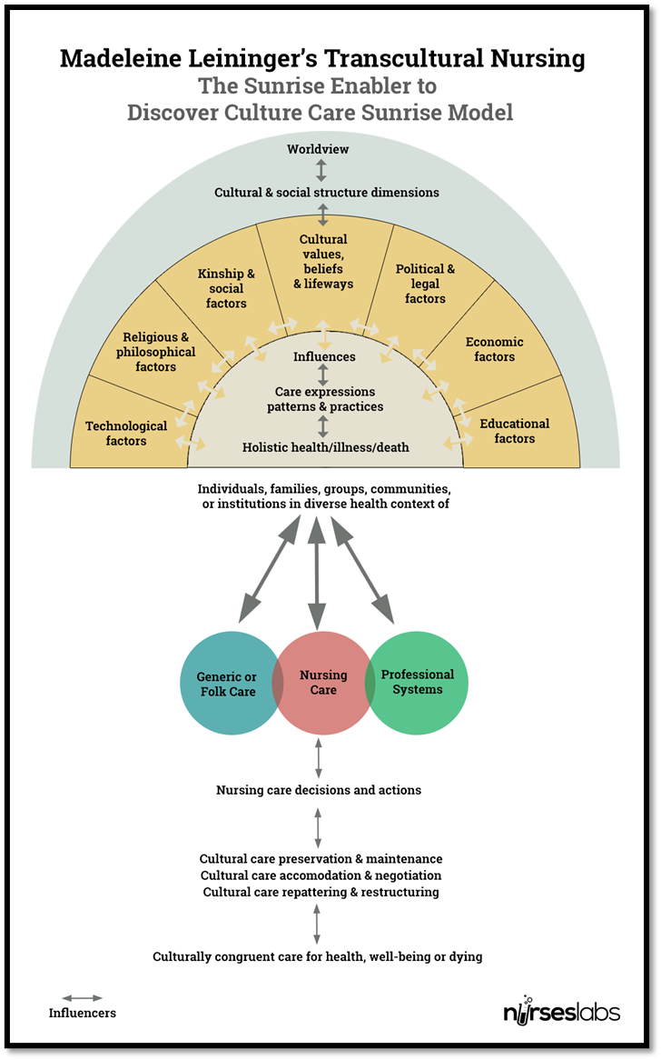
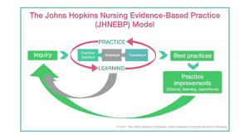
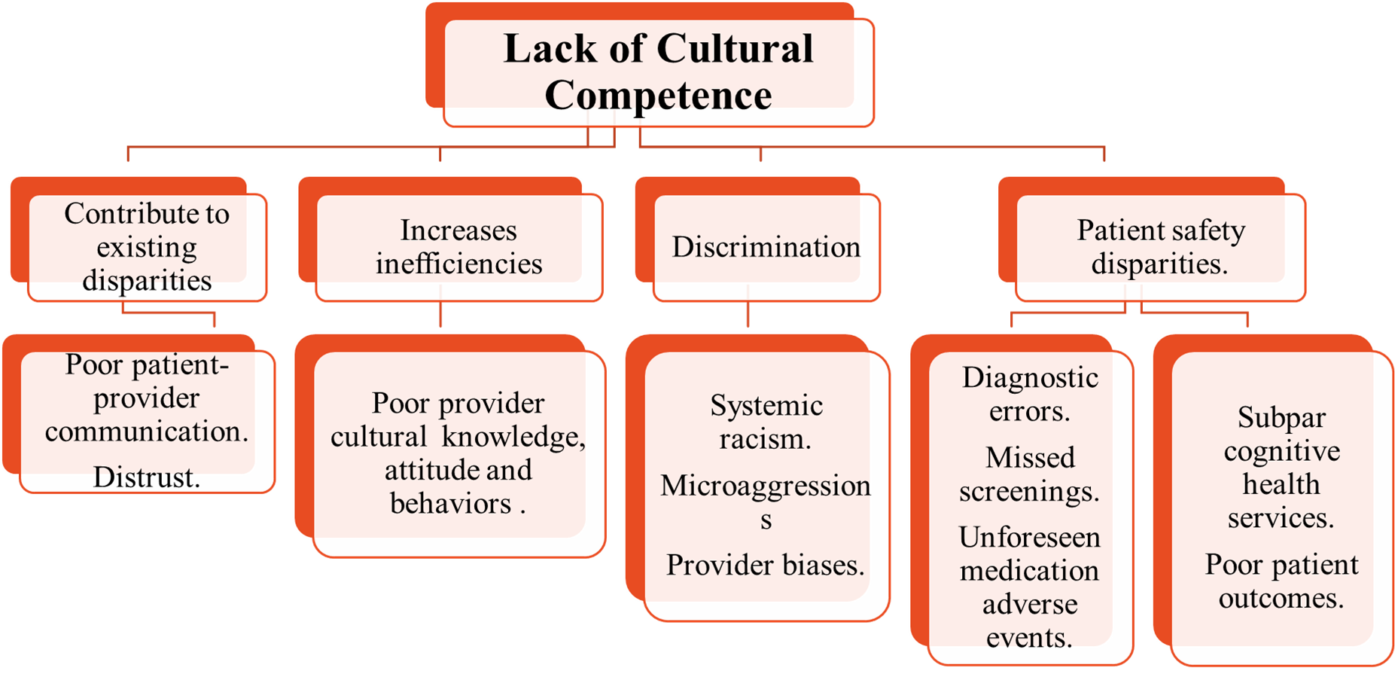
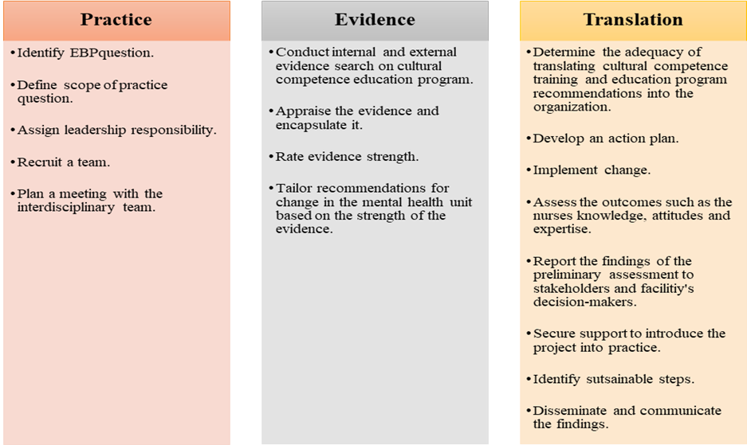
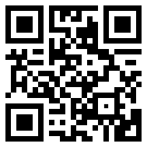
The Implementation of a Cultural Competence Educational Intervention for Nurses in a Psychiatric Mental Health Setting
Bruce Nsubuga, DNP(c), BSN, RN-PMHNP
Young School of Nursing | Regis College
Weston, Massachusetts | regiscollege.edu
SCHOLARLY COMMITTEE
LEININGER'S SUNRISE MODEL
JOHNS HOPKINS NURSING EBP MODEL
PLAN AND PROCEDURES
Chair: Dr. Celeste M. Baldwin, PhD, MS, APRN-CNS, GHNA.
Mentor: Dr. Anne Kabuusu DNP, PMHNP-BC
Second Reader: Dr. William Byansi, MSW, PhD.
Familiarize with Qualtrics to collect data.
Send invitation link via Qualtrics, inviting participants.
Once the participants sign the informed consent, the data will be stored in Qualtrics.
Data will be deidentified once the participants sign informed consent and each participant will receive a numerical code in Qualtrics.
Participants will then complete the demographic survey.
Pre- and post-survey will be conducted using Vancouver cultural competence self-assessment checklist.
Create the educational intervention based on Leininger power point.
Obtain external site permission.
Obtain permission to use instrument the Vancouver cultural competence self-assessment checklist and confidence scale.
Create open-ended questions for the nurses about their feelings.
Become familiar with Intellectus Statistics and secure a Statistician consult
PURPOSE
To train psychiatric registered mental health nurses on culturally competence.
To boost their levels of cultural competence.
To assess nurse confidence levels.
To create a cultural competence educational intervention.
To share the findings with the stakeholders.
BACKGROUND
SIGNIFICANCE
PROCESS
Nursing Practice: Improving the efficiency of healthcare delivery.
Nursing Education: Creating a more skilled, diverse, and confident nursing workforce capable of addressing the distinct needs of their patients (Arruzza & Chau, 2021).
Nursing Leadership: Fostering the adaptation of diverse cultural practices (Cerveny et al., 2022).
Nursing Research: Exploring effective culturally competent training approaches.
PLAN FOR DATA COLLECTION
PI will collect data in Qualtrics software.
Participants will get access to informed consent and after they agree to participate they will be deidentified and granted random numerical value.
Data will be collectaed in May of 2025.
Only the PI and project chair will have access to the data in a password protected computer.
Data will be stored for three years and then destroyed.
(Dang et al., 2022)
(Arruzza & Chau, 2021; Handtke et al., 2019)
CLINICAL PRACTICE QUESTION
EVALUATION
INTENDED OUTCOMES
INTENDED OUTCOMES
Does the implementation of a culturally competent educational intervention improve the competence for psychiatric mental health registered nurses?
Use a paired t-test to assess pre- and post- intervention scores.
Disseminate the findings to stakeholders and the organization.
Increased levels of cultural competence and confidence.
Increased nurses’ cultural awareness, knowledge, and skills.

