Slide 1
THE ROLE OF THE DNP PREPARED NURSE AS A MENTOR
Name
Chamberlain university college of nursing
COURSE NAME AND NUMBER
SESSION, MONTH, YEAR
Notes:
Hello and welcome to the presentation which will explore the role of the DNP-prepared nurse as a mentor. The presentation will discuss the impact of mentorship on the healthcare system, professional development and nursing retention.

Slide 2

OBJECTIVE AND DEFINITION: OBJECTIVES
Define mentorship in nursing
Discussing DNP-prepared nurse’s role
Discuss nurse mentoring and retention
Evaluate professional benefits from mentorship
Essence of mentorship in healthcare
Retrieved from: https://www.npwomenshealthcare.com/the-mentoring-role-for-dnp-projects/
Notes:
The objectives of the presentation based on the selected topic outline the major points or topics for discussion throughout the presentation. The first step is to define mentorship to understand the concept before delving into its constructs. This is because mentorship plays a crucial role in leadership development and career growth among others. The presentation will also focus on discussing the DNP’s role as a mentor, in addition to examining the influence of mentorship on nurse retention, professional development and satisfaction. Such a step will help to evaluate professional benefits associated with mentorship and ultimately determine the essence of mentorship in healthcare.

Slide 3
OBJECTIVE AND DEFINITION: DEFINITION
Professional support and guidance
Fosters skill and career growth
Encourage learning and knowledge sharing
Strengthens leadership and decision-making
Enhance professional accountability
Notes:
Mentorship can be defined as a structured professional relationship where nurses support and guide others (Mínguez Moreno et al., 2023). Qualified and experienced nurses mentor other nurses towards fostering skill and career growth while encouraging learning and Knowledge sharing. This means that mentors share knowledge to support continuous learning, enhance professional accountability and strengthen leadership and decision-making (Wang et al., 2024). For this reason, mentees gain knowledge that allow them to navigate through the complex health system hence improving their competence.

Slide 4
MENTORING AND NURSE RETENTION
Improves job satisfaction levels
Enhances opportunities for career advancement
Reduces nurse turnover rates
Creates a supportive environment
Encourages workplace commitment
High job satisfaction
Reduced turnover rates
Supportive environment
Encourages workplace commitment
Enhances Opprotunities
Career advancements
Notes:
Mentorship is accompanied by various benefits from a broad viewpoint which includes improving job satisfaction levels, reducing nurse turnover rates and encouraging workplace commitment. Consequently, nurses can handle stressful environments by applying the concepts learned from their mentors, an action that creates a supportive environment. This also encourages workplace commitment given that nurses feel a sense of belonging due to the supportive nature associated with mentorship (Gong et al., 2022).

Slide 5
MENTORING AND PROFESSIONAL GROWTH
Strengthens evidence-based nursing skills
Enhances resilience and confidence
Promotes a culture of continuous learning
Supports academic and career progression
Builds critical thinking and leadership
Notes:
Other benefits associated with mentorship is that it strengthens evidence-based nursing skills since most mentors focus on the portent issues in nursing such as upholding evidence-based practices. Learning about the essence of employing EBP practice enhances confidence and resilience in addition to promoting a culture of continuous learning and encouraging career progression (Gularte-Rinaldo et al., 2023). Therefore, mentees gain adaptability in nursing practice hence emerging competent to handle patient and organizational needs.

Slide 6
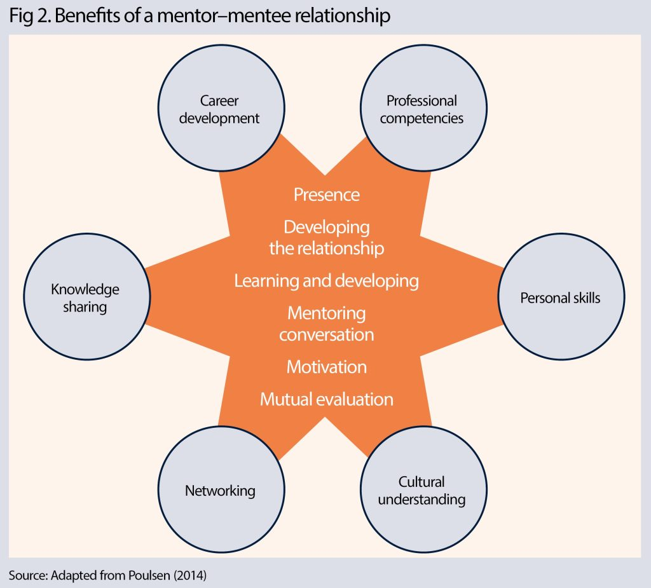
IMPACT, BENEFITS AND RATIONALE
Benefits for mentees;
Supports career development
Expands professional networking
Increases job confidence
Enhances clinical decision-making
Strengthens problem-solving skills
Retrieved from: https://www.nursingtimes.net/education-and-training/leadership-education-through-a-student-lecturer-partnership-02-09-2024/
Notes:
Mentorship benefits mentees in various ways such as equipping them with the ability to solve problems. This means that addressing issues such as ethical dilemmas at the workplace will be simpler due to the confidence and problem-solving skills gained from the mentorship program (Nunan et al., 2023). Consequently, mentees will further develop their career from gaining clinical experience from mentorship.

Slide 7
IMPACT, BENEFITS AND RATIONALE CONT.
Benefits for mentors;
Builds a legacy
Encourages lifelong learning
Develops leadership skills
Enhances career satisfaction
Strengthens professional fulfillment
Notes:
Although mentorship could be perceived as beneficial to mentees, mentors also benefit through further development of their skills as they continue sharing new knowledge. Leadership skills are also developed during mentorship where nurses continue building their confidence as they guide mentees into achieving best practices in healthcare (Xu et al., 2021). On the other hand, most mentors build and leave a legacy over time due to the impact they cause on mentees, by empowering them to work towards achieving their intended goals. For this reason, professional fulfillment is achieved once mentees begin to demonstrate competency in their practice.

Slide 8
IMPACT, BENEFITS AND RATIONALE CONT.
Benefits for organization;
Improves workplace culture
Increases staff engagement
Supports leadership development
Reduces employee turnover
Strengthens patient care quality
Notes:
Similar to mentors and mentees, the organization also benefits and is impacted by mentorship where creating awareness and supporting mentees about potential challenges experienced increases staff engagement and improves the workplace culture. Organizations also benefits from mentorship since passing on the tradition, value and purpose of an organization through the mentor’s guidance increases a sense of identity with the organization (Gong et al., 2022). Ultimately, mentorship also proves beneficial to the organization due to increased staff engagement, reduced employee turnover rates and an improved workplace culture.

Slide 9
MENTORING IN HEALTHCARE TODAY
Facilitates knowledge transfer
Encourages collaboration
Enhances resilience
Improves recruitment and retention
Addresses workforce shortages
Knowledge transfer
Collaboration
Resilience
Addresses workforce shortages
Notes:
Mentorship is crucial in the current healthcare system as it improves recruitment and retention and facilitates knowledge transfer thereby contributing to a culture of growth and continuous learning (Teo et al., 2024). On the other hand, mentoring in healthcare today is important as it encourages collaboration where mentors and mentees come together to address specific issues of concern hence upholding quality care and patient outcomes. Such an action also enhances resilience among nurses as they understand the dynamics of healthcare and have been prepared to handle potential challenges. Therefore, the process of mentorship is repeated and facilitates the transfer of knowledge to ensure continuity in improvement.

Slide 10
WHY MENTORING MATTERS
Enhances patient safety
Crucial for professional growth
Improves job satisfaction
Enhances communication skills
Strengthens healthcare workforce
Notes:
Mentoring other nurses matters as it demonstrates collaborative efforts towards knowledge sharing for better support and increased motivation (Voss et al., 2022). Additionally, mentorship matters since it is crucial for professional growth, and enhances patient safety. According to Wynn et al. (2021), mentorship also enhances communication skills and decreases nurse burnout hence improving job satisfaction.

Slide 11
CONCLUSION
Mentorship;
Encourages professional collaboration
Improves patient outcomes
Supports career development
Essential for nurse retention
Strengthens healthcare leadership
Notes:
The presentation has defined mentorship and addressed its essence in the current healthcare system. Given the need to understand the concept of mentorship, the presentation has outlined benefits mentorship to the mentee, mentor and organization to gain a deeper understanding of how and why mentorship programs should be included in healthcare organizations. Ultimately, mentorship can be considered as a strategic approach towards strengthening healthcare leadership and system by equipping nurses with knowledge and understanding regarding navigating challenges and addressing healthcare concerns.

Slide 12
REFERENCES
Gong, Z., Van Swol, L. M., & Wang, X. (2022). Study on the relationship between nurses’ mentoring relationship and organizational commitment. International journal of environmental research and public health, 19(20), 13362. https://doi.org/10.3390/ijerph192013362
Gularte-Rinaldo, J., Baumgardner, R., Tilton, T., & Brailoff, V. (2023). Mentorship respect study: a nurse Mentorship program’s impact on transition to practice and decision to remain in nursing for newly graduated nurses. Nurse Leader, 21(2), 262-267. https://doi.org/10.1016/j.mnl.2022.07.003
Mínguez Moreno, I., González de la Cuesta, D., Barrado Narvión, M. J., Arnaldos Esteban, M., & González Cantalejo, M. (2023, August). Nurse Mentoring: A Scoping Review. In Healthcare (Vol. 11, No. 16, p. 2302). MDPI. https://doi.org/10.3390/healthcare11162302
Nunan, J. L. R., Ebrahim, A. B., & Stander, M. W. (2023). Mentoring in the workplace: Exploring the experiences of mentor-mentee relations. SA Journal of Industrial Psychology, 49(1), 1-11. https://doi.org/10.4102/sajip.v49i0.2067
Teo, M. Y. K., Ibrahim, H., Lin, C. K. R., Hamid, N. A. B. A., Govindasamy, R., Somasundaram, N., ... & Krishna, L. K. R. (2024). Mentoring as a complex adaptive system–a systematic scoping review of prevailing mentoring theories in medical education. BMC Medical Education, 24(1), 726. https://doi.org/10.1186/s12909-024-05707-5
Voss, J. G., Alfes, C. M., Clark, A., Lilly, K. D., & Moore, S. (2022). Why mentoring matters for new graduates transitioning to practice: Implications for nurse leaders. Nurse Leader, 20(4), 399-403. https://doi.org/10.1016/j.mnl.2022.01.003
Wang, Y., Hu, S., Yao, J., Pan, Y., Wang, J., & Wang, H. (2024). Clinical nursing mentors’ motivation, attitude, and practice for mentoring and factors associated with them. BMC nursing, 23(1), 76. https://doi.org/10.1186/s12912-024-01757-8
Wynn, S., Holden, C., Romero, S., & Julian, P. (2021). The importance of mentoring in nursing academia. Open Journal of Nursing, 11(04), 241. https://doi.org/10.4236/ojn.2021.114021
Xu, S., Liu, P., Yang, Z., Cui, Z., & Yang, F. (2021). How does mentoring affect the creative performance of mentors: The role of personal learning and career stage. Frontiers in Psychology, 12, 741139. https://doi.org/10.3389/fpsyg.2021.741139

