Slide 1

DNP Project Education Plan
Name
Institutional Affiliation
Course
Instructor
Date of Presentation

Slide 2
NURSES’ EDUCATION
Notes:
The overarching aim of the educational sessions is to enhance nurses’ knowledge and skills in cognitive behavioral therapy and prepare patients for the sessions. By the end of the sessions, the learner will understand the core principles of CBT, its application in practice, and the use of the AUDIT tool in assessing the severity of alcohol consumption. This understanding is essential to ensuring accurate assessment before and after the intervention.

Slide 3
Introduction
Aim: Enhance CBT knowledge and skills
Target population: Nursing staff and patients
Learner outcomes:
  Understand core CBT principles
  Understand application of CBT in practice
  Understand use of the AUDIT tool
Notes:
The overarching aim of the educational sessions is to enhance nurses’ knowledge and skills in cognitive behavioral therapy and prepare patients for the sessions. By the end of the sessions, the learner will understand the core principles of CBT, its application in practice, and the use of the AUDIT tool in assessing the severity of alcohol consumption. This understanding is essential to ensuring accurate assessment before and after the intervention.

Slide 4
Evidence-Based Intervention
Cognitive Behavioral Therapy (CBT)
First-line psychotherapy (Brown et al., 2021)
  Motivational strategies
    Motivate engagement in meaningful activities (Malik et al., 2021)
  Cognitive restructuring
    Supplant of dysfunctional cognitions (Crum, 2021)
Notes:
Before delving into the educational content, let us recap about cognitive behavioral therapy (CBT), which will serve as the evidence-based intervention in the project. CBT is considered the first-line or gold standard psychotherapeutic intervention for depression and can be used alone or in combination with pharmacotherapy (Brown et al., 2021). The intervention works through cognitive restructuring and behavioral activation. Behavioral activation can simply be understood as an approach that focuses on overt behaviors. It involves motivating individuals to engage in meaningful activities, which could involve routine activities, pleasurable activities, or necessary activities (Malik et al., 2021). On the other hand, cognitive restructuring involves supplanting dysfunctional thoughts or cognitions with adaptive thoughts (Crum, 2021).

Slide 5
Functional Analysis
Self-help goals as a roadmap
Identification of triggers
Set goals
  What do they hope to achieve?
  What will be different?
  How can they achieve the changes?
Frequent review of goals
Notes:
Now let us focus on functional analysis, which is the process of setting the agenda and guiding patients in setting goals. Self-help goals serve as a roadmap for change and assessment of progress. Goal-setting should start with the identification of stimuli and triggers. For example, this could involve prompting clients to identify and list triggers that lead to alcohol comsuption, including environmental, personal, or social triggers. In turn, this leads to the development of SMART goals that focus on what the client hopes to achieve, what will be different, and how they can achieve the changes. It is essential to encourage clients to set goals relevant to their problems and set a timeline for the achievement to evoke commitment.

Slide 6
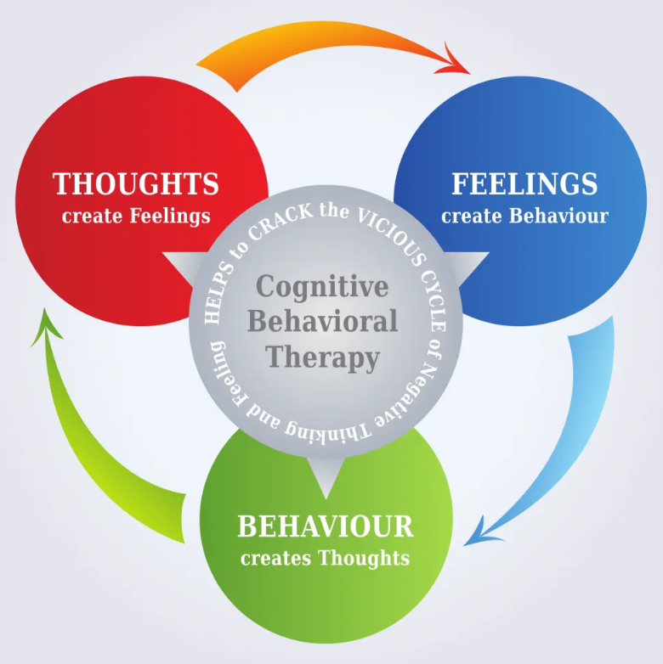
The ABC Model
Interpretation of stimuli that trigger cravings or alcohol use
Analyzing situations that lead to NATs
Linking NATs with behaviors, and physical symptoms
  Focus on where, when, what, with whom?
Guiding patients to challenge the beliefs
Notes:
Next, it will be essential to apply the ABC model when implementing CBT during the initial sessions. Applying the ABC model implies supporting patients in understanding their cognitions, physical manifestations, and behaviors through the interpretations of stimuli or situations that trigger cravings for alcohol. In other words, this implies helping them to analyze situations that cause negative automatic thoughts (NATs) or unhelpful thoughts that occur without effort. These thoughts could be misguided and result in alcohol use as an escape. After analyzing the situations and the association thoughts, the next step involves helping clients in linking NATs with behaviors and physical symptoms. In making the link, we should focus clients on the where, when, what, and with whom about the identified situations or stimuli. This will serve as the foundation to guide patients in challenging their beliefs.

Slide 7
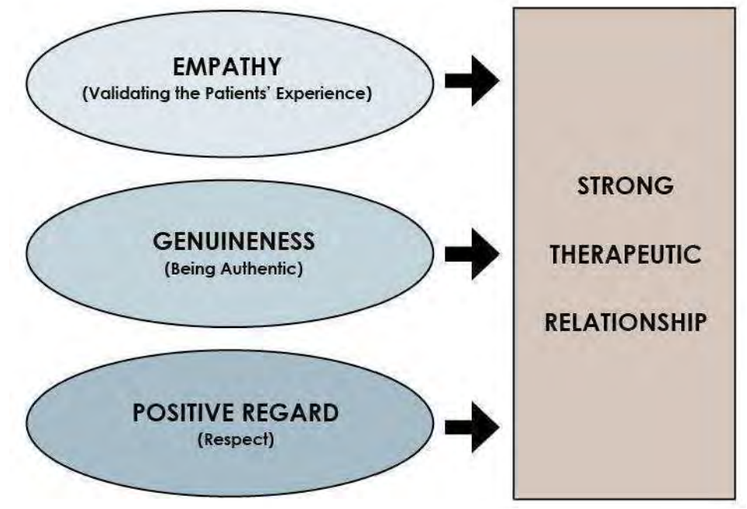
Motivational Strategies
Assessment of alcohol use motives
Assess ambivalence to change
Target cognitive distortions
  For example, rationalizing use (McHugh et al., 2020)
Elicit accurate information about rationalized thoughts
Identify alternative appraisals and provide psychoeducation
Notes:
You will use motivational strategies after identifying high-risk events, situations, or triggers (cues) that lead to alcohol use. This will take the form of motivational interviewing in which you will assess patients’ motives for alcohol use and their ambivalence to change. Based on the information acquired, you will educate patients on rehearsing and using non-alcohol alternatives to the cues. Moreover, you will target cognitive distortions identified using the ABC model. This could include patients’ rationalizing the use of alcohol, as highlighted by McHugh et al. (2020). For example, take note of statements such as “It has been a bad day, I deserve a drink,” or “One drink won’t hurt me,” or “why even try quitting.” Based on the information elicited, you will guide patients in identifying and using alternative appraisals and psychoeducation about the thoughts.

Slide 8

Cognitive Restructuring
Identify beliefs about a specific problematic aspect of life that triggers use
Rate belief on a scale of 0-100%
Evaluate patients’ expectancies
Design behavioral experiment for the alternative belief
Evaluate outcomes of the alternative
Notes:
Cognitive restructuring will be among the most essential part of the program. In this approach, you will start by guiding patients in identifying beliefs about a specific aspect of their life that triggers alcohol use. It is common to find patients maintaining a belief that a particular problem or situation in their life requires addressing through alcohol. For instance, a patient may believe that a tiring or stressful day after work should always be dealt with a drink. You will ask the patient to rate the belief on a scale of 0-100% and evaluate the patients’ expectancies about encountering the situation in the future. In turn, you will design a behavioral experiment for the patient and give it as homework to complete before the next session. For example, you could encourage the patient to refrain from drinking after work and assess the degree to which this affected them. The outcomes will be evaluated in the subsequent sessions.

Slide 9
Shifting Contingencies and Skills Training
Rewarding abstinence
  Acknowledging progress, offering praise, and signposting patients to enjoyable activities
Exposure to cues
Addressing anxieties and fears
Skills building
  Interpersonal skills
  Emotion regulation
  Problem-solving skills
Notes:
Besides, you will be applying the techniques of shifting contingencies and skills training during the sessions. With the consideration that the motivational and cognitive strategies will reduce alcohol use, it will be essential to reward abstinence. Some of the approaches you could use include acknowledging patients’ progress, offering praise, and signposting them to enjoyable activities within their communities. It could also involve exposing the patients to moderate cues based on clinical judgment of improvements achieved. You will also be required to address anxieties and fears that often amplify individuals’ aversiveness of withdrawal or consequences of quitting. Finally, skills training will focus on interpersonal skills, emotion regulation, and problem-solving skills. For instance, you will use your knowledge and rapport built with patients to rehearse socially-acceptable responses to offers for alcohol, strategies of coping, development of pleasurable sober activities.

Slide 10
Use of the AUDIT Tool
Scores ranging from 0-40
Item 1-8 scored as 0,1,2,3, or 4
Item 9 and 10 scored as 0, 2, or 4
Scores for each item added for a total score
  0: abstinent
  1-7: low risk
  8-12: Risky
  13+: High risk
Notes:
Since we will be using the AUDIT tool, it is essential to understand how the tool should be used. The tool is used to assess the severity of alcohol consumption, with scores ranging from 0-10. As illustrated in the next slide, item 1-8 of the tool are scored as 0,1,2,3, or 4, while item 9 and 10 are scored as 0, 2, or 4. Patients will fill in these paper-based questions but you should ensure they understand the items fully. In scoring the tool, you will add all the scores for each item. A score of 0 is desired and illustrates abstinence, a case which a patient will receive positive reinforcement to sustain the behavior. Scores of 1-7 indicate low risk. In this case, you will discuss the score with the patient and discuss the benefits of low-risk drinking while motivating improvements. Scores above 8 will be considered harmful. You will discuss the scores with the patients and probably refer them for additional treatment.

Slide 11

Evaluation
Teach back method and feedback
Role-playing scenarios
  Exercise with motivational and cognitive strategies
  Exercise with shifting contingencies and skills training
Personal exercise with the AUDIT tool
Notes:
The evaluation of the achievement of outcomes will involve three primary strategies. Firstly, the teach back method and formative feedback will be used to assess participants’ understanding of some of the concepts and their application. Secondly, role-playing scenarios will also be used to exercise motivational and cognitive strategies, shifting contingencies, and skills training. Finally, participants will take personal exercises with the AUDIT tool to reinforce their understanding of the tool and interpretation of the scores.

Slide 12
PATIENTS’ EDUCATION
Notes:
In this session, we will learn several things about cognitive behavioral therapy. Broadly, CBT involves a therapeutic approach that aims at changing individuals thoughts that affect emotions and actions (Beck, 1970). The treatment modality is considered essential in the treatment of depression for many reasons. For instance, working with the PMHNPs will help you in learning ways to manage negative automatic thoughts (NATs), increase your engagement in positive activities, and impart knowledge and skills about new ways of coping with stress and managing situations that evoke negative thoughts.

Slide 13
Cognitive Behavioral Therapy
What is CBT?
  Changing thoughts affecting emotions and actions (Beck, 1970)
Why CBT?
  Learn ways to manage negative thoughts
  Increase positive activities
  New ways to cope and manage situations
Notes:
In this session, we will learn several things about cognitive behavioral therapy. Broadly, CBT involves a therapeutic approach that aims at changing individuals thoughts that affect emotions and actions (Beck, 1970). The treatment modality is considered essential in the treatment of depression for many reasons. For instance, working with the PMHNPs will help you in learning ways to manage negative automatic thoughts (NATs), increase your engagement in positive activities, and impart knowledge and skills about new ways of coping with stress and managing situations that evoke negative thoughts.

Slide 14
The ABC Model
Activating event situation occurs
Negative automatic thoughts emerge
Thoughts influence behavior and actions (Tiba, 2024)
For example:
“I had a bad day, I have to reward myself with a drink.”
“I’m stressed, I need a drink.”
Notes:
Implementing the modality requires an understanding of the ABC model. The model posits that when people face adversities (A), they create unhealthy emotions (C) because of the destructive beliefs (B) (Tiba, 2024). Conventionally, many NATs emerge after the occurrence of an activating situation. In turn, these thoughts tend to influence our behaviors and actions. For example, this could involve a situation where one had a bad day at work and rationalizes drinking as a reward. It may also involve having a stressful moment and believing that only drinking could reduce the feeling. From this example, you understand that rationalizing drinking often leads to a cycle of drinking because it embeds it as an automatic thought.

Slide 15
Steps and Expectations
Identify NATs
Link to behaviors and symptoms
SMART goal setting
Motivational strategies
Cognitive restructuring (Ciharova et al., 2021)
  Replace NATs with healthier thoughts
  Focus on goals
Notes:
With this understanding, we can explore the steps that the sessions will include and the expectations for you, as the patient. Initial sessions will focus on identifying and linking the negative thoughts that often lead to alcohol use. Based on the earlier example, this could involve assessing the situations that often result in drinking. You will be exploring these cues and linking them with the drinking behavior. In turn, this will form the basis for SMART goal setting. You will work collaborative with the nurse in setting easy, measurable, and achievable goals that target your thoughts. In turn, you will be participating in motivation-based activities, including reviewing and engaging in relevant activities to supplant the thoughts that emerge after exposure to cues. We will also explore cognitive distortions and involve you in exercises aimed at enhancing specific skills that may improve abstinence. The activities will be focused on the goals you set at the start of the sessions and based on your progress.

Slide 16
Evaluation of Progress
Document thoughts in a journal
Write down daily activities
Open discussion of thoughts and feelings
Attend all sessions
Adjust goals based on progress
Notes:
Tracking progress and remaining committed to therapy will be essential to achieving the expected treatment outcomes. Documenting your thoughts and writing down your daily activities in a journal will be crucial to tracking your progress. From the journal, you might identify patterns of negative thoughts and identify the activities that pose the most significant challenge. It will be essential for you to discuss your thoughts and feelings with the nurse openly to ensure tailored support in efforts to achieve your goals. In addition, you are encouraged to attend all sessions and adjust your goals based on progress.

Slide 17
Questions?
Thank You
Notes:
If you have any questions, feel free to ask them or share your concerns. Thank you for participating. We look forward to working collaboratively with you to ensure you achieve holistic health and wellness.

Slide 18
References
Beck, A. T. (1970). Cognitive therapy: Nature and relation to behavior therapy. Behavior therapy, 1(2), 184-200. https://doi.org/10.1016/S0005-7894(70)80030-2
Brown, L. K., Chernoff, M., Kennard, B. D., Emslie, G. J., Lypen, K., Buisson, S., Weinberg, A., Whiteley, L. B., Traite, S., Krotje, C., Harriff, L., Townley, E., Bunch, A., Purswani, M., Shaw, R., Spector, S. A., Agwu, A., Shapiro, D. E., & IMPAACT 2002 team. (2021). Site-randomized controlled trial of a combined cognitive behavioral therapy and a medication management algorithm for treatment of depression among youth living with HIV in the United States. Journal of Acquired Immune Deficiency Syndromes (1999), 88(5), 497–505. https://doi.org/10.1097/QAI.0000000000002790
Ciharova, M., Furukawa, T. A., Efthimiou, O., Karyotaki, E., Miguel, C., Noma, H., Cipriani, A., Riper, H., & Cuijpers, P. (2021). Cognitive restructuring, behavioral activation and cognitive-behavioral therapy in the treatment of adult depression: A network meta-analysis. Journal of consulting and clinical psychology, 89(6), 563–574. https://doi.org/10.1037/ccp0000654
Crum J. (2021). Understanding mental health and cognitive restructuring with ecological neuroscience. Frontiers in Psychiatry, 12, 697095. https://doi.org/10.3389/fpsyt.2021.697095
Malik, K., Ibrahim, M., Bernstein, A., Venkatesh, R. K., Rai, T., Chorpita, B., & Patel, V. (2021). Behavioral Activation as an 'active ingredient' of interventions addressing depression and anxiety among young people: a systematic review and evidence synthesis. BMC Psychology, 9(1), 150. https://doi.org/10.1186/s40359-021-00655-x
McHugh, R. K., Hearon, B. A., & Otto, M. W. (2020). Cognitive behavioral therapy for substance use disorders. The Psychiatric clinics of North America, 33(3), 511–525. https://doi.org/10.1016/j.psc.2020.04.012
Tiba A. I. (2024). The grounded cognition foundation of the first cognitive model in cognitive behavior therapy: implications for practice. Frontiers in psychology, 15, 1364458. https://doi.org/10.3389/fpsyg.2024.1364458

