Slide 1




Case Study Presentation
Name
Institution
Instructor
Course
Due date
Notes:
Hello Everyone,
Welcome to my scheduled case study presentation.
My name is XXXX, a student at Wilkes University Passan School of Nursing Graduate Program pursuing (COURSE) under (Instructor).
The case study presentation focuses on a patient I encountered during my practicum experience with a personality disorder namely substance use disorder with depression.

Slide 2
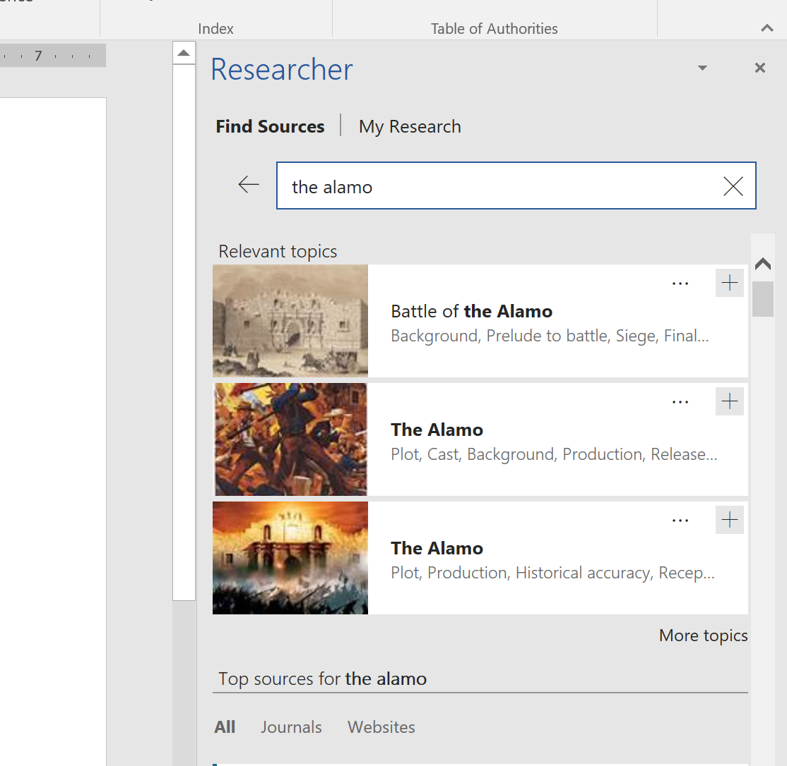
Overview
Subjective Data: Chief complaint (CC), symptoms, duration, and history of presenting illness (HPI).
Review of Symptoms (ROS) – Identification of potential symptoms across various body systems that might be omitted in chief complaint.
Objective Data – Observations made during psychiatric evaluation including mental status exam (MSE) results.
Assessment – Case formulation & differential diagnoses per DSM-5-TR.
Treatment Plan – Evidence-based, comprehensive and holistic plan and recommendations.
Notes:
The presentation seeks to select a patient encountered during practicum experience and develop a case study presentation. The objective of the assignment is to practice in a grand rounds format of the psychiatric evaluation of a patient to present a case and entire treatment plan to peers in a logical, thorough, concise and organized manner. The presentation will incorporate data including details provided by the patients on chief complaint, symptomology, duration and their impacts in functioning to derive a diagnosis. The presentation will discuss objective information based on observations made during the psychiatric evaluation. Besides, the presentation will provide mental status exam results and appropriate physical vital signs or other relevant diagnostic results. The presentation will include assessment by formulating differential diagnoses per the Diagnostic and Statistical Manual of Mental Disorders, Fifth Edition, Text Revision (DSM-5-TR) aligned to history of presenting illness (HPI) description. An evidenced-based treatment plan will be offered with rationales in a holistic and comprehensive synthesizing critical thinking and strong evidence.

Slide 3
Subjective Data
Pt. Initials: XYZ Age: 29 Gender: Male Ethnicity: Indian
Historian: Mother and the patient.
Chief Complaint: “He seems depressed, irritable, aggressive and excessive drug use.”
History of Presenting Illness (HPI):
  29 year old Indian male with severe headaches, reduced sleep and appetite, weight loss, aggression, sweating, chills, irritable, anger, craving for drugs, and potential violent behavior.
  Excessive drug use lead to aggressive behaviors, ultimately causing disturbance in social relationship with family, peers and colleagues.
Notes:
XYZ is a 29 year old Indian male who reported to the clinic accompanied by his mother. The initial assessment during the assessment, the client spoke in a trembling voice, struggled to maintain eye contact and greeting everyone with low energy. His clothes were untidy and his shirt was unbuttoned.
The mother reported that her son suffers from with severe headaches, reduced sleep and appetite, weight loss, aggression, irritable, anger, craving for drugs, and potential violent behavior. She added that his excessive drug use lead to aggressive behavior, ultimately causing disturbance in social relationship with family, peers and colleagues.

Slide 4
Subjective Cont’
Current Medications: None
Allergies: None
Birth & Developmental Milestones: Development milestones attained at appropriate age.
Adverse Childhood Events/Abuse History: Loving family, small circle of friends, introverted personality.
Past Medical & Surgical History: Got sick once at childhood and had measles. No surgeries.
Notes:
The client is not taking any prescribed or over-the-counter medications and denies any form of allergies including pollen, fur, dust or drug related allergies. In assessing the client birth and developmental milestones, the client is a first born. His mother had normal pregnancy with no pre-and-postnatal complications. Health child with normal weight. He has no history of bedwetting, thumb sucking, nail biting or sleep walking implying he achieve all developmental milestones at the appropriate age. XYZ was brought up in a loving Pathan family with his younger brother. He had a small circle of friends due to his introverted nature or personality. He denied having any childhood trauma or history of abuse growing up. The mother added he got sick only once in his childhood with measles and never had a surgical operation.

Slide 5
Subjective Cont’
Psychosocial History:
  First born.
  Degree in Business Administration.
  Proficient in Urdu.
  Commenced working at 21 years in book printing.
  He works in gents garments.
  He has two kids in two different marriages.
  Lives with parents, second-wife and children.
Substance Use History: Started drugs due to peer influence (White crystals, cocaine, alcohol, psychedelics and heroine).
Psychiatric history: Denied.
Legal and Violence History: Used to sell drugs and petty robberies at an early age.
Family History: Live in a combined family. Mother and father are alive and healthy. Denies history of psychiatric illnesses, or substance use.
Notes:
The client is a first born in a family of two. He has a degree in business administration. He is proficient in English and Urdu. He started working at 21 years in book printing and paper pressing but later diversified in Gent garments. He has been married twice and his first marriage failed to due to family interference. He has two kids and lives with his parents, wife and children. He possesses positive attitudes towards family unlike relatives. He claimed he started using drug due to peer pressure as early as 16 years old out of curiosity but got “hooked.” He denied any history of mental health disorders. Forensic history reveals the client has a history of violence and legal issues at an early by engaging in petty robberies and selling drugs. The family lives in a combined environment all under one roof. Both the mother and father are alive and healthy and denies history of mental health illnesses or substance use including alcohol intake, smoking tobacco, marijuana, cocaine, cigarettes and heroine.

Slide 6

Review of Systems
Systems | Symptoms
Constitutional: | Appearance was abnormal and barely maintained eye contact. Complaints of fatigue, weight loss and change in appetite.
HEENT: | Denied vision loss, ear discharge, pain, runny nose or sore throat.
Cardiovascular: | No palpitation, chest pain or discomfort.
Integumentary: | Dry and warm skin. No rashes, itchiness or lesions.
Respiratory | No wheezing, coughing or shortness of breath.
Gastrointestinal | Denied changes in bowel movements, diarrhea, vomiting or nausea.
Genitourinary | Denied burning sensation, increase frequency or urgency.
Neurological | Reports of severe headaches. Denies numbness, seizures, ataxia or tingling on toes.
Musculoskeletal | Denied joint pains, muscle weaknesses or back pain.
Hematological | Denied easy bruising, anemia or bleeding condition.
Lymphatic | Denied enlarged nodes.
Endocrinologic | Reported sweating and chills.
Notes:
The general appearance was odd characterized by shivering hands, his eyes were brown and pale yellow in color. He was dressed in unbuttoned shalwar kameez. He barely maintained eye contact throughout the interview.
In reviewing diverse body systems, he denied vision loss, ear discharge, pain, runny nose or sore throat, palpitation, chest pain or discomfort. His skin was warm and dry with no lesions, rashes or itchiness. He denied wheezing, coughing or shortness of breath, changes in bowel movements, diarrhea, vomiting or nausea, burning sensation during urination, increase frequency or urgency.
He reported having severe headaches but denied numbness, seizures or tingling on his toes. He further denied joint pains, muscle weaknesses, back pain, easy bruising/bleeding, history of anemia, or enlarged lymph nodes. He complained of sweating and chills but denied fever.

Slide 7
Objective Data
Physical Exam
Vital Signs: Wt.- 120lbs Ht.- 5’ 10”, BMI-17.2 kg/m2 (Mild Thinness) Temp-98.6 F , BP- 121/81, HR- 72 , RR- 16.
Mental State Exam:
  Appearance: Dressed in Shalwar Kameez. Appropriate height with pale yellow and brown eyes.
  Behavior: Not in distress. Normal gait and decent walking style.
  Motor Activity: Regular posture and gait. Psychomotor agitation and hands shivering continuously.
  Speech: Clear, understandable but low pitch.
  Mood: Sad, anxious and
  Affect: Congruent to mood.
  Thought Process: Denied flight of ideas.
  Thought Content: Hallucinate hearing weird voices.
  Perceptions: Pessimistic
  Cognition: He capacity to recall is good. Alert and oriented to person, time and place.
  Insight: Fair
  Judgment: Fair.
Notes:
Objective data involved physical exam incorporating vital signs ranging from weight, height, body mass index or BMI, temperature, Bloop pressure, heart (pulse) rate and respiratory rate as depicted above.
The mental state exam, the patient was dressed in shalwar kameez. His height is appropriate but his eyes were pale yellow and brown in color. The client seemed disheveled. His hands were constantly shivering but maintained normal gait, body posture and walked in a upright manner. His speech was low-pitched, audible, and coherent. He seemed a little nervous and anxious. When asked about his feelings, his responses were unambiguous in happy and sad situations. The patient’s abstract cognitions revealed impaired thinking. He demonstrated a negative outlook about himself. He believed that his personality was good enough to be improved. He was coherent and insightful. He answered all questions appropriately. However, he thought he heard strange voices. He was oriented to person, time and place.

Slide 8
Diagnostic Results
Drug Abuse Screening Test (DAST-10) – To detect potential substance use problems on various drugs apart from alcohol (Shirinbayan et al., 2020).
  Scored an average of 7 for substantial level problem for drug abuse.
Visual Analog Scale (VAS) to quantify trait, attitude and behavior.
  Scored average of 8 indicative of problematic behavior.
Beck depression inventory (BDI) – To determine depression severity (Almeida et al., 2023).
  Scored 32 suggestive of severe depression.
Beck Anxiety Inventory (BAI) – To assess level of anxiety.
  Scored 20 indicative of low anxiety.
Notes:
Several screening tools were administered based on patient’s symptoms.
The drugs Abuse Screening test (DAST-10) was administered to quantify the severity of effects related to drug use. It is a 10-item tool to detect substance abuse on range of drugs apart from alcohol (). The patient score 7 indicative of substantial problem for drug abuse including white crystal, ecstasy, heroine, cannabis, cocaine, stimulants, and opioids.
Besides, a visual Analog Scale was administered to measure various aspects of health-related quality of life including symptoms and mobility. The results revealed a problematic behavior.
The Beck depression inventory (BDI) screening tool was administered to determine the severity of depression. The tool was created by Dr. Aaron Beck and released in 1961. The BDI tool has 21 items to assist health providers develop a diagnosis and monitor treatment. A reduction in BDI scores is indicative of improvement in depressive symptoms (Almeida et al., 2023). The patient scored 32 suggestive of severe depression ranging between 31 to 40. The Beck Anxiety Inventory (BAI) was administered to determine severity of anxiety symptoms. It comprises of 21 items and each item is rated on 4 points scale with 0 rated not at all and 3 rated severely. The screening tool helps to make accurate diagnosis. The patient score 20 indicative of low anxiety.

Slide 9
Assessment
Case Formulation
XYZ is a 29 year old with complaints of severe headaches, craving of drugs, aggression, irritability, reduced appetite, weight loss, sleep disturbance, low energy and potential violence under drug influence.
MSE - constant hand shivering, sadness, anxiety, disturbed thinking, and hallucinations.
Diagnostic results - substantial level of problematic drug abuse, severe depression and low anxiety.
Notes:
In formulating the case for the patient, XYZ is a 29 year old with complaints of severe headaches, craving of drugs, aggression, irritability, reduced appetite, weight loss, sleep disturbance, low energy and potential violence under drug influence.
The mental state exam (MSE) results reveal constant hand shivering, sadness, anxiety, disturbed thinking, hallucinations, and delusion. Diagnostic results indicate substantial level of problematic drug abuse, severe depression and low anxiety confirmed by various screening tools.

Slide 10
Diagnosis
F19.20 Severe - Other or (unknown) Substance-induced depressive disorder
Problematic pattern of taking intoxicating substance over 12 months evidence by;
  Intake of substance in larger amounts
  Craving of substance use
  Continued substance abuse
  Recurrent substance use leading to failure to report to work.
  Giving up social, and recreational activities.
  Tolerance
  Withdrawal syndrome
Comorbidities - severe depression and low anxiety.
Notes:
The patient symptoms satisfies the Diagnostic and Statistical Manual of Mental Disorders, Fifth Edition, Text Revision (DSM-5-TR) for severe substance-induced depressive disorder. The patient clinical manifestation for the past 12 months satisfies criterion A of the diagnosis characterized by intake of substance in large amounts for a long time that anticipated, spending a lot of time obtaining and using substance or recovering from effects (APA, 2022). The patient complain of craving and strong urge to use substances, recurrent use impacting his occupation, giving up social and recreational activities, continued use despite recurrent interpersonal issues, tolerance and withdrawal symptoms.
The patient use drugs to avoid and relieve withdrawal symptoms. Comorbidities affecting the patient include low anxiety and severe depression.

Slide 11
Risk Factors & Stressors
Use of poly-drugs
Higher level of symptoms
Lower functioning levels
Risk of hospitalization
Challenges diagnosing co-occurring conditions
Accessibility to treatment resources
Understanding addiction context and comorbidity etiology
Risk of relapse
Stress induced depression characterized by anhedonia
(Calarco & Lobo, 2021).
Notes:
Some of the risks and stressors associated with the patient’s case include use of poly-drugs, higher level of symptoms, lower functioning levels, risk of hospitalization, challenges diagnosing and treating co-occurring conditions, accessibility to treatment resources and understanding addition context, comorbidity etiology and Stress induced depression characterized by anhedonia due to social pressure (Calarco & Lobo, 2021).

Slide 12
Treatment Plan
Medication
  Fluoxetine 50 mg to be titrated gradually (Rao et al., 2023).
Psychotherapeutic interventions
  Cognitive behavioral therapy
  Motivational interviewing
  12-step facilitation
  Community reinforcement approach (Iqbal et al., 2019).
Patient Education
  Abstinence
  Sleep hygiene
  Lifestyle modification
  Diet and nutrition
  Join Support groups (Revadigar & Gupta, 2022).
Notes:
The patient should be prescribed with Sertraline 50 mg as the minimum dose to be titrated gradually until therapeutic dosage to address symptoms associated with depressive disorder diagnosis to improve symptoms related with depression (Rao et al., 2023). According to Iqbal et al. (2019), cognitive behavioral therapy (CBT), motivational interviewing (MI), 12-step facilitation, and community reinforcement approach are some of the behavioral interventions recommended to address issues affecting the patient. Combination of these interventions adjunct to medication will helps in reducing substance use, and alleviate depression, minimize risk of relapse, treatment of comorbid anxiety and increase the probability of abstinence. The patient should be educated on aspects of substance induced depressive disorder including diagnosis, etiology, risk factors and treatment modalities. The patient should be educated on how to maintain sleep hygiene to have good quality and quantity sleep by avoiding coffee after 5pm, relaxation exercises and engage in physical activities. The patient should be referred to a nutritionist for diet and meal planning to increase appetite, quit smoking, and gain weight. The patient should be encouraged to refrain from illicit drugs, join support groups with people with similar condition, avoid triggers, and have a discussion with the physician on any concerns related to the medications.

Slide 13
References
Almeida, S., Camacho, M., Barahona-Corrêa, J. B., Oliveira, J., Lemos, R., da Silva, D. R., da Silva, J. A., Baptista, T. M., Grácio, J., & Oliveira-Maia, A. J. (2023). Criterion and construct validity of the Beck Depression Inventory (BDI-II) to measure depression in patients with cancer: The contribution of somatic items. International journal of clinical and health psychology : IJCHP, 23(2), 100350. https://doi.org/10.1016/j.ijchp.2022.100350
American Psychiatric Association. (2022). Diagnostic and statistical manual of mental disorders (5th ed., text rev.). https://doi.org/10.1176/appi.books.9780890425787
Calarco, C. A., & Lobo, M. K. (2021). Depression and substance use disorders: Clinical comorbidity and shared neurobiology. In International review of neurobiology (Vol. 157, pp. 245-309). Academic Press. https://doi.org/10.1016/bs.irn.2020.09.004
Iqbal, M. N., Levin, C. J., & Levin, F. R. (2019). Treatment for Substance Use Disorder With Co-Occurring Mental Illness. Focus (American Psychiatric Publishing), 17(2), 88–97. https://doi.org/10.1176/appi.focus.20180042
Rao, V., Lanni, S., Yule, A. M., DiSalvo, M., Stone, M., Berger, A. F., & Wilens, T. E. (2023). Diagnosing major depressive disorder and substance use disorder using the electronic health record: A preliminary validation study. Journal of mood and anxiety disorders, 2, 100007. https://doi.org/10.1016/j.xjmad.2023.100007
Revadigar, N., & Gupta, V. (2022). Substance induced mood disorders. StatPearls [Internet]. Treasure Island (FL): StatPearls Publishing. https://www.ncbi.nlm.nih.gov/books/NBK555887/
Shirinbayan, P., Salavati, M., Soleimani, F., Saeedi, A., Asghari-Jafarabadi, M., Hemmati-Garakani, S., & Vameghi, R. (2020). The Psychometric Properties of the Drug Abuse Screening Test. Addiction & health, 12(1), 25–33. https://doi.org/10.22122/ahj.v12i1.256
Notes:
Above are the scholarly articles used in the presentation.

Slide 14
Case Study Presentation End
Thank you Everyone
Notes:
Thank you everyone for your time and attention throughout the presentation. Any questions?

