Slide 1
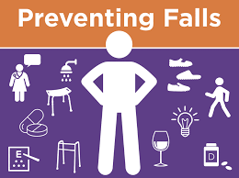
NURS FPX 4035 Assessment 3: Fall Prevention Improvement Plan In-Service
Student’s Name
Institution
Course
Instructor
Due Date
Notes:
Hello Everyone, and welcome to NURS FPX 4035 Assessment 3 My name is XXXX, and the presentation focuses on in-service training to improve fall prevention within the health organization.

Slide 2
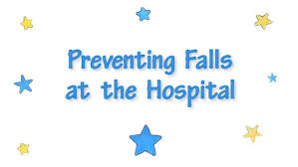
Part 1: Agenda & Outcomes
Problem Statement – Falls are major issue globally and negatively affect patients approximately 1 million annually, leading to above 11,000 deaths and 250,000 injuries and increase healthcare costs.
Goal 1: Evaluate patient falls events in the hospital.
Goal 2: Appraisal evidence-based interventions in preventing falls.
Goal 3: Equip nurses with knowledge and practical skills in fall prevention.
Outcomes
Reduce fall incidence rates
Improve patient safety
Enhance staff awareness, competence and confidence
(Li& Surineni, 2025).
Notes:
Patient falls in hospital is a major issue globally affecting approximately a million patients causing over 11,000 deaths and 250,000 injuries due to age-related issues, such as cognitive issues and mobility impairments subsequently leading to increased cost and high fall incidence rate (Li& Surineni, 2025). Effective prevention strategies are recommended through formulation of fall prevention goals, including evaluating patient fall rates within the hospital, appraise evidence-based intervention in fall prevention, and equip nurses with knowledge and practical skills in preventing falls. The outcome of in-service training among nurses, involves reduce incidence rates, enhance patient safety, and improve staff confidence, self-awareness and competence (Li& Surineni, 2025).

Slide 3
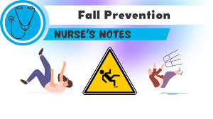
Part 2: Safety Improvement Plan
Falls incidence is prevalent among geriatric patients due to age-associated factors.
It is the second cause of accidental deaths accounting got 646,000 deaths.
Falls are associated with traditional strategies, such as chair alarms, use of vinyl flooring, and lighting.
Patient related factors, include impaired mobility, chronic conditions, advanced age, cognitive impairments, polypharmacy, sensory deficits, and environmental hazards.
Falls leads to economic burden, fatal injuries, decline in functioning, increases morbidity and mortality.
There is need to prioritize fall prevention and quality of life through multifaceted strategies and in-service training.
(Tiago, 2024; Ojo & Thiamwong, 2022)
Current problem
Notes:
Falls incidence is prevalent among geriatric patients due to age-associated factors. It is the second cause of accidental deaths accounting got 646,000 deaths and are associated with traditional strategies, such as chair alarms, use of vinyl flooring, and lighting (Ojo & Thiamwong, 2022). The patient related factors, include impaired mobility, chronic conditions, advanced age, cognitive impairments, polypharmacy, sensory deficits, and environmental hazards. Falls leads to economic burden, fatal injuries, decline in functioning, increases morbidity and mortality, hence the need to prioritize fall prevention and quality of life through multifaceted strategies and in-service training (Tiago, 2024; Ojo & Thiamwong, 2022).

Slide 4
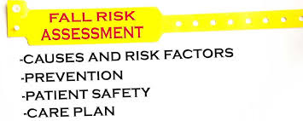
Evidence-based interventions for Proposed Plan
Patient monitoring,
Bed modification,
Use of patient fall assessment risk tools (Morse Fall Scale)
Providing support and data for quality improvement (QI)
Designating leadership,
Stakeholders and staff education, training consultation
Revising roles and structural modification (Turner et al., 2022).
Establishing teams and continuous QI procedures
Integrate iterative, evaluative, and interactive assistance
Use action target and financial strategies (Spoon et al., 2024)
Notes:
Evidence based strategies for fall prevention include identification and improvement of visibility through use of signage, fall-risk bracelet, and leaving rooms door open and bed modification practices through bedside commode, bed locked in place, and use of specialty low bed (Turner et al., 2022). It is crucial to integrate patient monitoring measures through hourly rounding, sitters on high-risk patients, scheduling toileting and safety practices by providing patients with nonskid socks, clutter free floors and access to ambulatory aid. It is crucial to use of patient fall assessment risk tools (Morse Fall Scale) and educate patients, families and health professionals on fall prevention and designate leaders to lead the interventions, revise/expand or structural modifications within the facility (Turner et al., 2022). It is crucial to integrate QI management measures by posting incidence and prevalence falls rates using dashboards among nurses. Besides, it is prudent to establish teams for continuous QI procedures integrating iterative, evaluative and interactive support using action target plans and financial strategies (Spoon et al., 2024).

Slide 5

Why Its Matters to the Organization
Reduce falls incidence rate
Offer effective and promising intervention in falll prevention
Establishment of standardized procedures to prevent falls
Integration of multiple modalities with education components
Improved communication among nurses.
Aid nursing compliance in fall prevention programs
Improve patients’ outcomes leading to enhanced quality of life.
Reduced budgeting associated with falls complications and injuries.
Improved skills, confidence, knowledge, and competence among nurses in fall prevention.
(Ojo & Thiamwong, 2022)
Notes:
The in-service training program within the facility among nurses have significant positive impact on the organization. The training program will lead to reduction of fall incidence rate, provision of effective and promising intervention in falll prevention and establishment of standardized procedures to prevent falls (). As well, there will be integration of multiple modalities with education components, improved communication among nurses and aiding nursing compliance in fall prevention programs. The training will lead to improvement of patients’ outcomes leading to enhanced quality of life, reduction of budgeting associated with falls complications and injuries and improved skills, confidence, knowledge, and competence among nurses in fall prevention (Ojo & Thiamwong, 2022).

Slide 6
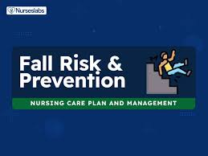
Part 3: Nurses’ Role & Significance
Patient evaluation to identify patients at risk of falls
Holistic assessment
Individualized plan of care tailored to patients needs.
Educate and train nurses on fall prevention
Empower patients with resources, knowledge, and strategies
Advocate for safe healthcare environment
Collaborate with interdisciplinary teams to mitigate falls
Active participation in policy development in fall prevention
Enhance patient safety and quality of life of fall patients
(Tiago, 2024)
Notes:
Nurses play a crucial role in prevention of falls and their roles has a significant role. Nurses evaluate patients to identify patients at risk of falls conducting holistic assessment and individualized plan of care tailored to patients needs (Tiago, 2024). As educators, nurses educate and train nurses on fall prevention, empower patients with resources, knowledge, and strategies and advocate for safer healthcare environments. Besides, nurses collaborate with interdisciplinary teams to mitigate falls, actively participate in policy development in fall prevention and enhance patient safety and quality of life of fall patients (Tiago, 2024).

Slide 7
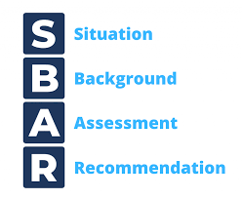
Part 4: New Processes & Skill Practice
Integration of The Situation-Background-Assessment-Recommendation (SBAR) to improve communication, patient safety and quality of care.
Improved skills related to falls during handoff due to increase knowledge after the program
Increased nurses' performance skills through structuralized communication tool.
Enhanced ability to observe, collect and report urgent situations
Positive change in attitude, judgment, and perception towards falls
Improved patient safety competencies among nurses
Improved cooperation and quality of care with medical teams
(Jeong & Kim, 2020)
Notes:
The new process involves integration of the Situation-Background-Assessment-Recommendation (SBAR) to improve communication, clarity, patient safety, quality of care and agency in regulations among nurses (Jeong & Kim, 2020). The in-service training program through integration of SBAR communication tool will lead to improved skills related to falls during handoff due to increase knowledge after the program, increased nurses' performance skills through structuralized communication tool and enhanced ability to observe, collect and report urgent situations (Jeong & Kim, 2020). As well, there will be demonstration of positive change in attitude, judgment, and perception towards falls, improved patient safety competencies among nurses, and enahnced cooperation and quality of care with medical teams.

Slide 8
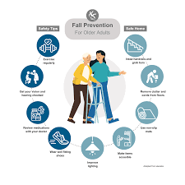
Resources & Activities
Face-to-face discussion or online discussion
Simulation programs on falls
Power point slides
Handouts - reference guides
Case studies – real life incidents
Interactive activities - role playing
Question and Answer forums
Practice quizzes

Slide 9
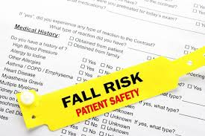
Part 5: Solicit Feedback
Evaluate process measures including procedures and protocols quarterly to determine fidelity and indicators of the programs.
Examine fall incidence and prevalence using hospital data on monthly basis.
Evaluate nurses’ confidence, skills and competence and data management systems with stakeholders
Dissemination of results to determine outcomes, need for change, improvement measures, barriers and limitations.
(Lamoureux, et al., 2024)
Notes:
It is crucial to solicit feedback by evaluating process measures, including procedures and protocols quarterly to determine fidelity and indicators of the programs and examine fall incidence and prevalence rates using hospital data on monthly basis (Lamoureux, et al., 2024). Besides, the administration should Evaluate nurses’ confidence, skills and competence and data management systems with stakeholders and disseminate results to relevant authorities to determine outcomes, need for change, improvement measures, barriers and limitations.

Slide 10
References
Jeong, J. H., & Kim, E. J. (2020). Development and evaluation of an SBAR-based fall simulation program for nursing students. Asian Nursing Research, 14(2), 114-121. https://doi.org/10.1016/j.anr.2020.04.004
Lamoureux, N. R., Lansing, J., Dixon, P. M., Phillips, L. A., Radske-Suchan, T., Dorneich, M. C., & Welk, G. J. (2024). Study protocol: process and outcome evaluation of the Walk with Ease program for fall prevention. BMC Public Health, 24(1), 2658. https://doi.org/10.1186/s12889-024-20138-z
Li, S., & Surineni, K. (2025). Falls in hospitalized patients and preventive strategies: A narrative review. The American Journal of Geriatric Psychiatry: Open Science, Education, and Practice, 5, 1-9. https://doi.org/10.1016/j.osep.2024.10.004
Ojo, E. O., & Thiamwong, L. (2022). Effects of Nurse-Led Fall Prevention Programs for Older Adults: A Systematic Review. Pacific Rim international journal of nursing research, 26(3), 417–431. https://pmc.ncbi.nlm.nih.gov/articles/PMC9432804/
Spoon, D., de Legé, T., Oudshoorn, C., van Dijk, M., & Ista, E. (2024). Implementation strategies of fall prevention interventions in hospitals: a systematic review. BMJ open quality, 13(4), e003006. https://doi.org/10.1136/bmjoq-2024-003006
Tiago Horta, R. D. S. (2024). Falls prevention in older people and the role of nursing. British journal of community nursing, 29(7), 335-339. http://dx.doi.org/10.12968/bjcn.2024.00005
Turner, K., Staggs, V. S., Potter, C., Cramer, E., Shorr, R. I., & Mion, L. C. (2022). Fall Prevention Practices and Implementation Strategies: Examining Consistency Across Hospital Units. Journal of patient safety, 18(1), e236–e242. https://doi.org/10.1097/PTS.0000000000000758

